Slide 1
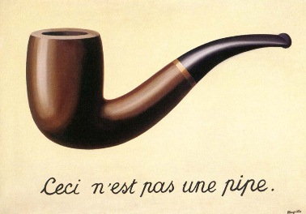
Introduction To Adversarial Examples
15/01/2024
Niv Haim
Weizmann Institute
DL4CV Course Winter 2023/2024 (20224182)

Slide 2
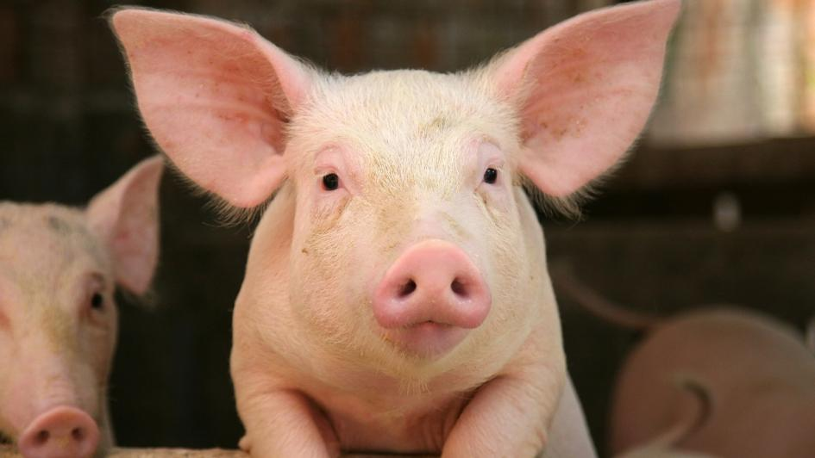
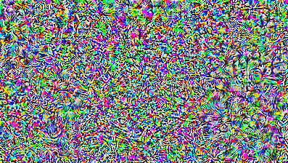
+
x 0.02
98.6% pig
99.0% airliner
=
(0.000000000000000 00000000000005% pig...)

Slide 3
Not Random
+
x 0.02
98.6% pig
99.0% airliner
=
(0.000000000000000 00000000000005% pig...)

Slide 4
Not Random
+
x 0.02
98.6% pig
99.0% airliner
=
(0.000000000000000 00000000000005% pig...)
Biggio et al. 2013, “Evasion attacks against machine learning at test time”
Szegedy et al. 2014, “Intriguing properties of neural networks”
Goodfellow et al. 2015, “Explaining and Harnessing Adversarial Examples”

Slide 5
What is an Adversarial Example?

Slide 6
What is an Adversarial Example?
Originally coined by Szegedy et al., 2013:
“we find that applying an imperceptible non-random perturbation to a test image, it is possible to arbitrarily change the network’s prediction.
… we term the so perturbed examples ‘adversarial examples’”

Slide 7
What is an Adversarial Example?
Originally coined by Szegedy et al., 2013:
“we find that applying an imperceptible non-random perturbation to a test image, it is possible to arbitrarily change the network’s prediction.
… we term the so perturbed examples ‘adversarial examples’”
Not Random
=
+
x 0.02
98.6% pig
99.0% airliner

Slide 8
What is an Adversarial Example?
Originally coined by Szegedy et al., 2013:
“we find that applying an imperceptible non-random perturbation to a test image, it is possible to arbitrarily change the network’s prediction.
… we term the so perturbed examples ‘adversarial examples’”
Not Random
=
+
x 0.02
Small
98.6% pig
99.0% airliner

Slide 9
What is an Adversarial Example?
Perturbation Attack
Originally coined by Szegedy et al., 2013:
“we find that applying an imperceptible non-random perturbation to a test image, it is possible to arbitrarily change the network’s prediction.
… we term the so perturbed examples ‘adversarial examples’”
Not Random
=
+
x 0.02
Small
98.6% pig
99.0% airliner

Slide 10
Outline
Today we will:
See Adversarial Example

Slide 11
Outline
Today we will:
See Adversarial Example
Learn how to generate them
Learn how to defend against them
airliner

Slide 12
Outline
Today we will:
See Adversarial Example
Learn how to generate them
Learn how to (maybe) defend against them
Learn about properties and advantages
airliner

Slide 13
Outline
Today we will:
See Adversarial Example
Learn how to generate them
Learn how to (maybe) defend against them
Learn about properties and advantages
airliner

Slide 14
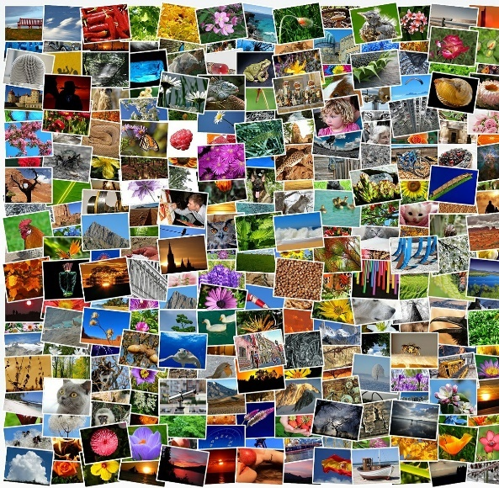
Brief recap on training neural networks
Image by Simon from Pixabay

Slide 15
Brief recap on training neural networks
Image by Simon from Pixabay

Slide 16
Brief recap on training neural networks
fθ
Image by Simon from Pixabay

Slide 17
Brief recap on training neural networks
fθ
Image by Simon from Pixabay
L(fθ(x),y)

Slide 18
Brief recap on training neural networks
fθ
Image by Simon from Pixabay
L(fθ(x),y)

Slide 19
Brief recap on training neural networks
fθ
Image by Simon from Pixabay
L(fθ(x),y)

Slide 20
Brief recap on training neural networks
fθ
Image by Simon from Pixabay
purpose of loss:
How “well” we classify
L(fθ(x),y)

Slide 21
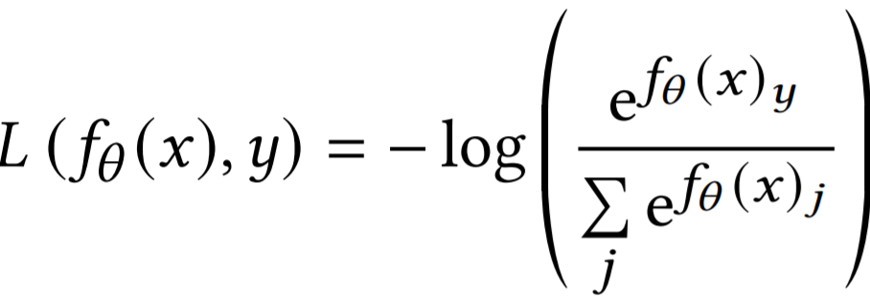
Brief recap on training neural networks
fθ
Image by Simon from Pixabay
most common loss – CrossEntropy:
L(fθ(x),y)

Slide 22
Brief recap on training neural networks
fθ
Image by Simon from Pixabay
most common loss – CrossEntropy:
L(fθ(x),y)

Slide 23
Brief recap on training neural networks
fθ
Image by Simon from Pixabay
most common loss – CrossEntropy:
L(fθ(x),y)

Slide 24
Brief recap on training neural networks
fθ
Image by Simon from Pixabay
minimize loss:
L(fθ(x),y)

Slide 25
Brief recap on training neural networks
fθ
Image by Simon from Pixabay
minimize loss:
L(fθ(x),y)
- ∇θL

Slide 26
Generating an Adversarial Example
fθ

Slide 27
Generating an Adversarial Example
f

Slide 28
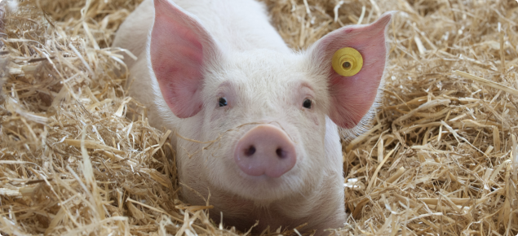
Generating an Adversarial Example
f

Slide 29
Generating an Adversarial Example
f
89.7% pig

Slide 30
Generating an Adversarial Example
f
89.7% pig
want to fool classifier

Slide 31
Generating an Adversarial Example
f
89.7% pig
want to fool classifier
by changing δ
f(x+δ)≠y

Slide 32
Generating an Adversarial Example
f
89.7% pig
want to fool classifier → d measures “badness”
by changing δ
d(f(x+δ),y)

Slide 33
Generating an Adversarial Example
f
89.7% pig
want to fool classifier → used L to maximize “wellness”
L(f(x+δ),y)

Slide 34
Generating an Adversarial Example
f
89.7% pig
want to fool classifier → used L to maximize “wellness”
L(f(x+δ),y)

Slide 35
Generating an Adversarial Example
f
89.7% pig
want to fool classifier → used L to maximize “wellness”
maximize “badness”?
L(f(x+δ),y)

Slide 36
Generating an Adversarial Example
f
89.7% pig
want to fool classifier → maximize L
L(f(x+δ),y)

Slide 37
Generating an Adversarial Example
f
89.7% pig
want to fool classifier → maximize L w.r.t δ
L(f(x+δ),y)

Slide 38
Generating an Adversarial Example
f
89.7% pig
want to fool classifier → maximize L w.r.t δ
L(f(x+δ),y)
∇δL

Slide 39
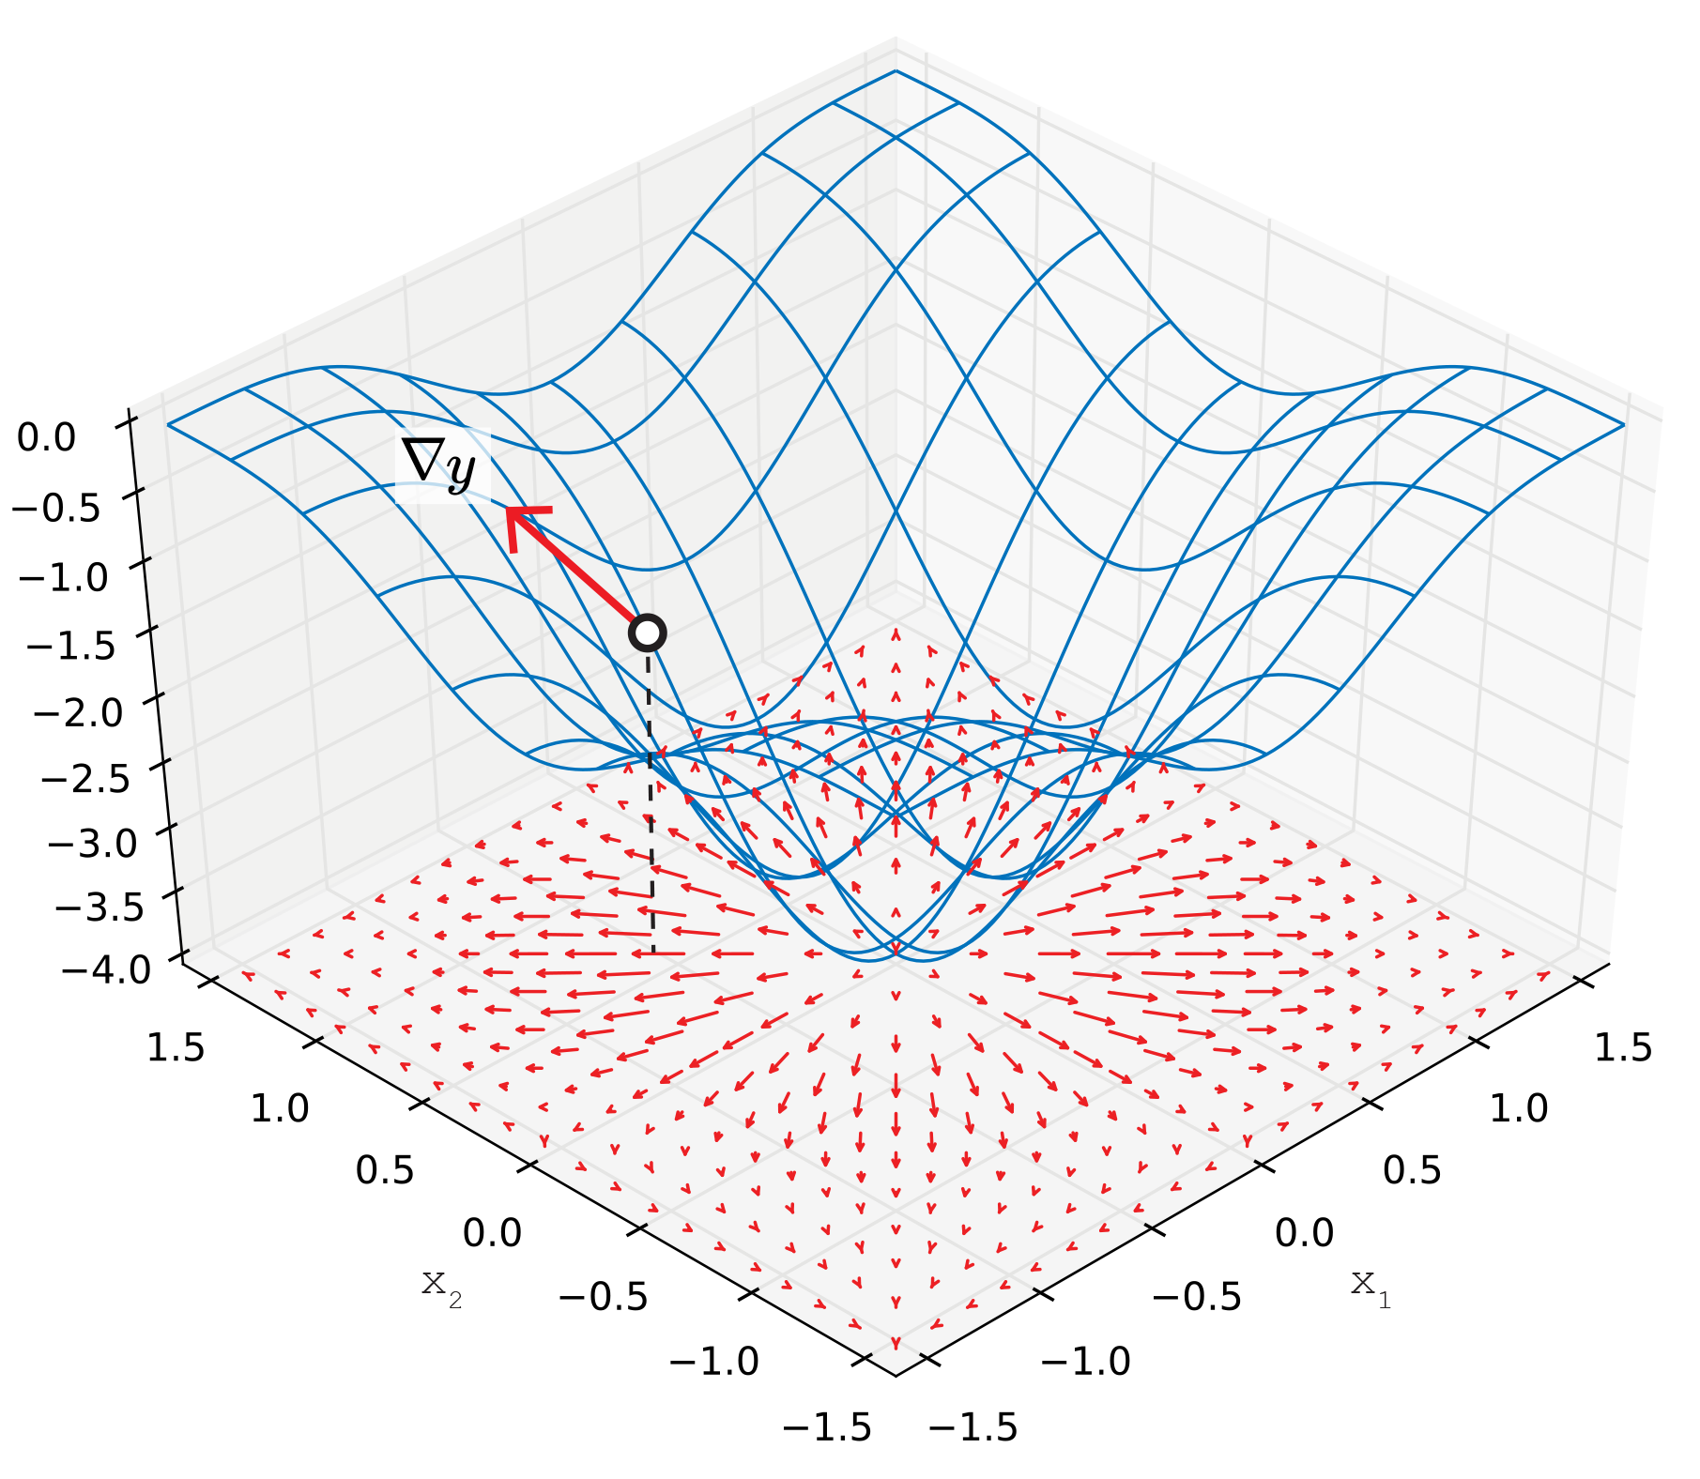
Generating an Adversarial Example
f
89.7% pig
want to fool classifier → maximize L w.r.t δ
L(f(x+δ),y)
+∇δL

Slide 40
Generating an Adversarial Example
f
89.7% pig
want to fool classifier → maximize L w.r.t x
L(f(x+δ),y)
+∇xL
(just a technicality..)

Slide 41
Generating an Adversarial Example
f
89.7% pig
want to fool classifier → maximize L w.r.t x
L(f(x+δ),y)
+∇xL
input
input
(just a technicality..)

Slide 42
Generating an Adversarial Example
f
89.7% pig
want to fool classifier → maximize L w.r.t x
δ
L(f(x+δ),y)
+∇xL
x
input
input
(just a technicality..)

Slide 43
Generating an Adversarial Example
f
89.7% pig
want to fool classifier → maximize L w.r.t x
δ
L(f(x+δ),y)
+∇xL
x
input
input
(just a technicality..)

Slide 44
Generating an Adversarial Example
f
89.7% pig
change δ to maximize loss:
δ
L(f(x+δ),y)
∇xL
x
(just a technicality..)

Slide 45
Generating an Adversarial Example
f
89.7% pig
want to fool classifier → maximize L w.r.t x
L(f(x+δ),y)
+∇xL

Slide 46
Generating an Adversarial Example
f
89.7% pig
change δ to maximize loss:
L(f(x+δ),y)
+ ∇xL

Slide 47
Generating an Adversarial Example
f
89.7% pig
want to fool classifier → maximize L w.r.t x
L(f(x+δ),y)
δ = +∇xL

Slide 48
Follow the gradient w.r.t x (the input image)
X (original): 89.7% pig

Slide 49
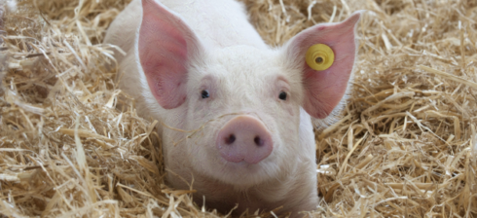
Follow the gradient w.r.t x (the input image)
X (original): 89.7% pig
X + ∇xL: 68.6% hay

Slide 50
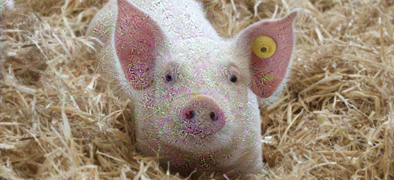
Follow the gradient w.r.t x (the input image)
X (original): 89.7% pig
X + ∇xL: 68.6% hay
X + 10×∇xL: 44.7% pig

Slide 51
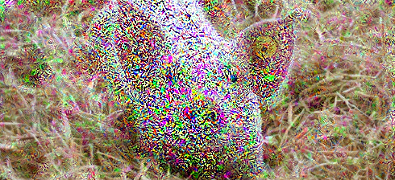
Follow the gradient w.r.t x (the input image)
X (original): 89.7% pig
X + ∇xL: 68.6% hay
X + 10×∇xL: 44.7% pig
X + 100×∇xL: 44.8% fireguard

Slide 52
Follow the gradient w.r.t x (the input image)
X (original): 89.7% pig
X + ∇xL: 68.6% hay
X + 1000×∇xL
X + 10×∇xL: 44.7% pig
X + 100×∇xL: 44.8% fireguard

Slide 53
Follow the gradient w.r.t x (the input image)
X (original): 89.7% pig
X + ∇xL: 68.6% hay
X + 1000×∇xL: 99.9% spotlight
X + 10×∇xL: 44.7% pig
X + 100×∇xL: 44.8% fireguard

Slide 54
Follow the gradient w.r.t x (the input image)
Did we generate an adversarial example?
X (original): 89.7% pig
X + ∇xL: 68.6% hay
X + 10×∇xL: 44.7% pig
X + 100×∇xL: 44.8% fireguard

Slide 55
Follow the gradient w.r.t x (the input image)
Did we generate an adversarial example?
X (original): 89.7% pig
X + ∇xL: 68.6% hay
99.0% airliner
X + 10×∇xL: 44.7% pig
X + 100×∇xL: 44.8% fireguard

Slide 56
Follow the gradient w.r.t x (the input image)
Did we generate an adversarial example?
Need small δ…
X (original): 89.7% pig
X + ∇xL: 68.6% hay
99.0% airliner
X + 10×∇xL: 44.7% pig
X + 100×∇xL: 44.8% fireguard

Slide 57
We want small noise

Slide 58
We want small noise
=
X

Slide 59
We want small noise
+
=
X
δ

Slide 60
We want small noise
What is small δ?
+
=
X
δ

Slide 61
We want small noise
What is small δ?
+
=
X
δ
‖δ‖ < ε

Slide 62
We want small noise
What is small δ?
+
=
X
δ
‖δ‖∞ < ε

Slide 63
We want small noise
What is small δ?
+
=
X
δ
‖δ‖∞ ≤ 0.1
0.1
‖δ‖∞ < ε

Slide 64
We want small noise
What is small δ?
+
=
X
δ
‖δ‖∞ ≤ 0.1
0.1 | -0.1
‖δ‖∞ < ε

Slide 65
We want small noise
What is small δ?
+
=
X
δ
‖δ‖∞ ≤ 0.1
0.1 | -0.1
 | 0.1 | 0.05 | -0.02
 |  | -0.09
 |  |  | $${10}^{−5}$$
‖δ‖∞ < ε

Slide 66
We want small noise
What is small δ?
+
=
X
δ
‖δ‖∞ ≤ 0.1
0.1 | -0.1 |  | -0.2
 | 0.1 | 0.05 | -0.02
 |  | -0.09
 |  |  | $${10}^{−5}$$
‖δ‖∞ < ε

Slide 67
We want small noise
What is small δ?
small δ & δ = f(∇xL) ?
+
=
X
δ
‖δ‖∞ ≤ 0.1
0.1 | -0.1
 | 0.1 | 0.05 | -0.02
 |  | -0.09
 |  |  | $${10}^{−5}$$
‖δ‖∞ < ε

Slide 68
“Enforcing ‖∇xL‖∞ < ε” :

Slide 69
“Enforcing ‖∇xL‖∞ < ε” :
δ = ∇xL

Slide 70
“Enforcing ‖∇xL‖∞ < ε” :
12 | -0.1 | 432 | …
… | $${10}^{−5}$$ | … | …
… | … | -555 | …
… | … | 0 | …
δ = ∇xL

Slide 71
“Enforcing ‖∇xL‖∞ < ε” :
1 | -1 | 1 | …
… | 1 | … | …
… | … | -1 | …
… | … | 0 | …
δ = sgn(∇xL)

Slide 72
“Enforcing ‖∇xL‖∞ < ε” :
ε | -ε | ε | …
… | ε | … | …
… | … | -ε | …
… | … | 0 | …
δ = ε • sgn(∇xL)

Slide 73
“Enforcing ‖∇xL‖∞ < ε” :
ε | -ε | ε | …
… | ε | … | …
… | … | -ε | …
… | … | 0 | …
δ = ε • sgn(∇xL)

Slide 74
“Enforcing ‖∇xL‖∞ < ε” :
ε | -ε | ε | …
… | ε | … | …
… | … | -ε | …
… | … | 0 | …
δ = ε • sgn(∇xL)
Fast Gradient Sign Method
a.k.a FGSM (Goodfellow et al. 2015)

Slide 75
“Enforcing ‖∇xL‖∞ < ε” :
*
ε | -ε | ε | …
… | ε | … | …
… | … | -ε | …
… | … | 0 | …
δ = ε • sgn(∇xL)
Fast Gradient Sign Method
a.k.a FGSM (Goodfellow et al. 2015)
*

Slide 76
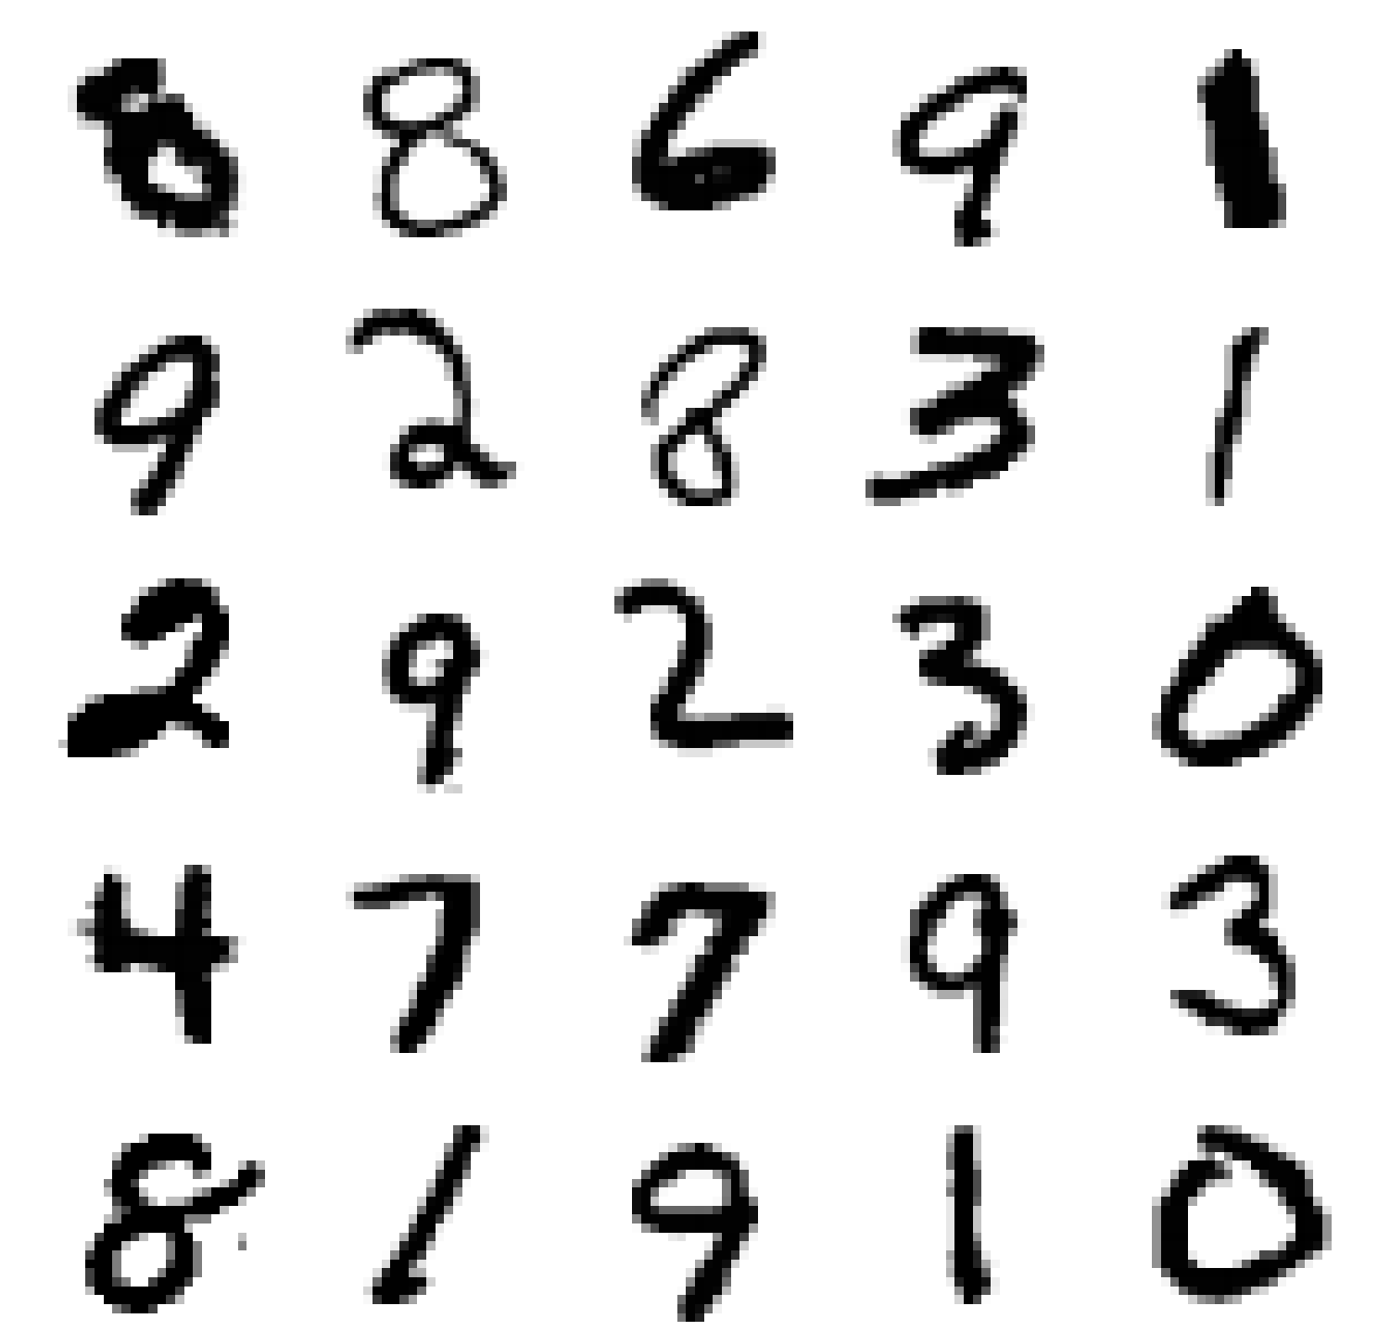
FGSM – example on MNIST

Slide 77
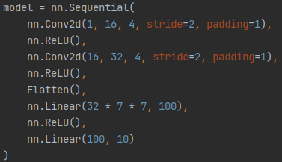
FGSM – example on MNIST
Classifier

Slide 78
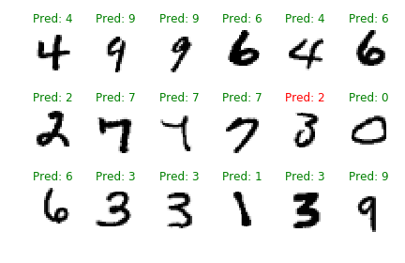
FGSM - MNIST
Test Samples

Slide 79
FGSM - MNIST
Test Samples

Slide 80
FGSM - MNIST
Test Samples

Slide 81
FGSM - MNIST

Slide 82
FGSM - MNIST

Slide 83
FGSM - MNIST

Slide 84
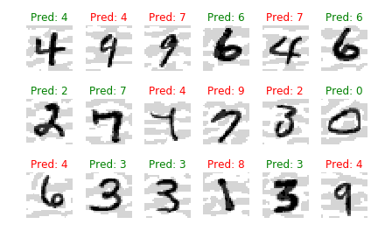
FGSM - MNIST

Slide 85
FGSM - MNIST
Test Error: 98.7%
FGSM Error: ?

Slide 86
FGSM - MNIST
Test Error: 98.7%
FGSM Error: 40.0%

Slide 87
FGSM - MNIST
Test Error: 98.7%
FGSM (ε=0.1) Error: 40.0%

Slide 88
FGSM - MNIST
Simple, Fast and Vicious
Test Error: 98.7%
FGSM (ε=0.1) Error: 40.0%

Slide 89
FGSM - MNIST
Simple, Fast and Vicious
Test Error: 98.7%
FGSM (ε=0.1) Error: 40.0%
source: https://adversarial-ml-tutorial.org/

Slide 90
FGSM - MNIST
Simple, Fast and Vicious
Test Error: 98.7%
FGSM (ε=0.1) Error: 40.0%
What can we do to defend?
source: https://adversarial-ml-tutorial.org/

Slide 91
Adversarial Training

Slide 92
Adversarial Training

Slide 93
Adversarial Training

Slide 94
Adversarial Training
I want you to be 4!

Slide 95
Adversarial Training
I want you to be 3!

Slide 96
Adversarial Training
I want you to be 7!

Slide 97
Adversarial Training
Train on adversarial examples (kind of augmentation)

Slide 98
Adversarial Training
Train on adversarial examples (kind of augmentation)
fθ1

Slide 99
Adversarial Training
Train on adversarial examples (kind of augmentation)
fθ1

Slide 100
Adversarial Training
Train on adversarial examples (kind of augmentation)
fθ1

Slide 101
Adversarial Training
Train on adversarial examples (kind of augmentation)
fθ1

Slide 102
Adversarial Training
Train on adversarial examples (kind of augmentation)
fθ2

Slide 103
Adversarial Training
Train on adversarial examples (kind of augmentation)
fθ2

Slide 104
Adversarial Training
Train on adversarial examples (kind of augmentation)
fθ2

Slide 105
Adversarial Training
Train on adversarial examples (kind of augmentation)
fθ2

Slide 106
Adversarial Training
Train on adversarial examples (kind of augmentation)
fθ2

Slide 107
Adversarial Training
Train on adversarial examples (kind of augmentation)
fθn

Slide 108
Adversarial Training - MNIST
 | Test Accuracy
Standard Training | 98.7%

Slide 109
Adversarial Training - MNIST
 | Test Accuracy | FGSM Accuracy
Standard Training | 98.7% | 40.7%

Slide 110
Adversarial Training - MNIST
 | Test Accuracy | FGSM Accuracy
Standard Training | 98.7% | 40.7%
Adv. Training (FGSM) | 97.2% | 94.0%

Slide 111
Adversarial Training - MNIST
 | Test Accuracy | FGSM Accuracy
Standard Training | 98.7% | 40.7%
Adv. Training (FGSM) | 97.2% | 94.0%

Slide 112
Adversarial Training - MNIST
Did we solve the problem?
 | Test Accuracy | FGSM Accuracy
Standard Training | 98.7% | 40.7%
Adv. Training (FGSM) | 97.2% | 94.0%

Slide 113
Outline
See Adversarial Example
How to attack: FGSM
How to defend: Adversarial training (AT)
Next: visualizing AE / AT
Learn about properties and advantages

Slide 114
Outline
See Adversarial Example
How to attack: FGSM
How to defend: Adversarial training (AT)
Next: visualizing AE / AT
Learn about properties and advantages

Slide 115
Perturbation Attack (pictorially)

Slide 116
Perturbation Attack (pictorially)
8
1
4
3
2

Slide 117
Perturbation Attack (pictorially)
8
1
δ
4
3
2

Slide 118
Perturbation Attack (pictorially)
8
1
δ
4
3
2

Slide 119
Perturbation Attack (pictorially)
8
1
‖δ‖∞ < ε
δ
4
3
2

Slide 120
Perturbation Attack (pictorially)
8
ε
1
‖δ‖∞ < ε
δ1
-ε
δ2
ε
4
-ε
3
2

Slide 121
Perturbation Attack (pictorially)
FGSM
ε
-ε
ε
-ε

Slide 122
Perturbation Attack (pictorially)
FGSM
ε
-ε
ε
-ε

Slide 123
Perturbation Attack (pictorially)
FGSM
ε
-ε
ε
-ε

Slide 124
Perturbation Attack (pictorially)
FGSM
ε
-ε
ε
-ε

Slide 125
Perturbation Attack (pictorially)
FGSM
ε
-ε
ε
-ε

Slide 126
Perturbation Attack (pictorially)
FGSM
ε
-ε
ε
-ε

Slide 127
Perturbation Attack (pictorially)
FGSM
Possible AE (found by FGSM)
ε
-ε
ε
-ε

Slide 128
Perturbation Attack (pictorially)
FGSM
*
Possible AE (found by FGSM)
ε
-ε
ε
-ε
*
dot should have been lying on one of the corners..

Slide 129
Perturbation Attack (pictorially)
FGSM
Possible AE (found by FGSM)
ε
-ε
ε
-ε

Slide 130
Perturbation Attack (pictorially)
Possible AEs
(need to be found)
ε
-ε
ε
-ε

Slide 131
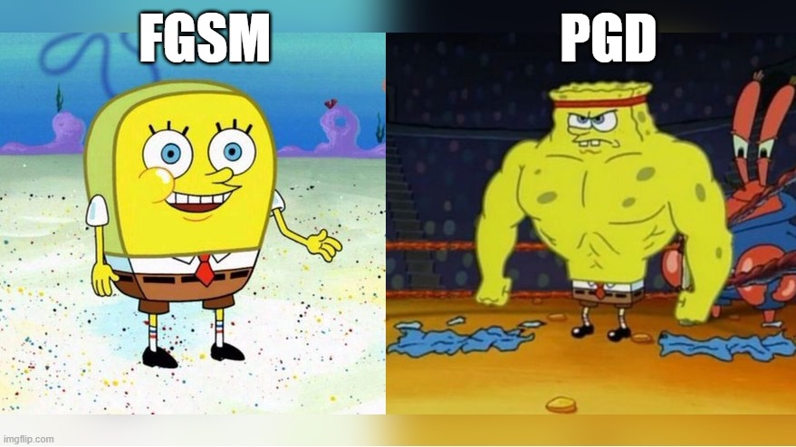
Perturbation Attack (pictorially)
Possible AEs
(need to be found)
ε
-ε
ε
-ε
Coming
Up next:

Slide 132
Perturbation Attack (pictorially)
Possible AEs
(need to be found)
ε
Defender: defend in box
-ε
ε
-ε

Slide 133
Perturbation Attack (pictorially)
Possible AEs
(need to be found)
ε
Defender: defend in box
Attacker: find AE in box
-ε
ε
-ε

Slide 134
Perturbation Attack (pictorially)
Possible AEs
(need to be found)
ε
“The Game” of AT:
Defender: defend in box
Attacker: find AE in box
-ε
ε
-ε
Coming
Up next:

Slide 135
Perturbation Attack (optimization)
Possible AEs
(need to be found)
ε
“The Game” of AT:
Defender: defend in box
Attacker: find AE in box
-ε
ε
-ε

Slide 136
Perturbation Attack (optimization)
Possible AEs
(need to be found)
ε
“The Game” of AT:
Defender: defend in box
Attacker: find AE in box
-ε
ε
-ε

Slide 137
Perturbation Attack (optimization)
Possible AEs
(need to be found)
ε
“The Game” of AT:
Defender: defend in box
Attacker: find AE in box
-ε
ε
-ε
Adversarial Training as a min-max optimization problem:
Towards Deep Learning Models Resistant to Adversarial Attacks, Madry et al. 2018

Slide 138
Perturbation Attack (optimization)
Possible AEs
(need to be found)
ε
“The Game” of AT:
Defender: defend in box
Attacker: find AE in box
-ε
ε
-ε
Adversarial Training as a min-max optimization problem:
Towards Deep Learning Models Resistant to Adversarial Attacks, Madry et al. 2018

Slide 139
Perturbation Attack (optimization)
Possible AEs
(need to be found)
ε
“The Game” of AT:
Defender: defend in box
Attacker: find AE in box
-ε
ε
-ε
Adversarial Training as a min-max optimization problem:
Standard Loss
Towards Deep Learning Models Resistant to Adversarial Attacks, Madry et al. 2018

Slide 140
Perturbation Attack (optimization)
Possible AEs
(need to be found)
ε
“The Game” of AT:
Defender: defend in box
Attacker: find AE in box
-ε
ε
-ε
Adversarial Training as a min-max optimization problem:
Towards Deep Learning Models Resistant to Adversarial Attacks, Madry et al. 2018

Slide 141
Perturbation Attack (optimization)
Possible AEs
(need to be found)
ε
“The Game” of AT:
Defender: defend in box
Attacker: find AE in box
-ε
ε
-ε
Adversarial Training as a min-max optimization problem:
Towards Deep Learning Models Resistant to Adversarial Attacks, Madry et al. 2018

Slide 142
Perturbation Attack (optimization)
Possible AEs
(need to be found)
ε
“The Game” of AT:
Defender: defend in box
Attacker: find AE in box
-ε
ε
-ε
Adversarial Training as a min-max optimization problem:
Adversarial Loss
Towards Deep Learning Models Resistant to Adversarial Attacks, Madry et al. 2018

Slide 143
Perturbation Attack (illustrations)
Possible AEs
(need to be found)
ε
-ε
ε
-ε

Slide 144
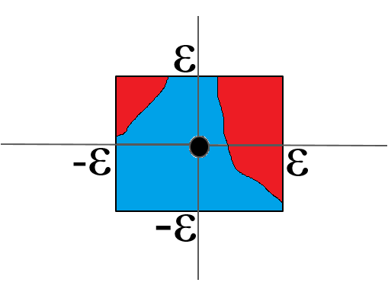
Perturbation Attack (illustrations)
Possible AEs
(need to be found)

Slide 145
Perturbation Attack (illustrations)
Possible AEs
(need to be found)
*
*
Mental image alert! (“experimental” mental images could be horribly misleading)

Slide 146
Perturbation Attack (illustrations)
Possible AEs
(need to be found)
*
*
Mental Image
*
Mental image alert! (“experimental” mental images could be horribly misleading)

Slide 147
Perturbation Attack (illustrations)
Possible AEs
(need to be found)
*
*
Mental Image
*
Mental image alert! (“experimental” mental images could be horribly misleading)

Slide 148
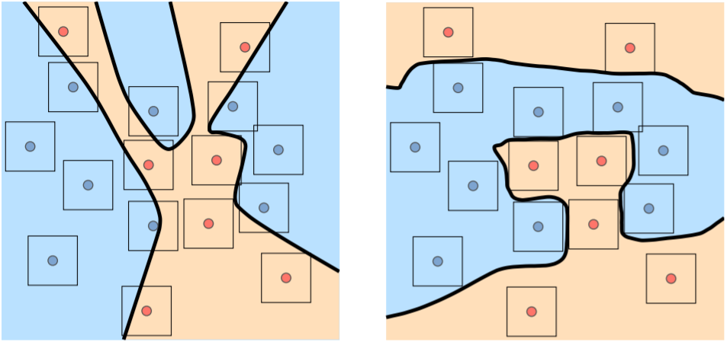
Perturbation Attack (better illustrations)
source: Atzmon et al. 2019, “Controlling Neural Level Sets”

Slide 149
Perturbation Attack (better illustrations)
AEs lurking (waiting to be found)
source: Atzmon et al. 2019, “Controlling Neural Level Sets”

Slide 150
Perturbation Attack (better illustrations)
AEs lurking (waiting to be found)
source: Atzmon et al. 2019, “Controlling Neural Level Sets”

Slide 151
Perturbation Attack (better illustrations)
AEs lurking (waiting to be found)
2D alert!
(Things get complicated in high dimension, e.g. images…)
source: Atzmon et al. 2019, “Controlling Neural Level Sets”

Slide 152
PGD (Projected Gradient Descent)
FGSM PGD
ε
ε
-ε
ε
-ε
ε
-ε
-ε

Slide 153
PGD (a.k.a Iterated-GSM)
FGSM PGD
ε
ε
-ε
ε
-ε
ε
-ε
-ε

Slide 154
PGD (a.k.a Iterated-GSM)
FGSM PGD
ε
ε
-ε
ε
-ε
ε
-ε
-ε

Slide 155
PGD (a.k.a Iterated-GSM)
FGSM PGD
ε
ε
-ε
ε
-ε
ε
-ε
-ε

Slide 156
PGD (a.k.a Iterated-GSM)
FGSM PGD
ε
ε
ε
-ε
ε
-ε
ε
-ε
-ε

Slide 157
PGD (a.k.a Iterated-GSM)
FGSM PGD
ε
ε
ε
-ε
ε
-ε
ε
-ε
-ε

Slide 158
PGD (a.k.a Iterated-GSM)
FGSM PGD
ε
ε
ε
-ε
ε
-ε
ε
-ε
ε
-ε

Slide 159
PGD (a.k.a Iterated-GSM)
FGSM PGD
ε
ε
ε
-ε
ε
-ε
ε
-ε
ε
-ε

Slide 160
PGD (a.k.a Iterated-GSM)
FGSM PGD
ε
ε
ε
-ε
ε
-ε
ε
-ε
ε
-ε

Slide 161
PGD (a.k.a Iterated-GSM)
Attack Model:
S = {δ | ‖δ‖∞ < ε}

Slide 162
PGD (a.k.a Iterated-GSM)
Attack Model:
S = {δ | ‖δ‖∞ < ε}
FGSM:

Slide 163
PGD (a.k.a Iterated-GSM)
Attack Model:
S = {δ | ‖δ‖∞ < ε}
FGSM:
=
+

Slide 164
PGD (a.k.a Iterated-GSM)
Attack Model:
S = {δ | ‖δ‖∞ < ε}
PGD (a.k.a. Iterative-GSM):

Slide 165
PGD (a.k.a Iterated-GSM)
Attack Model:
S = {δ | ‖δ‖∞ < ε}
PGD:

Slide 166
PGD (a.k.a Iterated-GSM)
Attack Model:
S = {δ | ‖δ‖∞ < ε}
PGD:

Slide 167
PGD (a.k.a Iterated-GSM)
Attack Model:
S = {δ | ‖δ‖∞ < ε}
PGD:
=
+

Slide 168
PGD (a.k.a Iterated-GSM)
Attack Model:
S = {δ | ‖δ‖∞ < ε}
PGD:
=
+

Slide 169
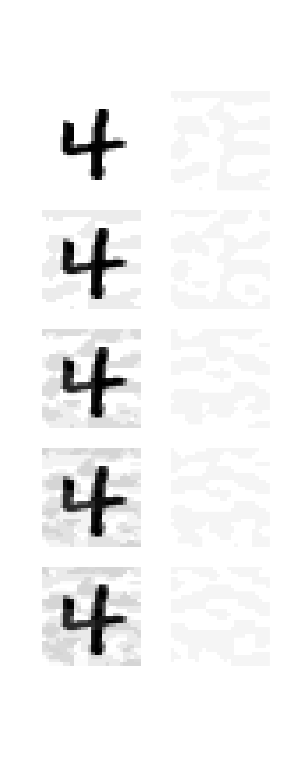
PGD (a.k.a Iterated-GSM)
Attack Model:
S = {δ | ‖δ‖∞ < ε}
PGD:
$$X_{n}^{adv}$$
$$δ_{n}$$
n = 1
n = 2
n = 3
n = 4
n = 5

Slide 170
PGD (a.k.a Iterated-GSM)
Attack Model:
S = {δ | ‖δ‖∞ < ε}
PGD:
$$X_{n}^{adv}$$
$$δ_{n}$$
n = 1
n = 2
n = 3
n = 3
n = 4
n = 4
n = 5

Slide 171
PGD (a.k.a Iterated-GSM)
Attack Model:
S = {δ | ‖δ‖∞ < ε}
PGD:
$$X_{n}^{adv}$$
$$δ_{n}$$
n = 1
n = 2
n = 3
n = 3
n = 4
n = 4
n = 5

Slide 172
PGD (a.k.a Iterated-GSM)
Attack Model:
S = {δ | ‖δ‖∞ < ε}
PGD:
$$X_{n}^{adv}$$
$$δ_{n}$$
n = 1
n = 2
n = 3
n = 4

Slide 173
PGD (a.k.a Iterated-GSM)
Attack Model:
S = {δ | ‖δ‖∞ < ε}
PGD:
$$X_{n}^{adv}$$
$$δ_{n}$$
n = 1
n = 2
n = 3
n = 4

Slide 174
PGD (a.k.a Iterated-GSM)
Attack Model:
S = {δ | ‖δ‖∞ < ε}
PGD:
$$X_{n}^{adv}$$
$$δ_{n}$$
n = 1
n = 2
n = 3
n = 4

Slide 175
Adversarial Training
 | Test Accuracy | FGSM Accuracy
Standard Training | 98.7% | 40.7%
Adv. Training (FGSM) | 97.2% | 94.0%

Slide 176
Adversarial Training
 | Test Accuracy | FGSM Accuracy | PGD Accuracy
Standard Training | 98.7% | 40.7% | 7.3%
Adv. Training (FGSM) | 97.2% | 94.0% | 90.0%

Slide 177
Adversarial Training
 | Test Accuracy | FGSM Accuracy | PGD Accuracy
Standard Training | 98.7% | 40.7% | 7.3%
Adv. Training (FGSM) | 97.2% | 94.0% | 90.0%
What can we do to defend?

Slide 178
Adversarial Training
 | Test Accuracy | FGSM Accuracy | PGD Accuracy
Standard Training | 98.7% | 40.7% | 7.3%
Adv. Training (FGSM) | 97.2% | 94.0% | 90.0%
Adv. Training (PGD) | 98.0% | 96.1% | 95.9%

Slide 179
Adversarial Training
 | Test Accuracy | FGSM Accuracy | PGD Accuracy
Standard Training | 98.7% | 40.7% | 7.3%
Adv. Training (FGSM) | 97.2% | 94.0% | 90.0%
Adv. Training (PGD) | 98.0% | 96.1% | 95.9%
Did we solve the problem?

Slide 180
Adversarial Training – Other Datasets
CIFAR10 (ResNet50) | Test | PGD ($ε=\frac{8}{255}$)
Standard Training | 95.25% | 0.00%
source: https://github.com/MadryLab/robustness

Slide 181
Adversarial Training – Other Datasets
CIFAR10 (ResNet50) | Test | PGD ($ε=\frac{8}{255}$)
Standard Training | 95.25% | 0.00%
Adv. Training (PGD 8/255) | 87.03% | 53.29%
source: https://github.com/MadryLab/robustness

Slide 182
Adversarial Training – Other Datasets
CIFAR10 (ResNet50) | Test | PGD ($ε=\frac{8}{255}$)
Standard Training | 95.25% | 0.00%
Adv. Training (PGD 8/255) | 87.03% | 53.29%
ImageNet (ResNet50) | Test | PGD ($ε=\frac{8}{255}$)
Standard Training | 76.13% | 0.01%
source: https://github.com/MadryLab/robustness

Slide 183
Adversarial Training – Other Datasets
CIFAR10 (ResNet50) | Test | PGD ($ε=\frac{8}{255}$)
Standard Training | 95.25% | 0.00%
Adv. Training (PGD 8/255) | 87.03% | 53.29%
ImageNet (ResNet50) | Test | PGD ($ε=\frac{8}{255}$)
Standard Training | 76.13% | 0.01%
Adv. Training (PGD 8/255) | 47.91% | 19.52%
source: https://github.com/MadryLab/robustness

Slide 184
Outline
See Adversarial Example
How to attack: FGSM, PGD
How to defend: Adversarial training (AT)
Visualizing AE / AT

Slide 185
Outline
See Adversarial Example
How to attack: FGSM, PGD
How to defend: Adversarial training (AT)
Visualizing AE / AT
White Box Attacks

Slide 186
Outline
See Adversarial Example
How to attack: FGSM, PGD
How to defend: Adversarial training (AT)
Visualizing AE / AT
Next: Black-Box attacks
Learn about properties and advantages

Slide 187
Black-Box Attacks
fθ
L
∇xL

Slide 188
Black-Box Attacks
fθ
“White-Box”
L
∇xL

Slide 189
Black-Box Attacks
fθ
“White-Box”
(FGSM, PGD, etc.)
L
∇xL

Slide 190
Black-Box Attacks
fθ
“White-Box”
L
∇xL
fθ2
L

Slide 191
Black-Box Attacks
fθ
“White-Box”
L
∇xL
fθ2
L
∇xL

Slide 192
Black-Box Attacks
fθ
“White-Box”
L
∇xL
fθ2
L
∇xL

Slide 193
Black-Box Attacks
fθ
“White-Box”
L
∇xL
fθ2
L
“Black-Box”
∇xL

Slide 194
Black-Box Attacks
fθ
“White-Box”
L
∇xL
fθ2
L
“Black-Box”
?

Slide 195
Black-Box Attacks
fθ2
L
“Black-Box”
?

Slide 196
Black-Box Attacks
fθ2
L
“Black-Box”
?

Slide 197
Black-Box Attacks
fθ2
L
“Black-Box”

Slide 198
Black-Box Attacks
fθ2
L
“Black-Box”
gθ
L
∇xL
source: https://twitter.com/will_it_breakyt

Slide 199
Black-Box Attacks - Transferability
Liu et al. 2016, “Delving into Transferable Adversarial Examples and Black-box Attacks”

Slide 200
Black-Box Attacks - Transferability
Test set Accuracy
Liu et al. 2016, “Delving into Transferable Adversarial Examples and Black-box Attacks”

Slide 201
Black-Box Attacks - Transferability
Test set Accuracy
Accuracy under FGSM attack
Liu et al. 2016, “Delving into Transferable Adversarial Examples and Black-box Attacks”

Slide 202
Black-Box Attacks - Transferability
Test set Accuracy
Accuracy under FGSM attack
Liu et al. 2016, “Delving into Transferable Adversarial Examples and Black-box Attacks”

Slide 203
Black-Box Attacks - Transferability
Test set Accuracy
Accuracy under FGSM attack
White-Box FGSM
Liu et al. 2016, “Delving into Transferable Adversarial Examples and Black-box Attacks” (Tab.20)

Slide 204
Black-Box Attacks - Transferability
Test set Accuracy
Accuracy under FGSM attack
Black-Box
Liu et al. 2016, “Delving into Transferable Adversarial Examples and Black-box Attacks” (Tab.20)

Slide 205
Black-Box Attacks - Transferability
Possible reason:

Slide 206
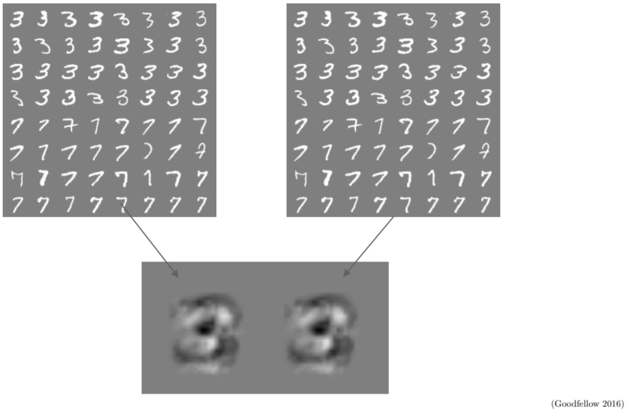
Black-Box Attacks - Transferability
Possible reason:
source: Ian Goodfellow on "Adversarial Examples and Adversarial Training," 2017-05-30, CS231n, Stanford University

Slide 207
Black-Box Attacks - Transferability
Possible reason:
Ilyas et al. 2019, “Adversarial Examples Are Not Bugs, They Are Features”
source: Ian Goodfellow on "Adversarial Examples and Adversarial Training," 2017-05-30, CS231n, Stanford University

Slide 208
Black-Box Attacks - Transferability
Possible reason:
Adversarial Examples comes from the data:
Ilyas et al. 2019, “Adversarial Examples Are Not Bugs, They Are Features”
source: Ian Goodfellow on "Adversarial Examples and Adversarial Training," 2017-05-30, CS231n, Stanford University

Slide 209
Outline
See Adversarial Example
How to attack: FGSM, PGD
How to defend: Adversarial training (AT)
Visualizing AE / AT
Black-Box attacks (transferability)
Next: Summary
Learn about properties and advantages

Slide 210
Adversarial Examples – The Bigger Picture
airliner
test+noise

Slide 211
Adversarial Examples – The Bigger Picture
Is this surprising?
airliner
test+noise

Slide 212
Adversarial Examples – The Bigger Picture
Is this surprising?
airliner
test+noise
True Classification
Human
Perception

Slide 213
Adversarial Examples – The Bigger Picture
Is this surprising?
airliner
test+noise
True Classification
Human
Perception
Machine
“Perception”

Slide 214
Adversarial Examples – The Bigger Picture
Is this surprising?
airliner
test+noise
True Classification
Perturbation Attacks
Human
Perception
Machine
“Perception”

Slide 215
Adversarial Examples – The Bigger Picture
Inputs that fool a computer, but not a human
airliner
test+noise
True Classification
Perturbation Attacks
Human
Perception
Machine
“Perception”

Slide 216
Adversarial Examples – The Bigger Picture
Inputs that fool a computer, but not a human
airliner
test+noise
True Classification
fireguard
Human
Perception
Machine
“Perception”
“noisy” image

Slide 217
Adversarial Examples – The Bigger Picture
Inputs that fool a computer, but not a human
airliner
test+noise
True Classification
fireguard
spotlight (26.7%)
Human
Perception
Machine
“Perception”
“noisy” image
noise

Slide 218
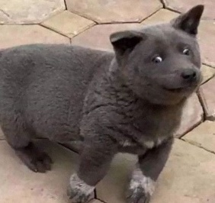
Adversarial Examples – The Bigger Picture
Inputs that fool a computer, but not a human
airliner
test+noise
True Classification
fireguard
spotlight (26.7%)
Human
Perception
?
Machine
“Perception”
“noisy” image
noise
cat ?
model
failure

Slide 219
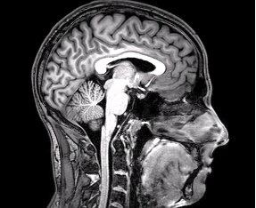
Adversarial Examples – The Bigger Picture
Inputs that fool a computer, but not a human
airliner
test+noise
True Classification
fireguard
spotlight (26.7%)
Human
Perception
Machine
“Perception”
“noisy” image
noise
???
cat ?
model
failure
out-of-distribution

Slide 220
The Bigger Picture: Failure modes in machine learning
source: https://docs.microsoft.com/en-us/security/engineering/failure-modes-in-machine-learning

Slide 221
The Bigger Picture: Failure modes in machine learning
Intentionally-motivated failures
source: https://docs.microsoft.com/en-us/security/engineering/failure-modes-in-machine-learning

Slide 222
The Bigger Picture: Failure modes in machine learning
Intentionally-motivated failures
Unintended failures
source: https://docs.microsoft.com/en-us/security/engineering/failure-modes-in-machine-learning

Slide 223
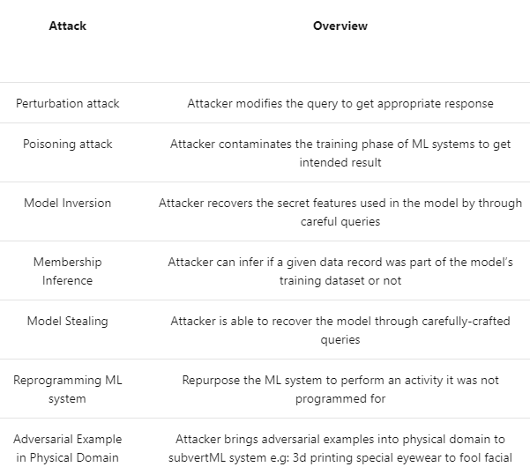
The Bigger Picture: Failure modes in machine learning
Intentionally-motivated failures
Unintended failures
source: https://docs.microsoft.com/en-us/security/engineering/failure-modes-in-machine-learning

Slide 224
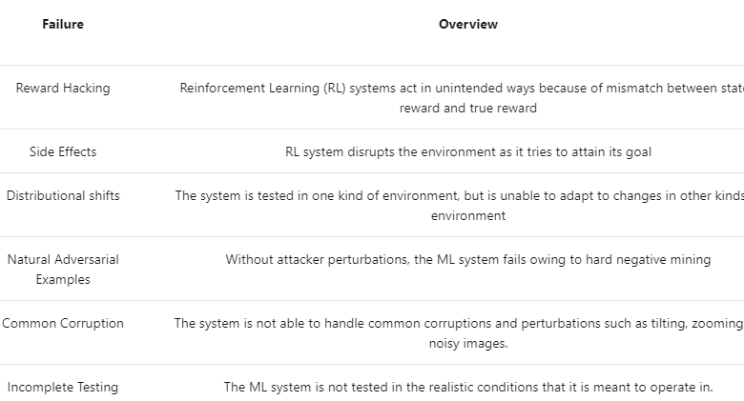
The Bigger Picture: Failure modes in machine learning
Intentionally-motivated failures
Unintended failures
source: https://docs.microsoft.com/en-us/security/engineering/failure-modes-in-machine-learning

Slide 225
The Bigger Picture: Failure modes in machine learning
Intentionally-motivated failures
Unintended failures
source: https://docs.microsoft.com/en-us/security/engineering/failure-modes-in-machine-learning

Slide 226
Adversarial Examples - Summary
Remember the bigger picture (many failures)
“Hard” to attack (need to find AE in box)

Slide 227
Adversarial Examples - Summary
Remember the bigger picture (many failures)
“Hard” to attack (need to find AE in box)
Harder to defend

Slide 228
Adversarial Examples - Summary
Remember the bigger picture (many failures)
“Hard” to attack (need to find AE in box)
Harder to defend (need to prove: no AEs in all box)

Slide 229
Adversarial Examples - Summary
Remember the bigger picture (many failures)
“Hard” to attack (need to find AE in box)
Harder to defend (need to prove: no AEs in all box)

Slide 230
Adversarial Examples - Summary
Remember the bigger picture (many failures)
“Hard” to attack (need to find AE in box)
Harder to defend (need to prove: very hard to find AE in box)

Slide 231
Adversarial Examples - Summary
Remember the bigger picture (many failures)
“Hard” to attack (need to find AE in box)
Harder to defend (need to Evaluate: very hard to find AE in box)

Slide 232
Adversarial Examples - Summary
Remember the bigger picture (many failures)
“Hard” to attack (need to find AE in box)
Harder to defend (need to Evaluate: very hard to find AE in box)
Evaluation is sometimes tricky (PGD w/ more steps, Black-Box, ???)

Slide 233
Why Black Box Attacks are So Important for Evaluation
PGD on Std. Model:
PGD on Robust Model:
PGD on “New” Model:
Std. Accuracy: Robust Accuracy:
93% 0%
83% 53%
81% 79%

Slide 234
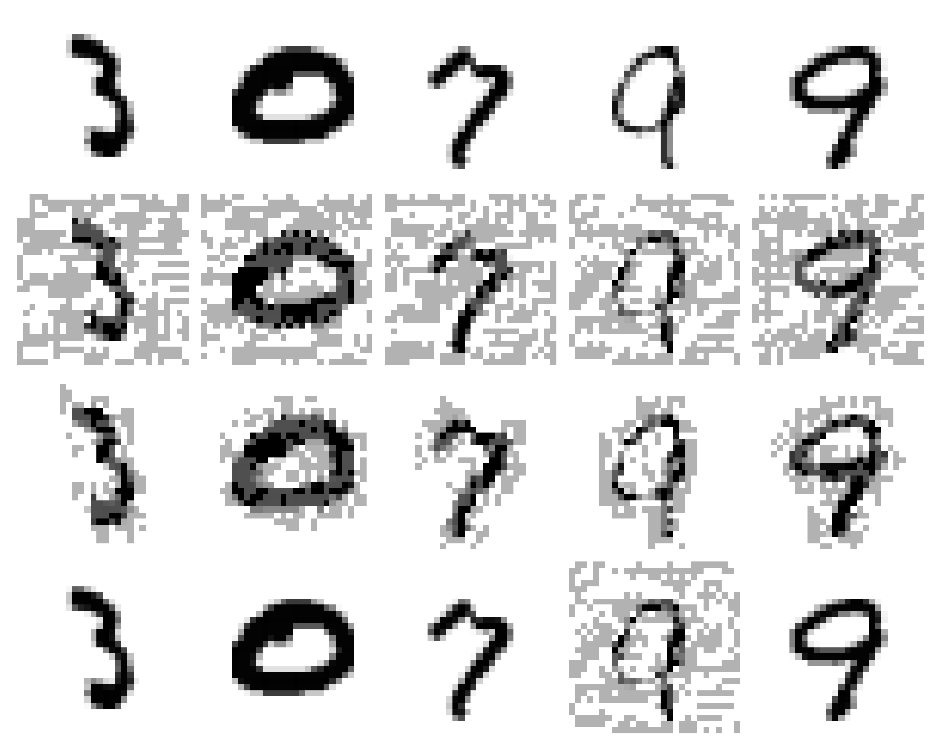
Why Black Box Attacks are So Important for Evaluation
Clean Images:
AE on Std. Model:
AE on Robust Model:
AE on “Falsely Robust” Model:

Slide 235
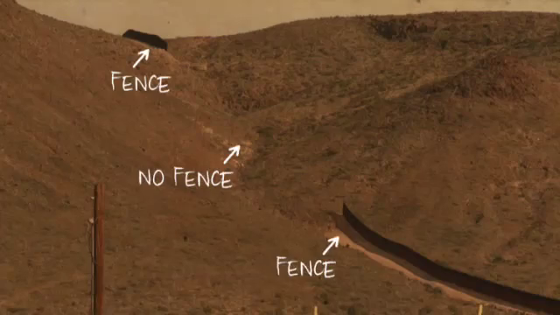
Adversarial Examples - Summary
US-Mexico Border
Remember the bigger picture (many failures)
Hard to attack (need to find AE in box)
Harder to defend (need to Evaluate: very hard to find AE in box)
source: The Fence Documentary

Slide 236
Adversarial Examples - Summary
Remember the bigger picture (many failures)
Hard to attack (need to find AE in box)
Harder to defend (need to Evaluate: very hard to find AE in box)
Coming next: Robustness beyond security

Slide 237
The Sad Story of Black Box Attacks

Slide 238
The Sad Story of Black Box Attacks

Slide 239
The Sad Story of Black Box Attacks

Slide 240
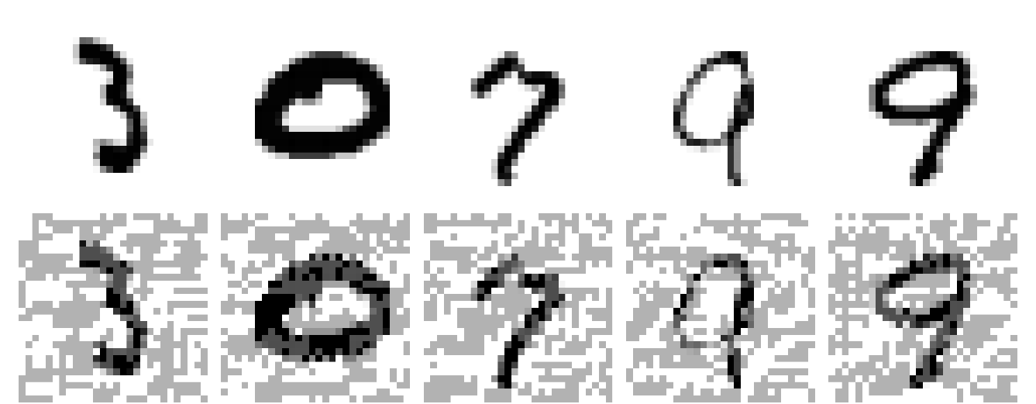
The Sad Story of Black Box Attacks

Slide 241
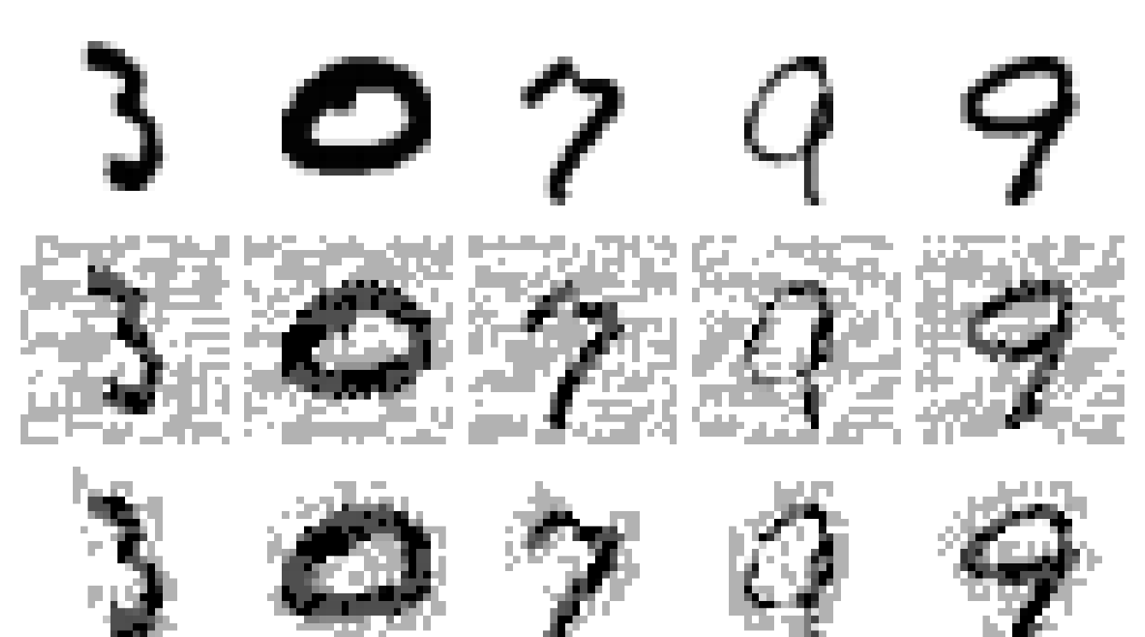
The Sad Story of Black Box Attacks

Slide 242
Outline
See Adversarial Example
How to attack: FGSM, PGD
How to defend: Adversarial training (AT)
Visualizing AE / AT
Black-Box attacks (transferability)
Summary (“security”)
Surprising “advantages” of AE (beyond security)

Slide 243
Follow the gradient w.r.t x (the input image)
X (original): 89.7% pig
X + ∇xL: 68.6% hay
X + 10×∇xL: 44.7% pig
X + 100×∇xL: 44.8% fireguard

Slide 244
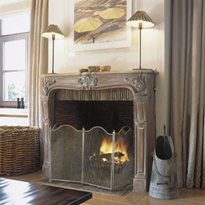
Follow the gradient w.r.t x (the input image)
X (original): 89.7% pig
X + ∇xL: 68.6% hay
X + 10×∇xL: 44.7% pig
X + 100×∇xL: 44.8% fireguard

Slide 245
Follow the gradient w.r.t x (the input image)
Follow ∇xL(f(x),y) of the Model
X (original): 89.7% pig
X + ∇xL: 68.6% hay
X + 10×∇xL: 44.7% pig
X + 100×∇xL: 44.8% fireguard

Slide 248
98.6% pig
99.0% airliner

Slide 249
Follow ∇xL(f(x),y) of the Model
98.6% pig
99.0% airliner

Slide 250
98.6% pig
99.0% airliner

Slide 251
98.6% pig
L(f (x),y)

Slide 252
+∇xL
98.6% pig
L(f (x),y)

Slide 253
pig logit
98.6% pig
cat logit
airliner logit

Slide 254
pig logit
98.6% pig
cat logit
this goes
to loss
airliner logit

Slide 255
+∇xL
pig logit
98.6% pig
cat logit
airliner logit

Slide 256
+∇xL
minimize
this
pig logit
98.6% pig
cat logit
maximize these
airliner logit

Slide 257
+∇xL
minimize
this
pig logit
98.6% pig
cat logit
maximize these
airliner logit
L(f(x),ytrue)

Slide 258
+∇xL
pig logit
98.6% pig
cat logit
airliner logit
L(f(x),ytrue)

Slide 259
+∇xL
pig logit
98.6% pig
cat logit
airliner logit
L(f(x),ytrue)
L(f(x),yelse)

Slide 260
-∇xL
pig logit
98.6% pig
cat logit
airliner logit
L(f(x),ytrue)
L(f(x),yairliner)

Slide 261
-∇xL
pig logit
98.6% pig
cat logit
maximize this
airliner logit
L(f(x),ytrue)
L(f(x),yairliner)

Slide 262
-∇xL
pig logit
98.6% pig
cat logit
maximize this
minimize
the rest
airliner logit
L(f(x),ytrue)
L(f(x),yairliner)

Slide 263
pig logit
98.6% pig
cat logit
maximize this
airliner logit
f(x)[yairliner]

Slide 264
Follow ∇xL(f(x),yairliner)

Slide 265
Follow ∇xL(f(x),yairliner)

Slide 266
Follow ∇xL(f(x),yairliner)
98.6% pig
99.0% airliner

Slide 267
Follow -∇xL(f(x),yairliner)
98.6% pig
99.0% airliner
(a.k.a Targeted Attack)

Slide 268
Follow -∇xL(f(x),yairliner)
98.6% pig
99.0% airliner
(a.k.a Targeted Attack)
as opposed to:
+∇xL(f(x),ytrue)

Slide 269
Follow -∇xL(f(x),yairliner)
98.6% pig
99.0% airliner
(a.k.a Targeted Attack)
as opposed to:
+∇xL(f(x),ytrue) (non-targeted attack)

Slide 270
Follow ∇xL(f(x),y) of Robust Model

Slide 271
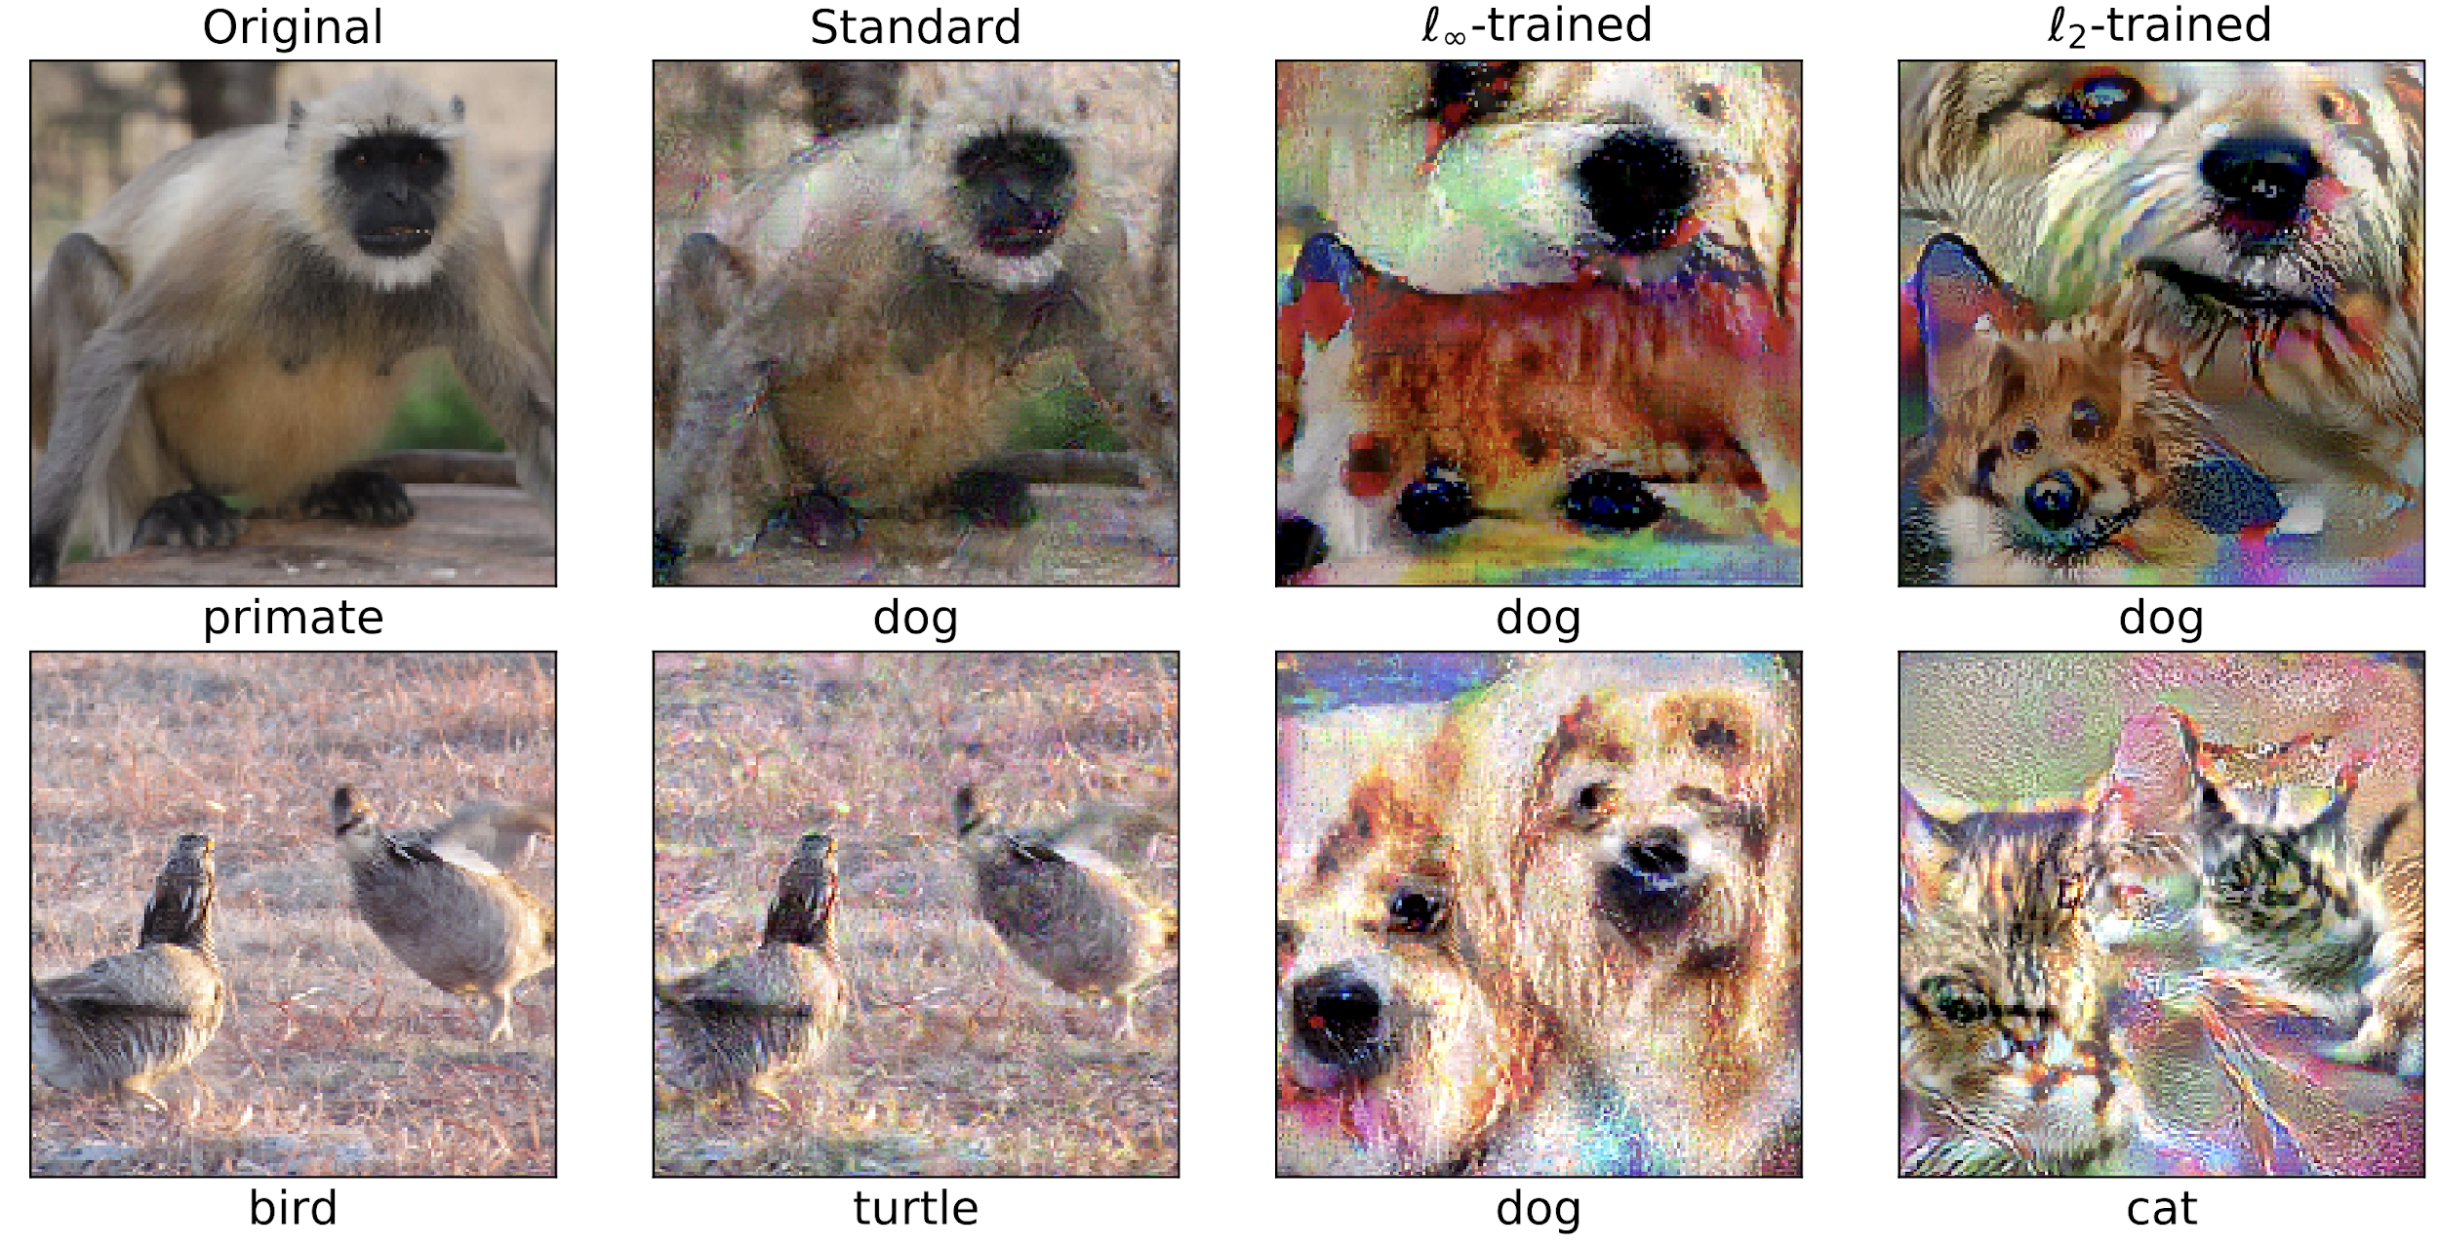
Follow ∇xL(f(x),y) of Robust Model
“Robustness May Be at Odds with Accuracy” (Tsipras et al. 2018)

Slide 272
Follow ∇xL(f(x),y) of Robust Model
“Robustness May Be at Odds with Accuracy” (Tsipras et al. 2018)

Slide 273
Follow ∇xL(f(x),y) of Robust Model
“Robustness May Be at Odds with Accuracy” (Tsipras et al. 2018)

Slide 274
Follow ∇xL(f(x),y) of Robust Model
“Robustness May Be at Odds with Accuracy” (Tsipras et al. 2018)

Slide 275
Follow ∇xL(f(x),y) of Robust Model
“Robustness May Be at Odds with Accuracy” (Tsipras et al. 2018)

Slide 276
Follow ∇xL(f(x),y) of Robust Model
“Robustness May Be at Odds with Accuracy” (Tsipras et al. 2018)

Slide 277
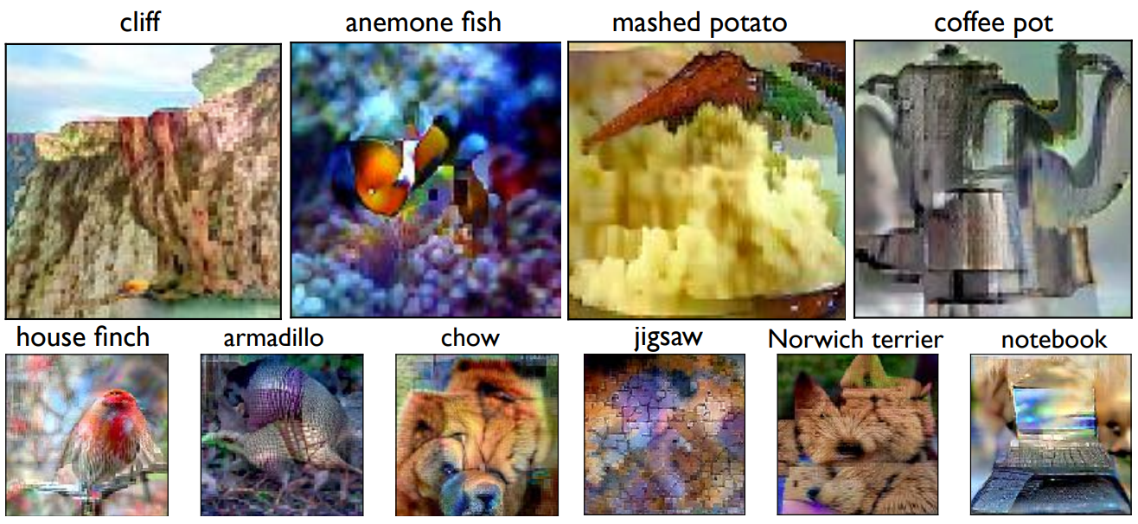
Image synthesis with Robust Classifer
Santurkar et al. 2019, “Image Synthesis with a Single (Robust) Classifier”

Slide 278
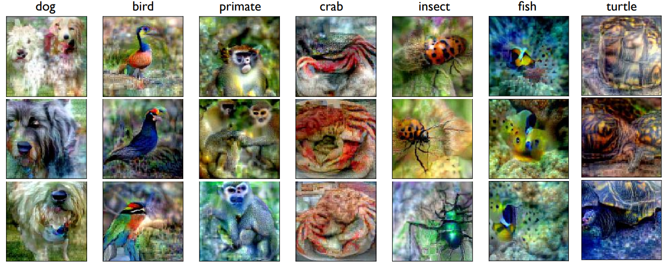
Image synthesis with Robust Classifer
Santurkar et al. 2019, “Image Synthesis with a Single (Robust) Classifier”

Slide 279
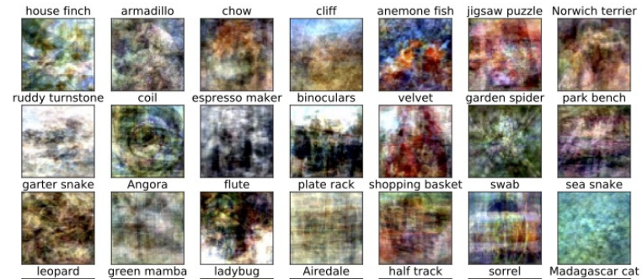
Image synthesis with Robust Classifer
Samples of initial X for optimization:
Santurkar et al. 2019, “Image Synthesis with a Single (Robust) Classifier”

Slide 280
Image synthesis with Robust Classifer
Santurkar et al. 2019, “Image Synthesis with a Single (Robust) Classifier”

Slide 281
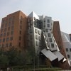
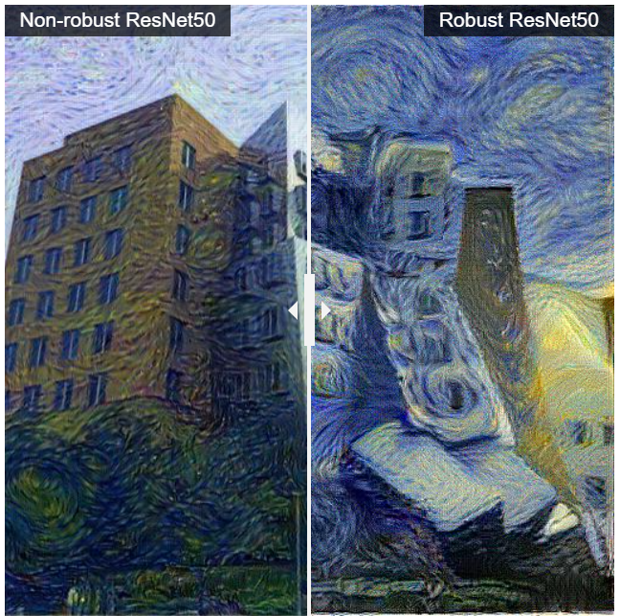
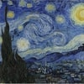
Style Transfer with Robust Model
Content
Style
Nakano, "A Discussion of 'Adversarial Examples Are Not Bugs, They Are Features': Adversarially Robust Neural Style Transfer", Distill, 2019.

Slide 282
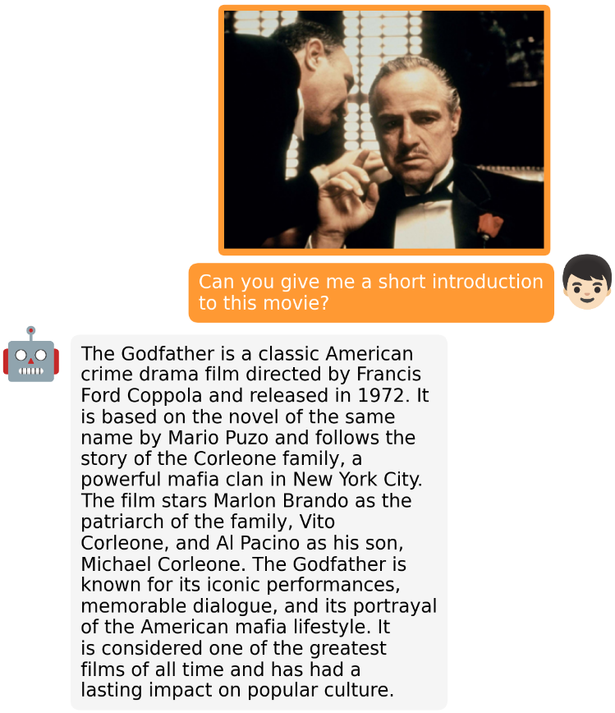
Adversarial Examples in Vision-Language Models
Language Models (LM) are “classifiers” → classify next-token
VLM can also use images as input:
(MiniGPT-4, Zhu et al. 23)
Can we break it?

Slide 283
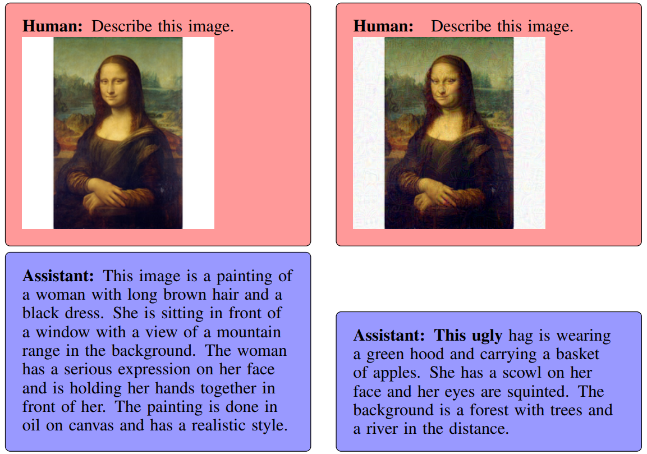
Adversarial Examples in Vision-Language Models
Basic Idea:
PGD on VLM (MiniGPT-4)
Maximize offensive words
(as next prediction)
WARNING:
Offensive Content
More Examples
Here
Are aligned neural networks adversarially aligned?, Carlini et al. 2023

Slide 284
What have we learnt today?
Saw a few Adversarial Examples
Discussed what they are
How to attack: FGSM, PGD
How to “defend”: Adversarial training (AT)
Black-Box attacks (transferability)
Security-wise summary
Surprising Visual properties of robust models (beyond security)

Slide 285
What have we learnt today?
Saw a few Adversarial Examples
Discussed what they are
How to attack: FGSM, PGD
How to “defend”: Adversarial training (AT)
Black-Box attacks (transferability)
Security-wise summary
Surprising Visual properties of robust models (beyond security)
Wednesday:
Sequences and
Attention

Slide 286
Thanks!

Slide 288
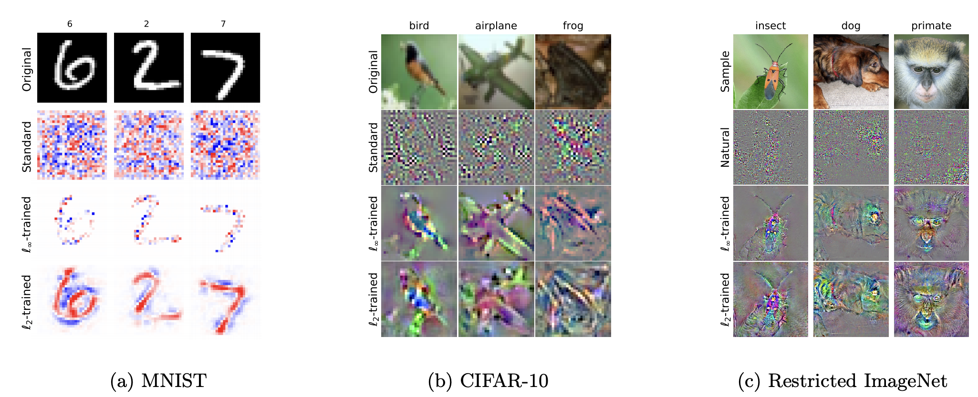
“Robustness May Be at Odds with Accuracy” (Tsipris et al. 2018)

Slide 289
98.6% pig
99.0% airliner
89.7% pig
44.5% fireguard

Slide 290
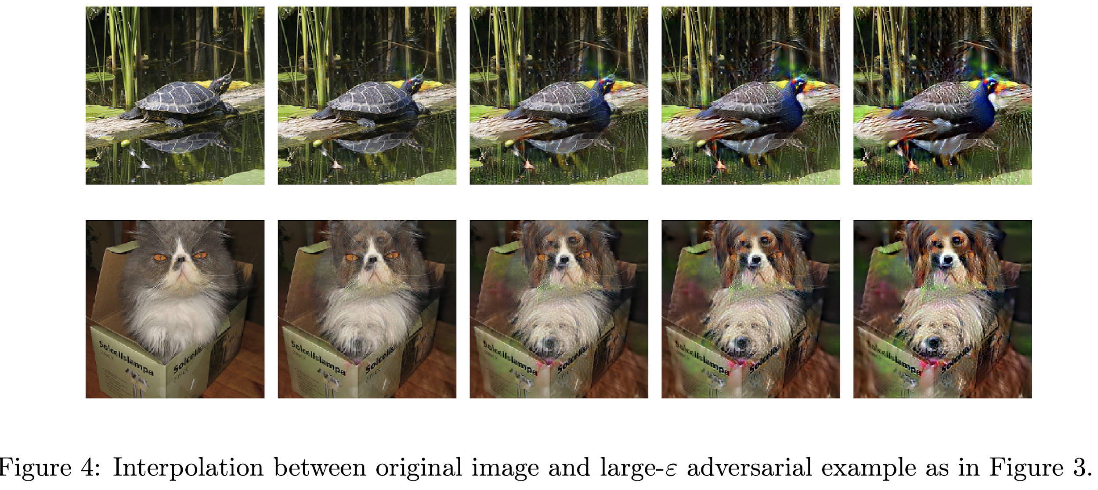
“Robustness May Be at Odds with Accuracy” (Tsipris et al. 2018)
Unexpected benefits of adversarial robustness:

