Slide 1
Organization of Biomembranes
Biochemistry and Metabolism
Felix Bast
Molecular Cell Biology, 6th edition, 2008.
Lodish • Berk • Kaiser • Krieger • Scott • Bretscher •Ploegh • Matsudaira

Slide 2
Biomembranes
Surrounds cell
Separates cell from environment
Allows cellular specialization
Separate some of the cellular organelles
Allows specialization within the cell
Continuity of membranes between adjoining cells (tight junctions) can separate two extracellular compartments
Important in organ function

Slide 3
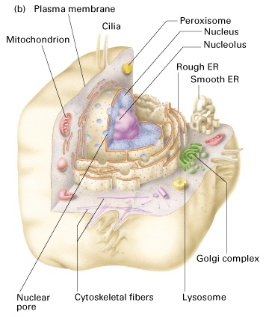
Biomembrane structure
Cell (plasma) membrane: defines cell boundaries
Internal membranes define a variety of cell organelles
Nucleus
Mitochondria
Endoplasmic reticulum (rough and smooth)
Golgi apparatus
Lysosomes
Peroxisomes
Chloroplasts
Other
Notes:
About 8 nm thick

Slide 4
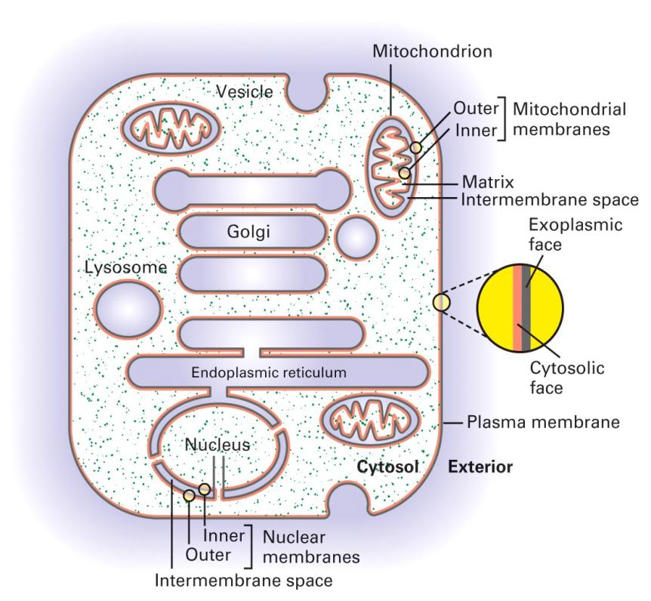
The Faces of Cellular Membranes
Two face:
Internal face (cytosolic face): and External face (exoplasmic face):
Two membranes:
Nucleus
mitrochondrion
chloroplast

Slide 5
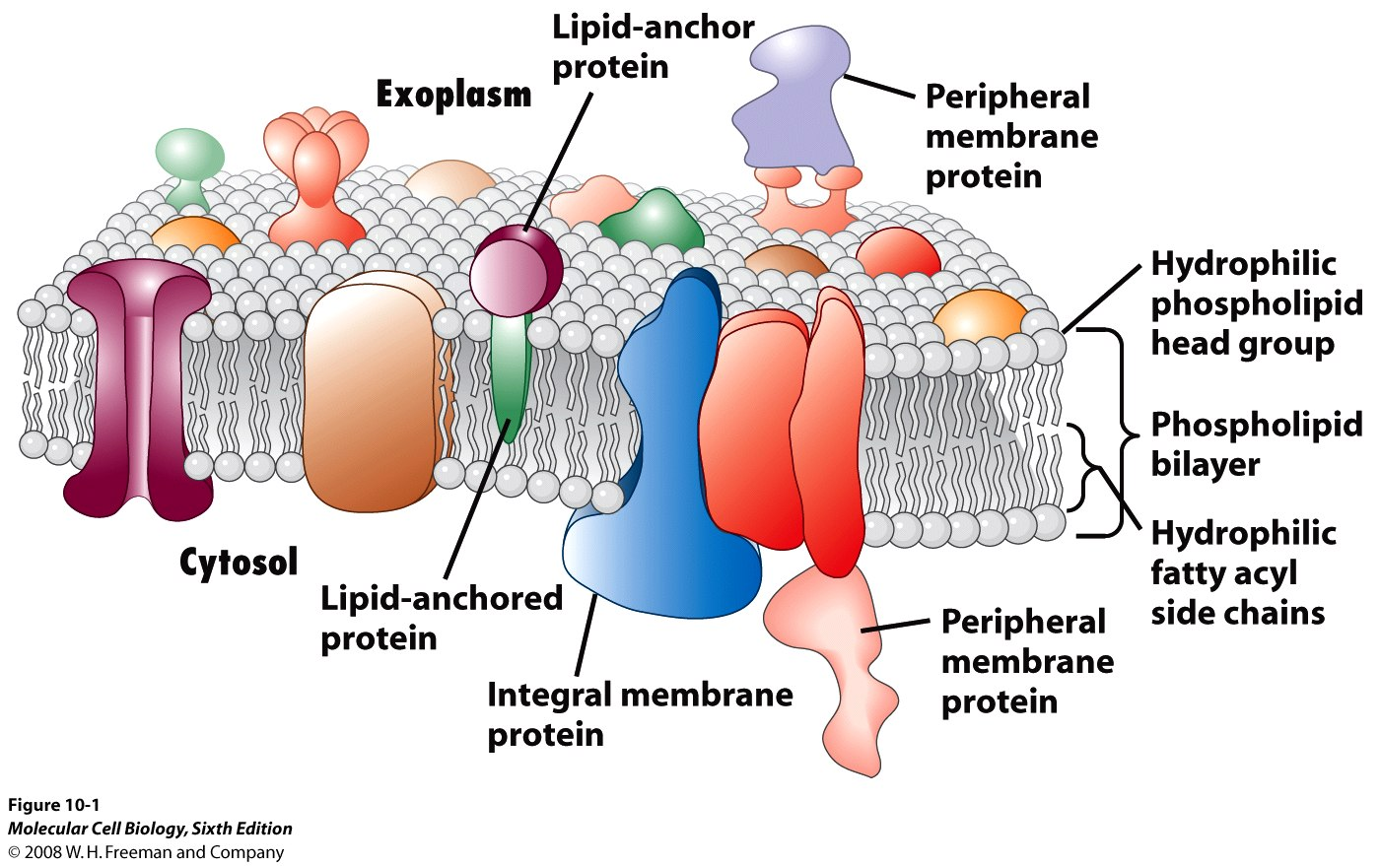
Membrane

Slide 6
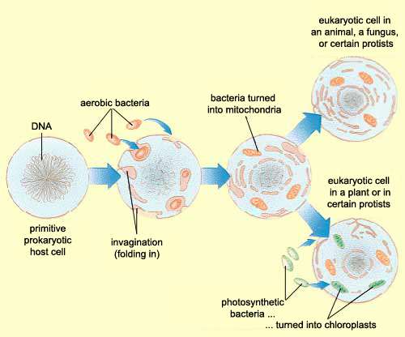
Endosymbiotic theory

Slide 7
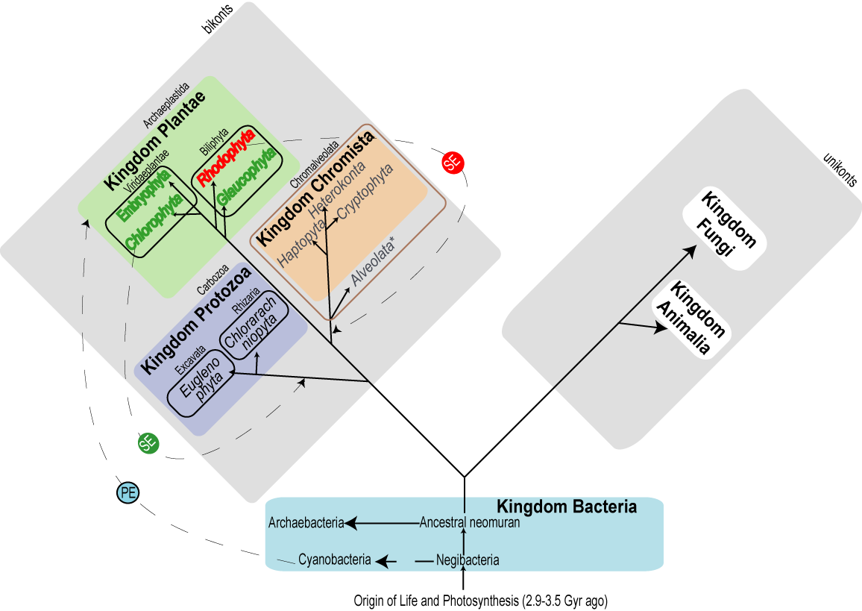

Slide 8
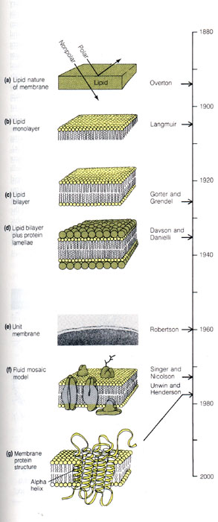
A brief history of studies
on the structure of the
plasma membrane
A. Conception:
Plasma membrane(cell membrane),
Intracellular membrane,
Biomembrane.
B. The history of study
Overton(1890s):
Lipid nature of PM;

Slide 9
Structure of biomembranes
1895 – membranes thought to be composed of lipids
1915 – chemical analysis – membranes composed of lipids and proteins
1917 – phospholipids dissolved in benzene form film on water – hydrophilic heads
1925 – phospholipid bilayer proposed (Gorter and Grendel)
1935 – sandwich model proposed with proteins on outside of phospholipid bilayer. Dominant model until 1960s – entrance of electron microscope (Davson-Danielli model)

Slide 10
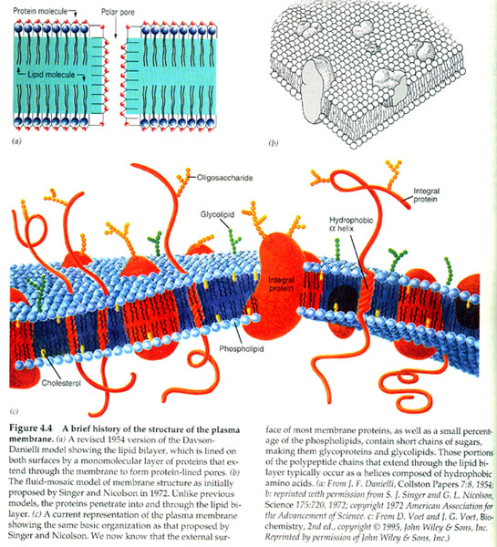
 J.D.Robertson(1959):
The TEM showing:the trilaminar appearance of PM;
Unit membrane model;
 S.J.Singer and G.Nicolson(1972):
fluid-mosaic model;
 K.Simons et al(1997):
lipid rafts model;
Functional rafts in Cell
membranes.
Nature 387:569-572

Slide 11
Fluid mosaic model
Fluid: Membrane lipids: supporting structure
Phospholipids
Glycolipids
Cholesterol
Mosaic: Membrane proteins: bits and pieces
Integral (integral) proteins
Peripheral (extrinsic) proteins
Notes:
Current model: proposed by Singer and Nicholson (1972)
Previously:
1895 – membranes thought to be composed of lipids
1915 – chemical analysis – membranes composed of lipids and proteins
1917 – phospholipids dissolved in benzene form film on water – hydrophilic heads
1925 – phospholipid bilayer proposed
1935 – sandwich model proposed with proteins on outside of phospholipid bilayer. Dominant model until 1960s – entrance of electron microscope

Slide 12
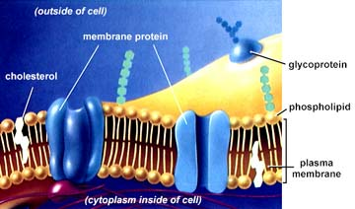
Singer and Nicolson’s Model of membrane structure: The fluid-mosaic model is the “central dogma” of membrane biology.
The core lipid bilayer exists in a fluid state, capable of dynamic movement.
Membrane proteins form a mosaic of particles penetrating the lipid to varying degrees.
The Fluid Mosaic Model, proposed in 1972 by Singer and Nicolson, had two key features, both implied in its name.

Slide 13
Membrane dynamics
Asymmetry
Lateral mobility
Fluidity

Slide 14
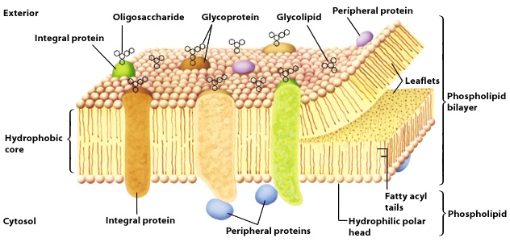
Membrane asymmetry
The inner and outer leaflets of the membrane have different compositions of lipids and proteins

Slide 15
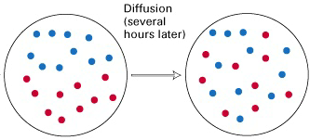
Lateral mobility
Biomembranes are a two-dimensional “mosaic” of lipids and proteins
Most membrane lipids and protein can freely move through the membrane plane
Notes:
Rapid movements of lipids: about 2 microns per second
Proteins move much slower; some not at all; rarely ‘flip-flop’

Slide 16
Experimental approach to quantify the lateral movement of Lipid and Proteins in Biomembranes
Fluorescence recovery after photobleaching (FRAP) experiments

Slide 17
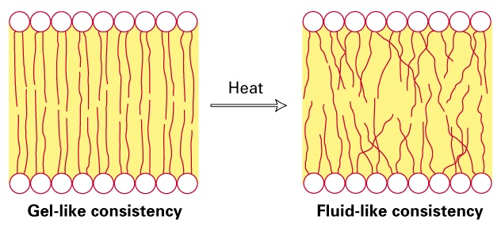
Membrane fluidity
Movement of hydrophobic tails
Depends on temperature and lipid composition
How does lipid composition affect fluidity?

Slide 18
Lipids and membrane fluidity
Interactions between hydrophobic tails decrease fluidity (movement):
Shorter tails have fewer interactions
Unsaturated fatty acids are kinked and decrease interactions
Cholesterol “buffers” fluidity
Prevents interactions
Restricts tail movement
Notes:
Cells can alter lipid composition of membranes to compensate for changes in fluidity caused by changing in temperature
For example, cold-adapted organisms, such as winter wheat, increase the percentage of unsaturated phospholipids in the autumn
This allows these organisms to prevent their membranes from solidifying during the winter

Slide 19
Gel and Fluid Forms of the Phospholipid Bilayer
The degree of bilayer fluidity depends on
1. Lipid composition
Cholesterol
Concentration effect:
High conc. -> interaction of the steroid ring with the long hydrophobic tails -> decrease biomembrane fluidity
Low conc. -> steroid ring separates and disperses phospholipid tails -> more fluid

Slide 20
2. Structure of the phospholipid hydrophobic tails
Van der Waals and the hydrophobic effect -> nonpolar tails of phospholipids to aggregate
gel-like state:
Long, saturated fatty acyl chains have the great tendency to aggregate
more fluid bilayers:
Short fatty acyl chains: less surface area for interaction
Unsaturated fatty acyl chains: less stable van der Waals interactions
3. Temperature
Heat disorders the nonpolar tails: from a gel to a fluid

Slide 21
Heat disorders the nonpolar tails and induces a transition from a gel to a fluid

Slide 22
Lipoproteins
Lipids
Proteins
Glycolipids
Glycoproteins
Sugars

Slide 23
Biomembrane composition
Phospholipid bilayer (basic structure)
Various membrane proteins, depending on membrane function
Glycolipids and glycoproteins (lipids and proteins with attached carbohydrates)
Cholesterol (in animal cells)

Slide 24
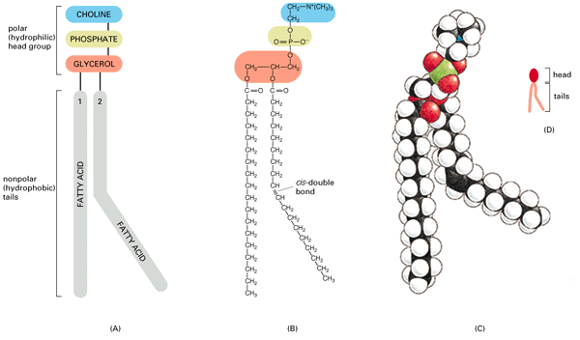
The parts of a phospholipid molecule. Phosphatidylcholine, represented schematically (A), in formula (B), as a space-filling model (C), and as a symbol (D). The kink due to the cis-double bond is exaggerated in these drawings for emphasis.

Slide 25
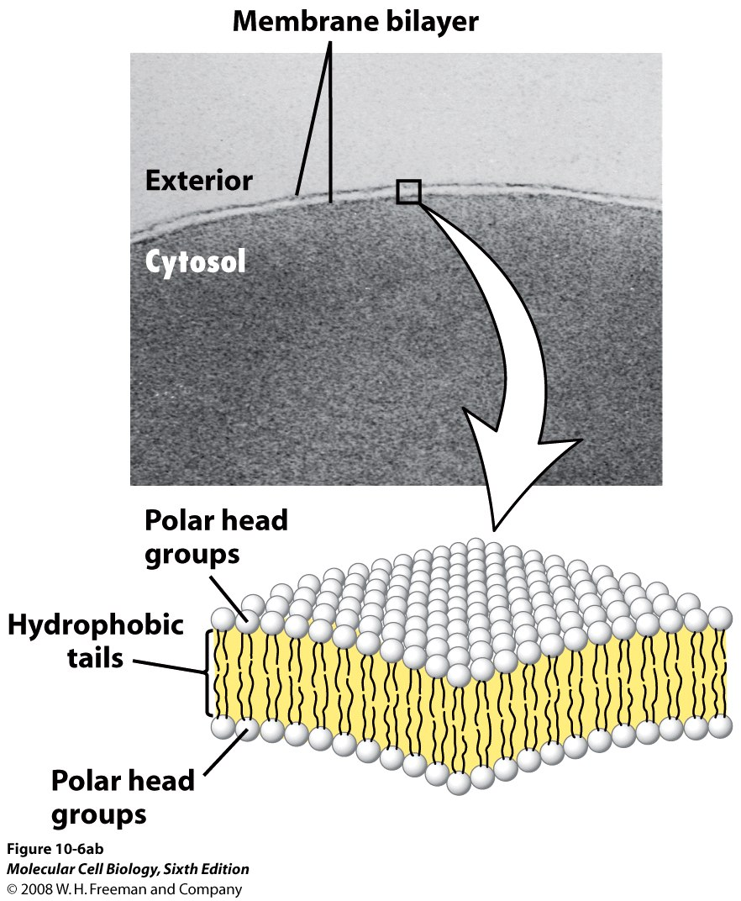
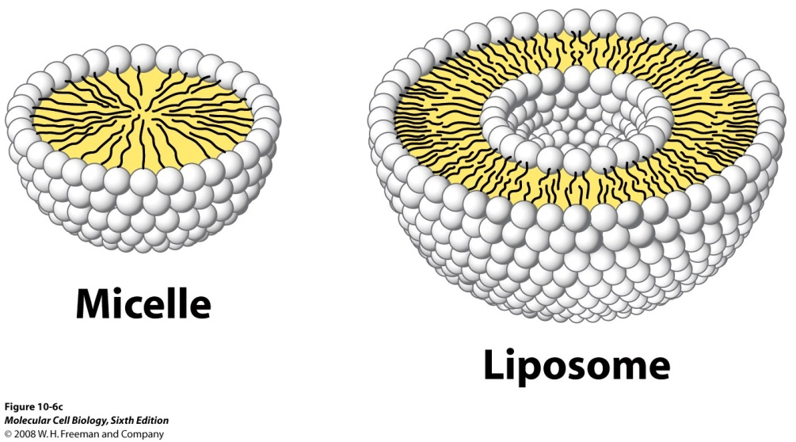
The bilayer structure of biomembrane

Slide 26
Liposome Vs Miscelle
Miscelle
Forms when surfactant mixes with colloid in appropriate thermodynamic conditions-Hydrophobic effect
CMC & CMT (Krafft Temperature)
Liposome
Ultrasonication-coarse liposomes
Analogy with soap bubble
Important vectors for molecularly-targeted drug delivery

Slide 27
Membrane Lipids
Amphipathic molecules
Polar head group and hydrophobic tail
Bilayer: hydrophobic effect and van der Waals interaction
Three classes:
phosphoglycerides
sphingolipids
Steroids
Differences:
chemical structure,
abundance
function

Slide 28
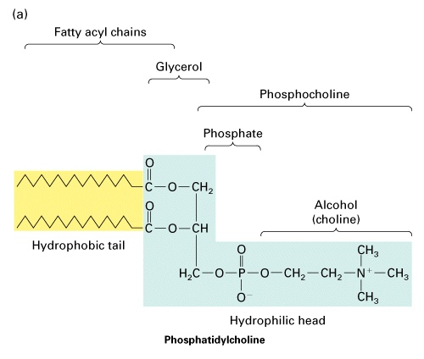
Membrane lipids
Phospholipids
Major lipid component of most biomembranes
Amphipathic: hydrophobic and hydrophilic
Examples
Phosphatidylcholine
Sphingomyelin
P-serine
P-ethanolamine
P-inositol

Slide 29
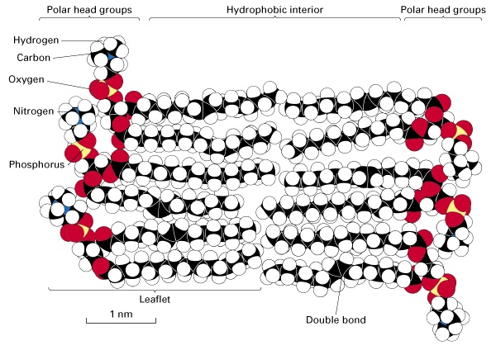
Phospholipid bilayer

Slide 30
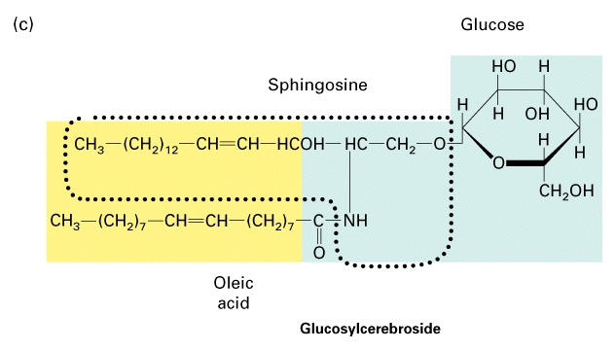
Membrane lipids
Glycolipids
Least common of the membrane lipids (ca. 2%)
Always found on outer leaflet of membrane
Carbohydrates covalently attached
Involved in cell identity (blood group antigens)

Slide 31
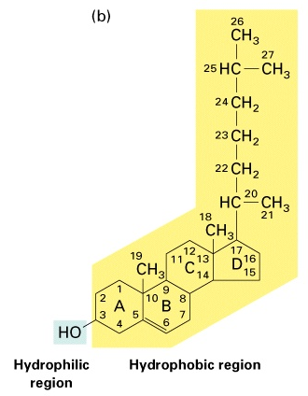
Membrane lipids
Cholesterol
Steroid; lipid-soluble
Found in both leaflets of bilayer
Amphipathic
Found in animal cells
Membrane fluidity “buffer”
Synthesized in membranes of ER

Slide 32
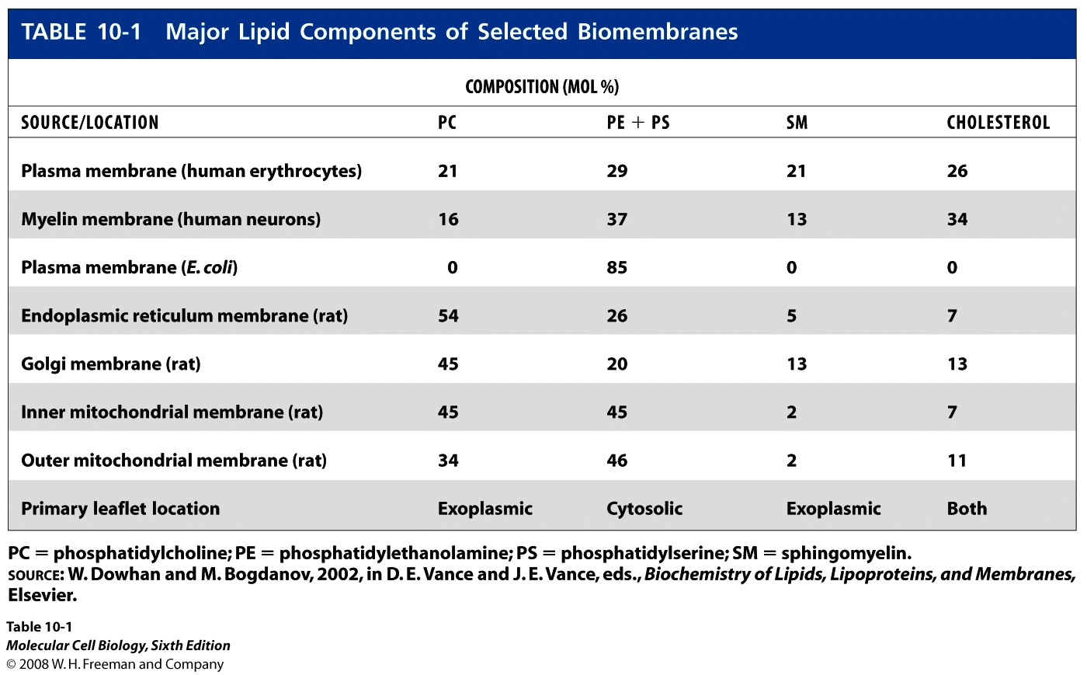

Slide 33
Membrane Proteins and Functions

Slide 34
Three classes of membrane proteins
Integral (transmembrane)
Cytosolic and exoplasmic domains have hydrophilic AAs
3nm Membrane-spanning domain have hydrophobic AAs. Mostly α-helices, some β-pleated
Exoplasmic domains are mostly glycosylated
Peripheral-no interaction with lipid core; interacts either with integral or with “head groups”
Lipid-anchored-bound covalently to lipid

Slide 35
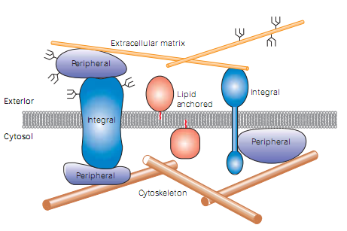
Three classes of membrane proteins
Carbohydrate side-chains
Covalently-attached hydrocarbon chain

Slide 36
Membrane proteins
Peripheral (extrinsic) proteins
Do not penetrate bilayer
Not covalently linked to other membrane components
Form ionic links to membrane structures
Can be dissociated from membranes
Dissociation does not disrupt membrane integrity
Located on both extracellular and intracellular sides of membrane
Synthesis
Cytoplasmic (inner) side – cytoplasm
Extracellular (outer) side – made in ER and exocytosed

Slide 37
Membrane proteins
Integral (intrinsic) proteins
Penetrate bilayer or span membrane
Can only be removed by disrupting bilayer
Types
Transmembrane proteins
Single-pass or Multiple-pass
Covalently tethered integral proteins
Many are glycoproteins
Covalently-linked via asparagine, serine, or threonine to sugars
Synthesized in rough ER
Function: enzymatic, receptors, transport, communication, adhesion

Slide 38
α-Helices
Single-Pass
Only one α-Helix, 20-25 hydrophobic residues
Example: Glycophorin-A – major protein in erythrocyte plasma membrane, rich in sialic acid
Multi-pass
Several α-Helices
Two important families:
Seven-Spanning
Ion Channels

Slide 39
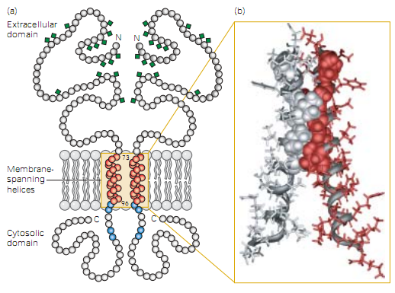
Single-pass
Glycophorin-A dimer
Coiled-coil dimer
3.75 nm

Slide 40
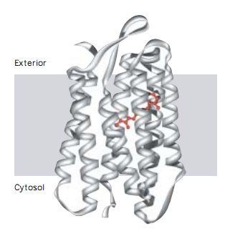
Multi-pass: Seven-Spanning
7 membrane-spanning α-helices
G-protein coupled receptors
Bacteriorhodopsin
Retinal group

Slide 41
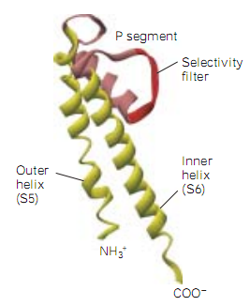
Multi-pass: Ion Channels
Tetrameric proteins
Each subunits have pair of transmembrane helices-that interact with helices of other subunits to form central channel
Turret
α-helix
Loop

Slide 42
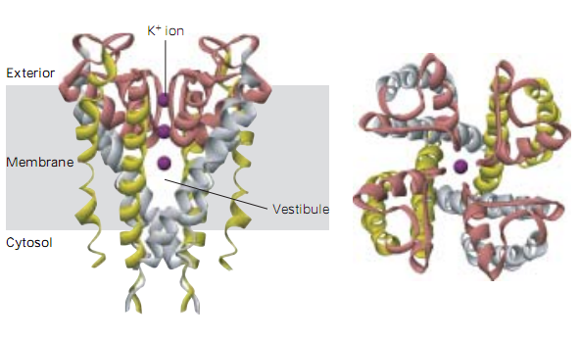
Multi-pass: Ion Channels
Ion-sensitivity Filters
S-6 α-helices

Slide 43
β-Sheets
Porins-an integral membrane protein- is composed of β-Sheets
Found in outer membranes of Gram-negative bacteria and outer membranes of mitochondria & Chloroplasts
AAs are mostly hydrophilic, with hydrophobic side-chains protruding outside (“inside-out”)
Trimers of identical subunits, each containing 16 β-Sheets forming barrel like structure

Slide 44
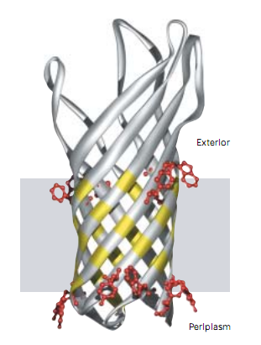
One sub-unit of Omp-X-a porin in E. coli
Aliphatic side-chains
β-sheet wall around central pore
Aromatic side-chains

Slide 45
Lipid-anchored proteins
Lipid side-chains covalently attach proteins with lipid tail-groups of HC core
One group of cytosolic proteins are anchored by palmitate or myristate side-chains attached with N-terminal Gly residue –Acyl anchors
Second group are anchored by unsaturated fatty-acyl side-chains (Prenyl anchors, made of isoprene units) attached with C-terminal (or near) Cys residue (Eg. Ras & Rab proteins)
Third group are anchored by glycosylphosphatidylinositol (GPI-anchors) attached with C-terminal residue (Eg. Placental Alkaline Phosphatase-PLAP)

Slide 46
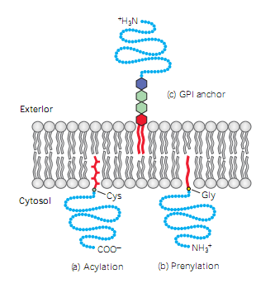
Lipid-anchored proteins
Phosphoethanolamine
Sugars
Phosphatidylinositol
Gly
Cys

Slide 47
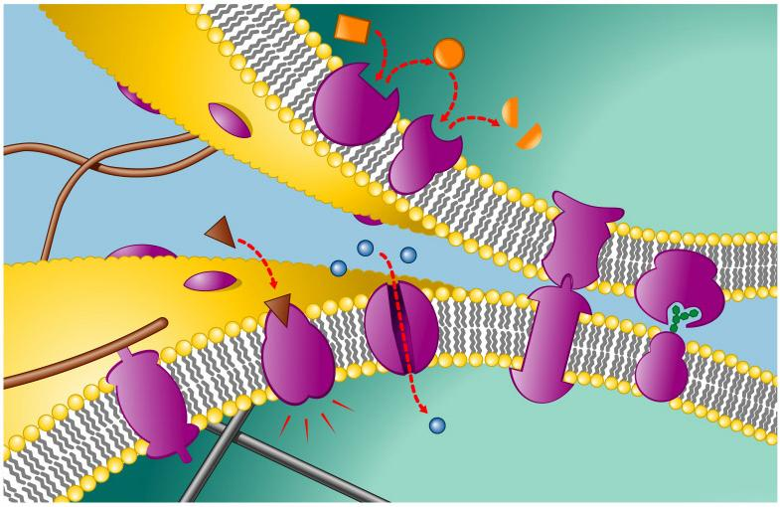
Membrane Protein: components and functions
Distinctive activities :
based on the proteins associated with a particular membrane
The density and complements of proteins depend on cell type and subcellular location
Fibers of
extracellular
matrix
Cytoplasm
c
Enzymatic activity
Cell signaling
b
Attachment to
cytoskeleton and
extracellular
matrix
a
Intercellular
joining
e
f
Cell-cell
recognition
d
Transport
Cytoskeleton
Cytoplasm

Slide 48
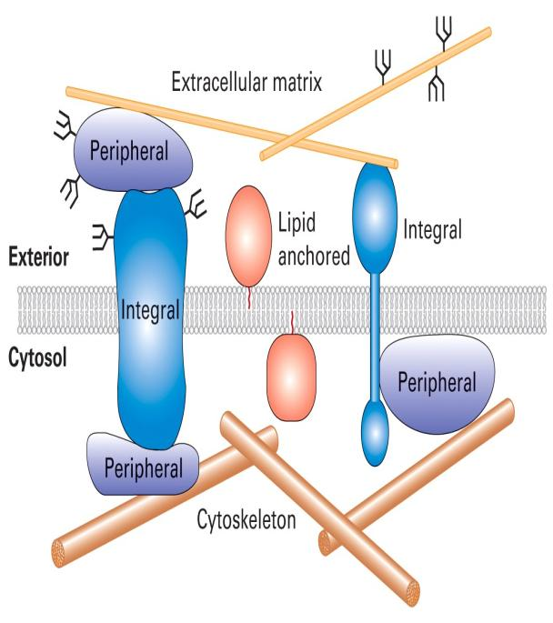
Interaction of Proteins and Membranes
1. Integral membrane proteins (transmembrane proteins)
Cytosolic and exoplasmic domain:
Hydrophilic exterior surfaces
Resemble other water-soluble proteins
Membrane-spanning domain:
hydrophobic amino acids
∗∗ α helices or multiple β strands
Most transmembrane proteins are glycosylated with a complex branched sugar group

Slide 49
2. Lipid-anchored membrane proteins
Are bound covalently to lipid molecules (hydrophobic carbon chain)
3. Peripheral membrane proteins
Associated with integral proteins or membrane lipids by specific noncovalent interactions

Slide 50
Protein mobility
30-90% of integral proteins are freely mobile, depending on cell type (shown by FRAP studies)
Lateral diffusion rate of membrane proteins in living cells is 10-30 times slower than that in liposomes
Mobility of integral membrane proteins are restricted by interactions with rigid submembrane cytoskeleton

Slide 51
Protein lipid interactions are as important as protein-protein interactions in localizing peripheral proteins to cellular membranes
Lipid-binding motives in proteins are very common in proteome
11th most common protein domain in humans is pleckstrin homology (PH) domain

Slide 52
Membrane carbohydrates
Membranes play key role in cell-cell recognition
Carbohydrates are usually branched oligosaccharides with fewer than 15 sugar units
Oligosaccharides on external of membranes are different among species, or individuals, or cells
Notes:
Cell-cell recognition is the ability of a cell to distinguish one type of neighbouring cell from another.
This attribute is important in cell sorting and organization as tissues and organs in development.
It is also the basis for rejection of foreign cells by the immune system
Membrane carbohydrates may be covalently linked to lipids [glycolipids] or proteins [glycoproteins]
Oligos on the external side of the membrane vary from species to species, invidual to individual, and even from cell type to cell type within the same individual
Marks each cell as distinct
Basis of blood groups – A, B, AB and O

Slide 53
Membrane carbohydrates
Glycosylated residues of glycolipids and glycoproteins always face exoplasmic side
Abundant in eukaryotic plasma membranes but absent in organellar membranes
Carbohydrate chains interact with extracellular matrix, growth factors, antibodies etc
Important implication of such interaction is ABO blood-group antigens

Slide 54
A, B, and O Blood-group Antigens
All human have the enzymes for synthesizing O antigen.
Type A: glycosyltransferase -> N-acetylgalactosamine
Type B: -> galactose

Slide 55
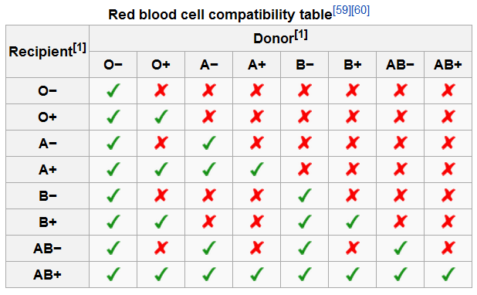
ABO-Blood Group

Slide 56
“Accessory” structures
Extracellular matrix (ECM)
Outside animal cells
Composed of proteins and carbohydrates
Attached to plasma membrane
Cell wall
Surrounds bacterial/fungal/plant/algal cells
Plants: Cellulose, Xylan and Lignin
Fungus: Chitin (Polymer of N-Acetyle Glucosamine)
Bacteria: Peptidoglycan
Algae: Glucans (Cellulose) Mannans, Xylans, Alginic Acid, Sulphonated Polysaccharides (agar, agarose, carrageenans)

Slide 57
Organelles

Slide 58
Nucleus
Houses Genome
Outer membrane is continuous with rough ER; Inner membrane defines nucleus; two membranes fuse at nuclear pores containing porins
rRNA-synthesized in nucleolus- binds to proteins forming ribonucleoprotein particles
DNA packed into chromosomes; heterochromatin attached to lamin-fibrous proteins forming 2D network in inner membrane

Slide 59
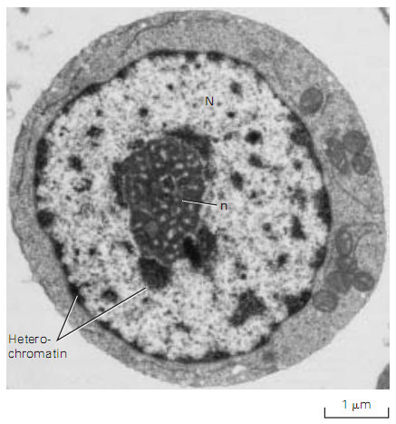
Nucleus

Slide 60
Mitochondrion
Up to 25% of volume of cytoplasm is mitochondria
Outer membrane: 50% Lipids, 50% proteins; contains porins
Inner membrane: 20% Lipids, 80% Proteins; continuous with crystae that protrude to matrix
Site of ETC and Chemiosmotic phosphorylation
28 molecules of ATP from 1 molecule of glucose generated in Mt
All ATPs in lipid metabolism generated in Mt
Power Plants of cell

Slide 61
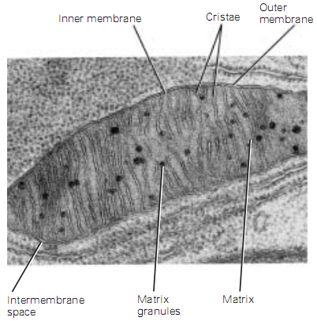
Mitochondrion

Slide 62
Chloroplast
Second largest organelle in plants
Inner membrane is continuous with thylakoids that forms stacks called grana, embedded in matrix stroma
All chlorophylls in plants are found in thylakoid membranes
Site of photophosphorylation in photosynthesis

Slide 63
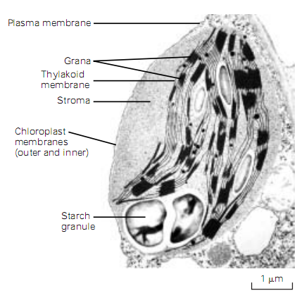
Chloroplast

Slide 64
Plant Vacuoles
Largest organelle in plants (almost 80% of cytoplasm)
Transport proteins in vacuolar membrane allows to store water, ions and nutrients
Acidic pH, may have degradative function like animal lysosomes
Influx of water in vacuoles due to osmosis, together with rigidity of cell walls creates turgor pressure-instrumental in plant water transport

Slide 65
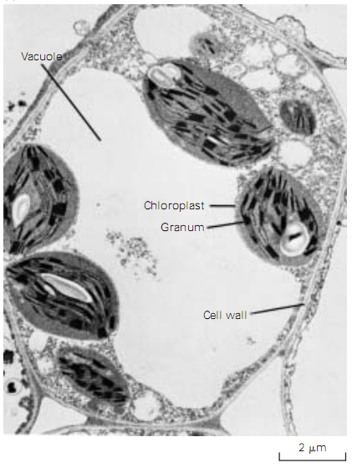
Plant Vacuoles

Slide 66
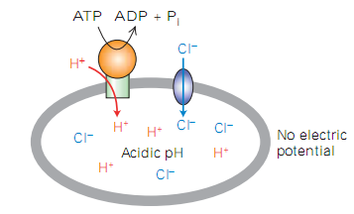
Lysosomes
Low pH inside the matrix, maintained by V-Class Proton Pump (active transport) and Cl⁻ Channel (Passive transport)

Slide 67
Lysosomes
Degrades endosomes (pinosomes), phagosomes and autophagosomes
Pinocytosis-(cell-drinking)-endocytosis of small solutes
Phagocytosis-(Cell-eating) large cells,bacteria etc
Autophagy (Eating oneself)-Mechanism by which aged organelle is recycled
Contains nucleases, phosphatases, peptidases- acid hydrolases

Slide 68
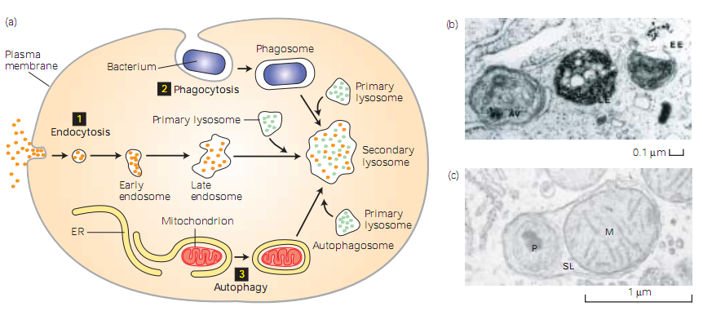
Lysosomes

Slide 69
Peroxisomes
Present in all animal cells (except erythrocytes) and many plant cells
Contains oxydases-oxidize organic substrates to H₂O₂
Also contain catalases-
Principal organelle for fatty acid oxidation
Plant seeds contain glyoxisomes-similar like peroxisomes and contain many peroxisomal enzymes

Slide 70
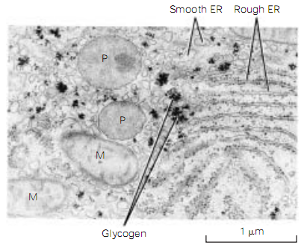
Peroxisomes

Slide 71
Endoplasmic Reticulum
Largest membrane-bound structure in any eukaryotic cell, made up of sacs called Cisternae
Cytosolic face of Rough ER is studded with ribosomes
Smooth ER involved in detoxification of carcinogens, synthesis of fatty acids and phospholipids; abundant in hepatocytes
Rough ER is abundant in cells secreting hormones (such as Islets of Langerhans) antibodies (Plasma cells) and enzymes (Pancreatic Acinar cells)

Slide 72
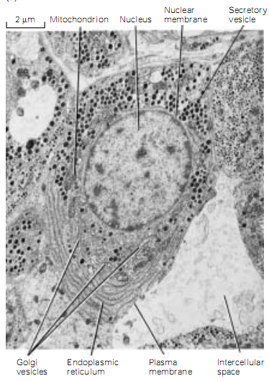
Endoplasmic Reticulum

Slide 73
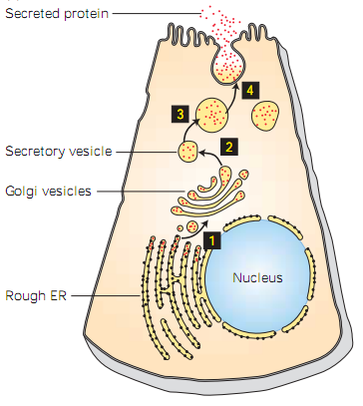
Endoplasmic Reticulum

Slide 74
Golgi Complex
Prominent in secretory cells
Involved with protein processing and packing
Three parts: cis, medial and trans
Trans-Golgi Network (TGN) is a major branch point in the secretory pathway where soluble secreted proteins, lysosomal proteins, and in some cells membrane proteins destined for the basolateral or apical plasma membrane are segregated into different transport vesicles.

Slide 75
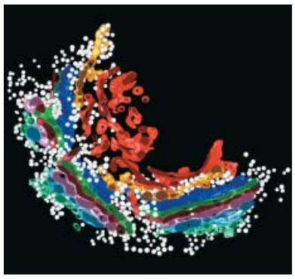
Golgi Complex

Slide 76
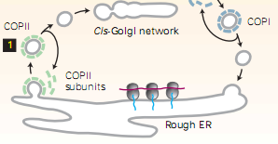
Secretory Pathway
Proteins from ER transported to Golgi by COP II anterograde transport vesicles, fuses at cis; some transports back to ER by COP I retrograde vesicles

Slide 77
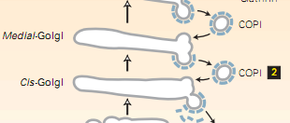
Secretory Pathway
Proteins from cis progress to medial and finally to trans (proteins get modified serially) – cisternal progression. Enzymes and other Golgi proteins are retrieved from later to earlier cisternae by COP I coated retrograde transport vesicles

Slide 78
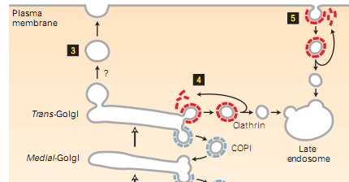
Secretory Pathway
After processing, “cargo proteins” buds off (mediated by dynamin) into clathrin-coated vesicles from trans
Vesicles either fuse with PM (Constitutive secretion) or with organelles like late endosome (whereby forming lysosomes)

