Slide 1

AMAT RHANG MANYANG
By : Group 5
Zaharatul Aini
waTTINI
MARDIANI
Nuratul Iqrama
Class : XI Ipa1
Narative Text
14 November 2016

Slide 2
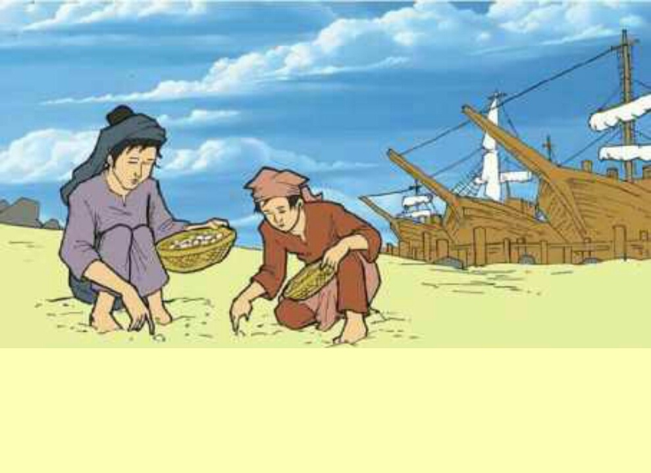
0nce upon a time, a village pasie near senara swamp in Raya river Aceh. There lived a family with a widow and a son named Amat Rhang Manyang . They were poor.

Slide 3
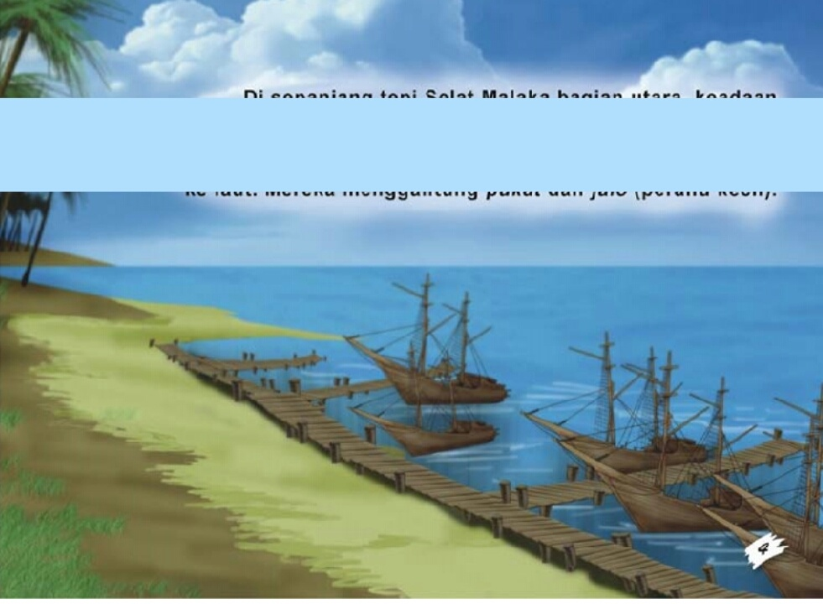
One day his father was sick and finally his father death. Because of the death they lived in trouble. Amat thought to make difference to their fate. Then he went to another side of country.

Slide 4
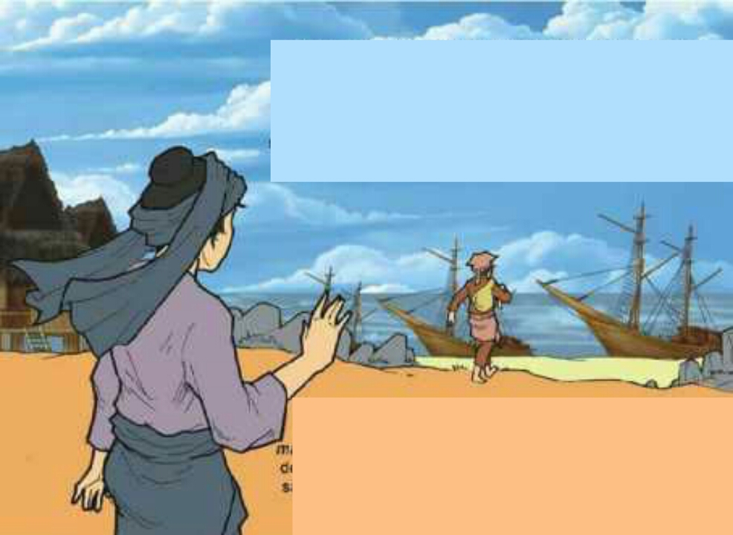
One night, Amat told his plan to his mother and he asked permission to his mother.But his mother did not agree with him. It made Amat sad and always asked that from his mother. Finally his mother blessed him to went.

Slide 5
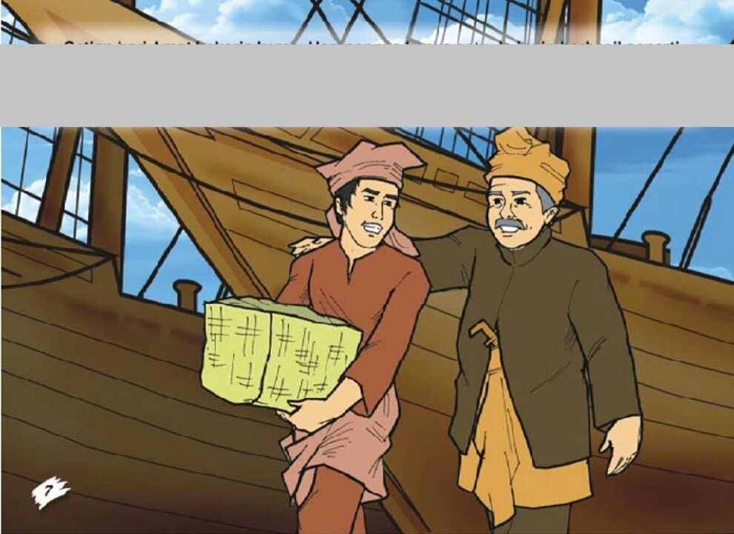
And then Amad went to another side of country. Amat worked with a rich merchant. He worked dilligently and he always pray to the God.

Slide 6
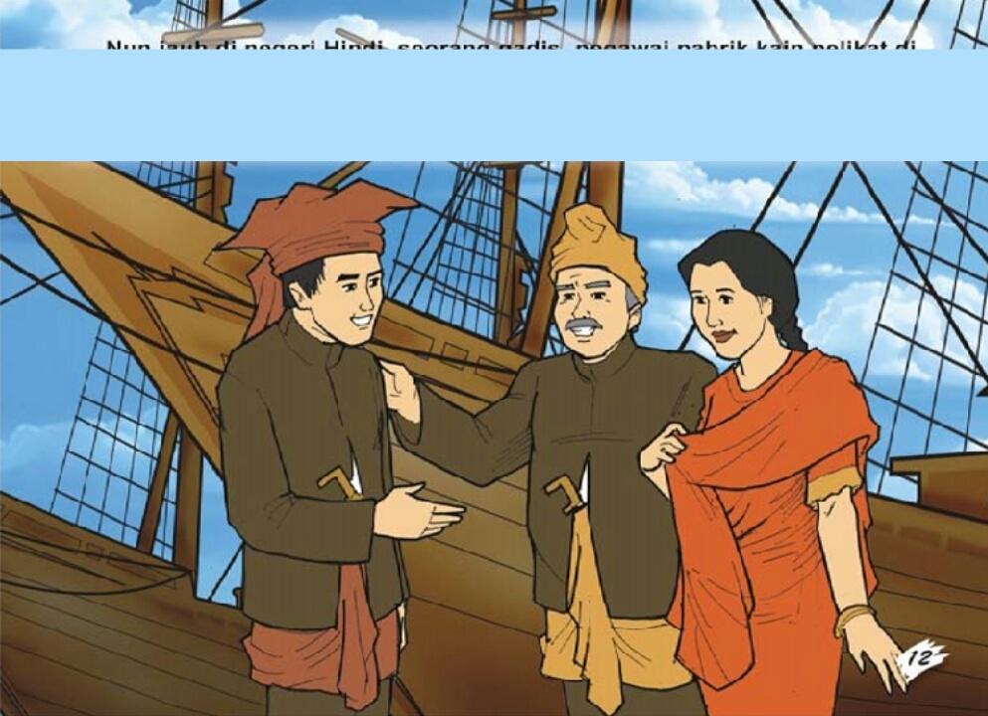
Some years later, Amat was be a rich people and married with rich merchant’s daughter. He was manage all of property his parent in law. Now, he forget to pray. One day his wife asked to him for meet with his parent. After that, Amat went to his born country with a luxurious ship.

Slide 7
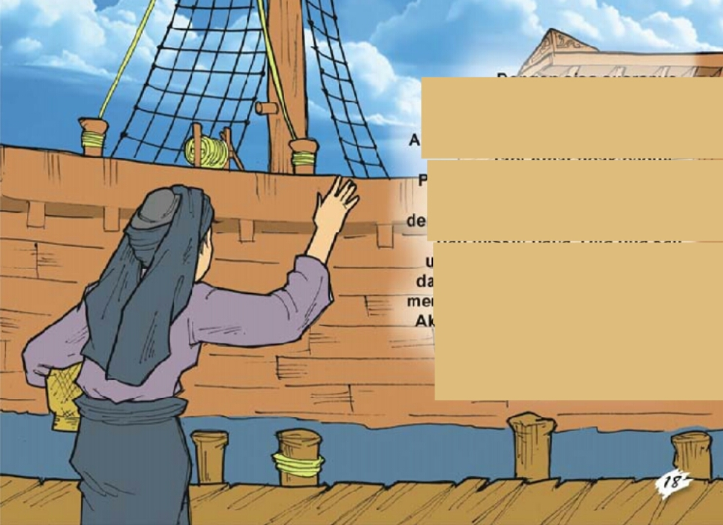
When arrived in the born country. Amat go down from the ship his mother hear about Amat come back.

Slide 8
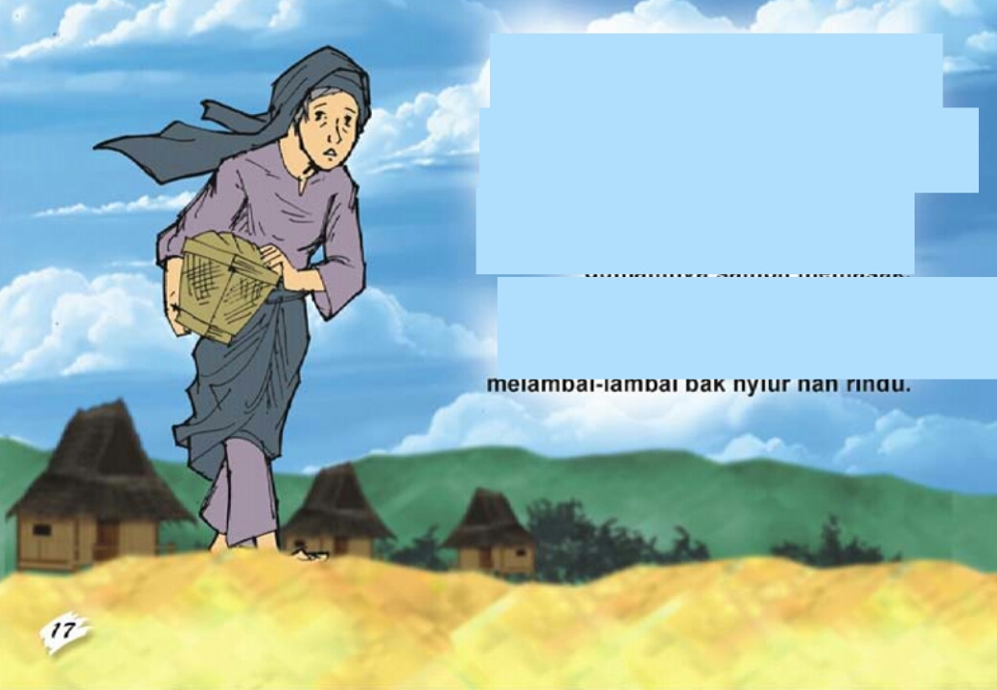
And immediately went to beach, she doesn’t forgot to bring Amat’s favorite food.

Slide 9
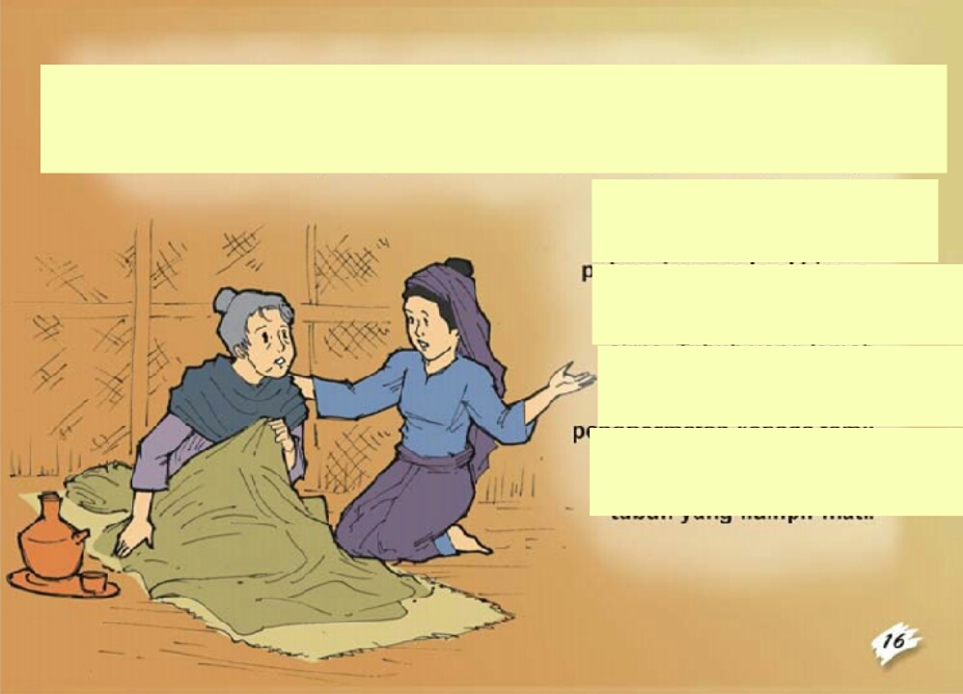
Arrived at the beach , she called Amat and Said Amat was her son. But Amat want not to admit that woman was his mother. Because he was shy to his wife, if is mother was a poor grand mother and Amat order his worker to dray that woman from in front of Amat. Then her mother Said “ ya Allah if that true a man in front of me, Amat my son so curse him and his wealthbe stone...”

Slide 10
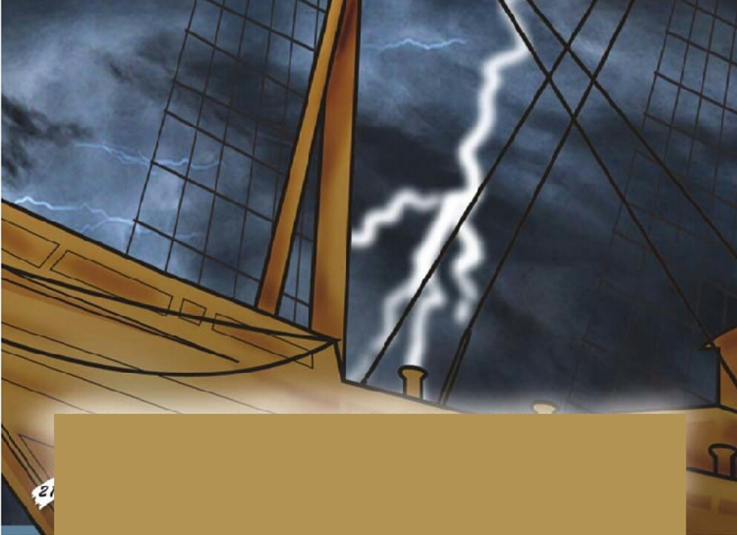
Then hurricance, thunderboit and swoop down...
Amat and wealth to change be stone.

Slide 11
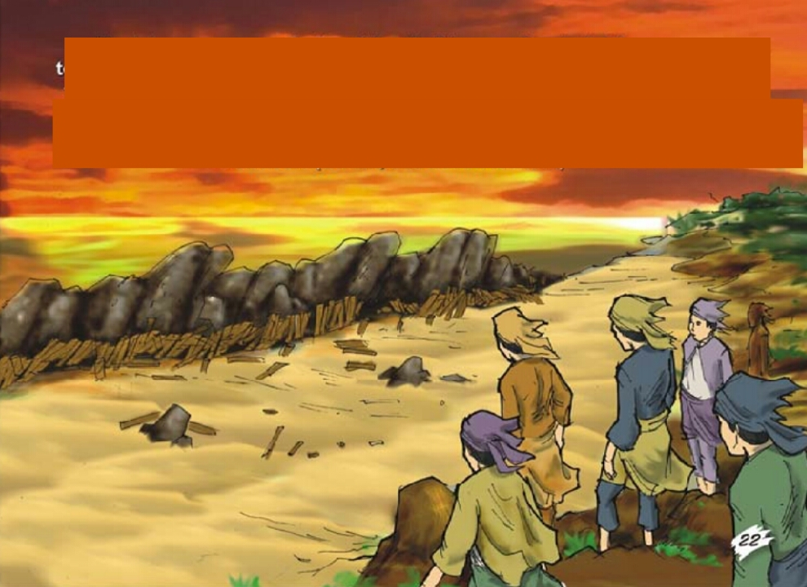
THANKS FOR
YOUR
ATTENTION

