Slide 1
AUTOBIOGRAPHY & AUTOETHNOGRAPHY
CASAE Webinar
June 16, 2020
Shauna Butterwick shaunab@mail.ubc.ca
Virginia Rego: virginia.rego1@gmail.com
Gina Buchanan: ghk.buchanan@gmail.com

Slide 2
Thanks for participating everyone & thanks to Jose for hosting & organizing. Stay safe, stay well, stay engaged
Please be in touch if you want more information or to chat:
Shauna Butterwick shaunab@mail.ubc.ca
Virginia Rego: virginia.rego1@gmail.com
Gina Buchanan: ghk.buchanan@gmail.com

Slide 3

Parker Palmer
As educators good teaching cannot be reduced to technique but is rooted in the identity, and integrity, of the teacher (2007, p. 10).
Photo by Kelly Sikkema on Unsplash

Slide 4

Autobiography as Resistance: Black & Indigenous Lives Matter
The Autobiography of Malcolm X
I Know Why the Caged Brid Sings by Maya Angelou
Dreams my Father by Barack Obama
They Call Me Number One by Bev Sellars
Seven Fallen Feathers by Tanya Talaga
Photo: David Thomson

Slide 5
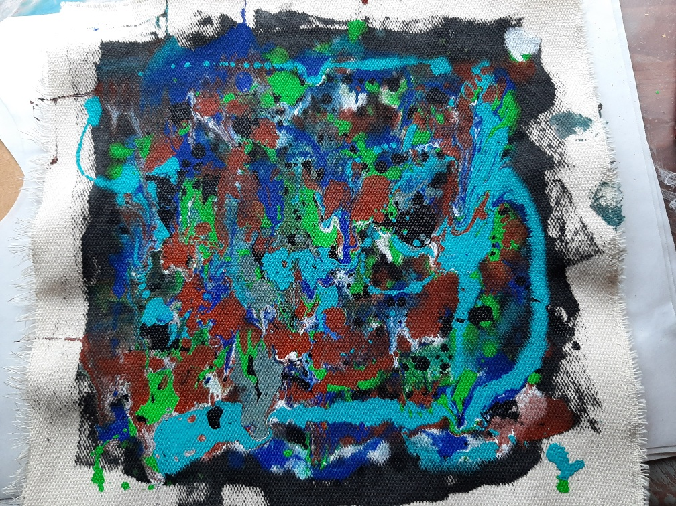
Webinar Plan
Introductions
Questions
Overview
Questions
Gina’s story
Virginia’s story
Questions & Discussion
Wrap Up

Slide 6
What are your questions?

Slide 7
Autobiographical Dissertations in EDST
What’s a mother? … who is my mother? … I use my body as a living archive from which to retrieve fragmentary details from inestimable amounts of data, stored in the conscious and the unconscious. … I construct life stories that combine fictional and non-fictional elements. These stories attest to the truth-value of genetic, autobiographical, topographical, and archival memory as matrices within which to conduct narrative inquiry into one’s origin. It is my aim that reading these stories students, teachers, educational and community leaders will appreciate the generative potential of repressed life memories. (p. ii)
Yvonee Brown (2005) Bodies, memories and empire: Life stories About Growing Up in Jamaica 1943-1965

Slide 8
Graduates’ reflections on autobiography:
I gained a strong personal understanding of the importance of learning Kwak’wala within the context of relationship and real-life experiences, upholding my responsibility as a learner, and honouring the spirit of our language. (p. 230)
Patricia Rosborough (2012) Angex̱tola Sewn-on-top: Kwak’wala revitalization and being Indigenous
I’ve become more courageous perhaps, to stand up and state my belief…(p. 204)
Peter Renner (2001) Vulnerable to possibilities: A journey of self-knowing through personal narrative

Slide 9
Further comments from graduates
Through this study, the value of a memoir was apparent as a way for nurses to reflect on their caring practice and to identify barriers to providing effective care. The memoir proved to be a catalyst for bringing additional resources to support nurses’ caring practice. (p. iii)
Catherine Robinson (2015) Can memoir contribute to a more collaborative approach to treating eating disorders that respects and includes the family?

Slide 10
Defining Autobiography
“…the ‘research text’ is the story, complete (but open) in itself, largely free of academic jargon and abstracted theory. The authors privilege stories over analysis, allowing and encouraging alternative readings and multiple interpretations. They ask their readers to feel the truth of their stories and to become co-participants, engaging the story line morally, emotionally and aesthetically and intellectually.”
(Ellis & Bochner, 2000, p. 745)

Slide 11
More definitions
[Autoethnography] “self-consciously explore[s] the interplay of the introspective, personally engaged self with cultural descriptions mediated through language, history and ethnographic explanation.”
(Ellis & Bochner, 2000, p. 742)

Slide 12
Autoethnography
Autoethnography is an ethnographic inquiry that utilizes the autobiographic materials of the researcher as the primary data. Differing from other self-narrative writings such as autobiography and memoir, autoethnography emphasizes cultural analysis and interpretation of the researcher’s behaviors, thoughts, and experiences in relation to others in society.
(Chang, 2007)

Slide 13
Benefits
accessible & friendly approach for researchers and readers
enhances understanding of self & others
transformative potential for self & others
potential for building coalition (esp across difference)
Chang, 2007

Slide 14
Concerns about autobiographical research:
Isn’t it a selfish and narcicistic pursuit?
  Telling your own story requires that you focus on yourself, however, in the process of narrating it for others to read, it becomes something that is selfless. Vulnerability & truth are required. As Pelias notes (2016) “[it] is simultaneously the most selfish and selfless thing I do”.
How can we tell our own story when others’ stories are always part of our own story?
  We live in relation to and in relationship with others and so our stories implicate others. Our interpretation of events however is our own and so it’s important to make that point clear. As Virginia Rego notes in her dissertation “I do not claim this dissertation to be an account of facts and events. Instead it is the inside story of an average person experiencing mental il’ness” (Rego, 2017, p.4). And Gina Buchanan comments: “I think it is first important to realize that our “own’ story is not only our story … but a story of me through which the stories of others are woven. Sometimes the threads of their stories are visible, but not always, and yet they are there woven into the fabric of mine. And thus, we have to be very careful about how it is that we choose to tell our story.
What about matters of bias?
  Bias is a term often associated with being unaware of how one’s position and social location or geneology has shaped how we experience & understand the world. In self-inquiry research, exploring one’s worldview is precisely the purpose but it also requires that we explore & narrate how that perspective came into being. The narrative of this kind of research should illustrate the effort to narrate the immediacy of our experiences and the process of exploring how the meaning of those events came into being.

Slide 15
More questions about this approach….
How can you find supportive & informed committee members?
  Listen to faculty & assess their openness and experience with this approach. Talk to them to see if they are supportive. Not all academics support nor understand this approach. Ask your peers for advice & suggestions.
How do you structure such a self-inquiry?
  The shape or structure of a thesis or dissertation emerges. Because writing is the methodology, how your story is put together cannot be predetermined. There is a lot of experimenting to create a structure that can work, that can hold your account in a good way. Read other examples and note their shape and structure. But it’s not about copying these examples. Read them for inspiration and to see the wide variety of dissertation & theses shapes.
Do you have to tell your whole life story?
  Absolutely not. It’s a matter of beginning with a question or curiosity that you want to explore how you might respond. Not all of your experiences are about that focus so you need to be selective.

Slide 16
What about the emotional dimension of this approach?
  Gina experienced “ … sadness, grief, resentment, anger. Through these difficulties I leaned on the strength, support and wisdom of my supervisor, the support and encouragement of my best friend. I returned over and over … and over to my intention, my commitment to myself and my determination to model for my daughters. There is the reality of trying, falling, sliding, failing, and beginning again that is so often a part of meaningful change and growth. … And there were also joyful exciting wondrous happy moments. Exquisite moments.”
  And Virginia found that “the emotions … experienced while writing my dissertation were manageable due in part to having a strong support network. This network cannot be understated, and while it may look different for everyone in terms of members or how they provide support, clues as to what those may be are often found in the acknowledgment or dedication pages. Outside of my support network, I also dealt with my emotions through the practice of meditation.

Slide 17
Sourcing & Creating Field Texts (Stories)
(1) Create visual tools e.g. free drawings of significant places, ‘kinsgrams,’ ‘culturegrams;
(2) Inventory people, artifacts, familial & societal values & proverbs
(3) Inventory mentors, cross-cultural experiences, and favorite/disliked activities;
(3) chronicle your educational history, typical day & week, & annual life cycle;
(4) read & respond to other autoethnographies & self-narratives;

Slide 18
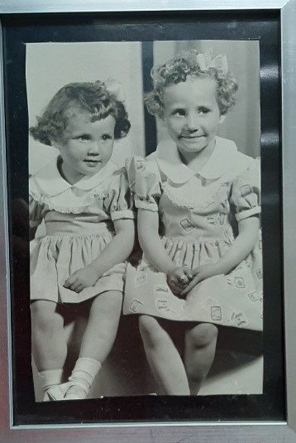
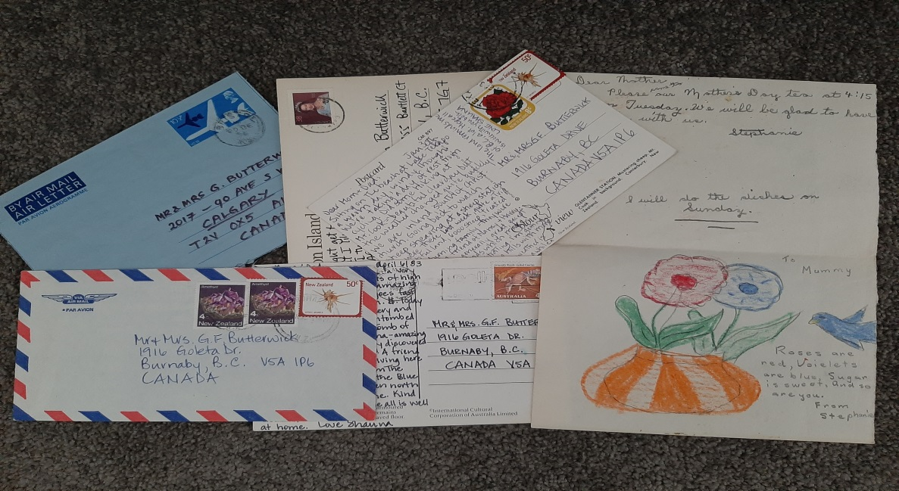
Sourcing other field texts (cont’d_:
Stories about others
Poems
Journals
Letters & conversations
Interviews with significant others
Family stories
Documents & photographs
(Clandenin & Connelly, 2000, p. 101)
Photos: Shauna Butterwick

Slide 19
Writing is the methodology
…writing is not just a mopping-up activity at the end of a research project. Writing is also a way of knowing—a method of discovery and analysis (Richardson, 2000, p. 923).
Photo by Kelly Sikkema on Unsplash

Slide 20
Some books on writing that can help….
Natalie Goldberg: Writing Down the Bones, The True Secret of Writing, Old Friend From Far Away: The Practice of Writing Memoir
Julia Cameron: The Right to Write: An Invitation and Initiation into the Writing Life
Anne Dillard: The Writing Life
Annie Lamott: Bird by Bird: Some Instructions on Writing and on Life
Christina Baldwin: Making Sense of Our Lives Through the Power and Practice of Story

Slide 21
Ethical Concerns & Risks
Vulnerability & exposure
Judgement of others
Process & outcome unknown
Others’ stories within your stories
Gina:
I can see ahead but not around the curve … what assumptions will be made about me from my story? What judgements? Will I be pitied, or scorned, or scoffed?”

Slide 22
Risks & Benefits cont’d
[Autobiography requires] “ordinary courage,” the courage to speak from the heart “honestly and openly about who we are and our experiences, good and bad” (Brown, 2007, p. xxiv).
“I understand that my autobiographical writing will expose me, but I must take the risk if I am to truly understand how my lived experiences have contributed to my development as a teacher” (Godfrey, 2003, p. 15).

Slide 23
Evaluating this approach: Issues of Validity etc
Is the voice authentic and honest; does it ring true?
Does it enable connection and promote insight and interpretation?
Does the narrative attend carefully to persons in context or setting?
Is the motivation to deepen understanding and improve practice?
Does it offer fresh perspectives on established truths?
Adapted from Bullough & Pinnegar (2001, p. 14-18)

Slide 24
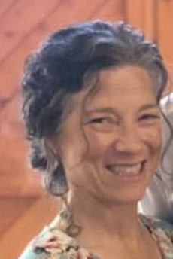
Virginia & Gina’s Experieinces
Virginia Rego
Gina Buchanan

Slide 25
A conversation with Virginia & Gina
How did you find your way to this methodology?
What process of writing did you use?
What was the impact of this research on your life & practice; what were the risks you considered?
What advice would you give to others thinking of using this approach?

Slide 26
Virginia Rego
YOU ARE MY MIRROR: ONE TEACHER’S AUTOBIOGRAPHICAL NARRATIVE INQUIRY INTO MENTAL ILLNESS
“…this dissertation emerged as I, the researcher, examined my own context in relation to who I was as a researcher, and in particular, as an educational researcher, and specifically, as a teacher, and even more specifically, a teacher with mental illness. “

Slide 27
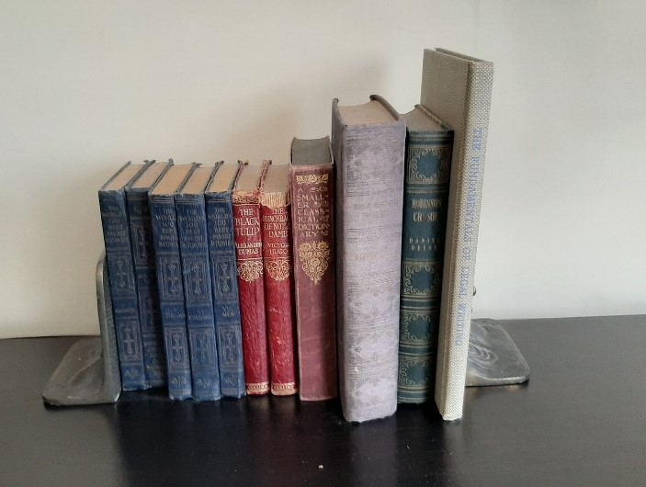
Virginia’s Dissertation Table of Contents:
1. Introduction
  Arriving at a methodology
  Accepting mental illness
2. Attending to Attendance
3. Broken Bones
Home
Kitchen table
Parental factors
4. A Pleasure to have in class
Fixing virginia
Please see me
5. Hell
The invisible battle with bulimia
Script the crazy
Losing myself
6. Conclusion & implications

Slide 28
Reflecting on my pedagogy: An accidental story
Gina Buchanan

Slide 29

The purpose of Gina’s study:
To understand how the experiences of my life, and more specifically, my experiences of schooling, and of education, have informed who I am as a teacher, and how I teach.

Slide 30
Gina’s Dissertation Structure
Part One: The Forward
Part Two: Family and Schooling: In search of belonging
Part Three: The Later Years: Education
Part Four: Just One Day
Part Five: A Legacy of Love: Foundations of Instruction
Part Six: The Pause

Slide 31

Questions and comments
Please post a comment or question in the chat room

Slide 32
In closing: A few thoughts….
Virginia
What’s your voice? There is only one you & only you can tell this particular story.
Researchers “show up" in this methodology to a greater degree than other approaches.
So show up, but within your comfort zone; it is your story.
Shauna
Your story is unique & important and can help to illuminate the practice of AE.
Documenting who you are in relation to your research, must be part of the research.

Slide 33
Links to UBC Autobiographical Dissertations (a few)
Yvonne Brown: http://hdl.handle.net/2429/16958
Valerie Lee Chapman: https://open.library.ubc.ca/cIRcle/collections/ubctheses/831/items/1.0055598
Nadine Fabbi: http://hdl.handle.net/2429/52691
Emi Garzitto: https://open.library.ubc.ca/cIRcle/collections/ubctheses/831/items/1.0054762
Fiona Lee: https://open.library.ubc.ca/cIRcle/collections/ubctheses/24/items/1.0055845
Virginia Rego: http://hdl.handle.net/2429/62570
Peter Renner: http://hdl.handle.net/2429/13270
Cathy Robinson: http://hdl.handle.net/2429/52347
Trish Rossborough: http://hdl.handle.net/2429/42965

Slide 34
References in slides
Brown, B. (2007). I thought it was just me: Making the journey from “what will people think?” to “I am enough.” New York, NY: Gotham Books.
Bullough, R. & Pinnegar, S. (2001). Guidelines for quality in autobiographical forms of self-study research. Educational Researcher, 30 (3), 13-21
Chang, Hl (2007). Autoethnography: Raising cultural consciousness of self and others. In R. Jeffrey & G. Troman (Eds). Methodological Developments in Ethnography (pp. 207-221). Emerald Group. https://doi.org/10.1016/S1529-210X(06)12012-4Chang
Clandinin, D. J., & Connelly, F. M. (2000). Narrative inquiry: Experience and story in qualitative research. San Francisco, CA: Jossey-Bass.
Ellis, C., & Bochner, A. P. (2000). Autoethnography, personal narrative, and personal reflexivity. In N. Denzin & Y. Lincoln (Eds), Handbook of qualitative research, (2nd ed.). Thousand Oaks, CA: Sage.
Godfrey, T. (2003). Writing in the critical spaces: Autobiographical narrative and reflective practice (Master’s Theses and Projects, University of Lethbridge). Retrieved from https://opus.uleth.ca/bitstream/handle/10133/895/Godfrey_Tracy.pdf
Pelias, R. (2000). The critical life. Communication Education, 49, 220-228.
Richardson, L. (2000) Writing – A method of inquiry. In N. Denzin & Y L Lincoln (Eds.) Handbook of Qualitative Research, Second Edition (pp.923-945). Thousand Oaks, CA: Sage Publications.

