Slide 1
Membrane Transport
Felix Bast

Slide 2
Transport across membranes
Nutrients in and waste out
Specific ion gradients
Signals relayed
Mediated by membrane proteins

Slide 3
Membrane transport
Soluble
Soluble
Notes:
Ions and large uncharged polar molecules need proteins to assist and regulate transport.
Diffusion – tendency of molecules of any substance to spread out in available space. Movement is driven by the intrinsic kinetic energy of molecules. Movement is random but movement of a population of molecules may be directional (down its concentration gradient).
Diffusion can be across a permeable membrane as well – will continue until a dynamic equilibrium is established. Across a biological membrane – passive transport. However, because membranes are selectively permeable, the interactions of the molecules with the membrane play a role in the diffusion rate. Diffusion of molecules with liumited permeability through a bilayer may be assisted by transported proteins.
Osmosis – movement of water.

Slide 4
Membrane Transport
This discussion aims to introduce basic concepts, while focusing in depth on a few selected examples of transport catalysts for which structure/function relationships are relatively well understood.
Transport proteins are of two general classes:
  Transporters (carrier-proteins) and channels.
These are exemplified by two ionophores (ion carriers produced by microorganisms):
  valinomycin (a carrier)
  gramicidin (a channel).

Slide 5
Membrane transport
Exocytosis
  Constitutive
  Regulated
Endocytosis
  Preferentially at clathrin-coated pits
Phagocytosis/pinocytosis
Small solute movement
  Simple diffusion
    Across lipid membrane
    Through pores
    Through ion channels
  Carrier-mediated
Exocytosis
Endocytosis

Slide 6
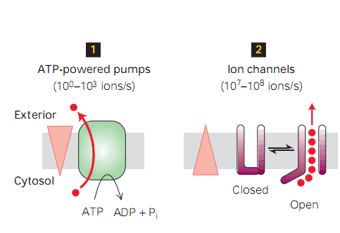
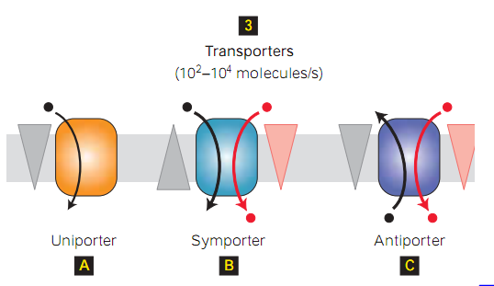
Membrane transport proteins

Slide 7
Transport phenomena
Active transport: ATP hydrolysis and transport of solute against its concentration gradient takes place
Facilitated diffusion (passive transport): Transport protein assists movement of specific substrate down its concentration gradient
Cotransport (secondary active transport): one substrate down the gradient; another against. Symporter/Antiporter

Slide 8
If transported substrate is charged, transport is affected by
  Concentration gradient (chemical gradient)
  Membrane potential-voltage across the membrane (electrical gradient)
Electrochemical gradient

Slide 9
Simple diffusion
Spontaneous, down the concentration gradient
Depend on hydrophobicity – measured by partition coefficient (K)
Higher K, higher hydrophobicity, faster diffusion rate
  Diethyl urea K = 0.01 diffuses 50 times faster
  Urea K = 0.0002

Slide 10
Carrier-mediated membrane transport
Carriers exhibit saturation kinetics with respect to solute concentration.
Carriers exhibit stereospecificity.
  Glucose carrier transports D-glucose but not L-glucose.
Carriers are susceptible to inhibition.
Carrier rates are susceptible to hormonal control (although channels may be as well).
  Influence of insulin on the glucose transporter
  Influence of aldosterone on the Na-K transporter (NaK-pump).
Notes:
Saturation kinetics – sigmoid curve ala enzyme kinetics; carriers catalyze a physical process

Slide 11
Kinetics of transport carriers
Carriers exhibit Michaelis-Menten kinetics.
The transport rate mediated by carriers is faster than in the absence of a catalyst, but slower than with channels.
A carrier transports only one or few solute molecules per conformational cycle.

Slide 12
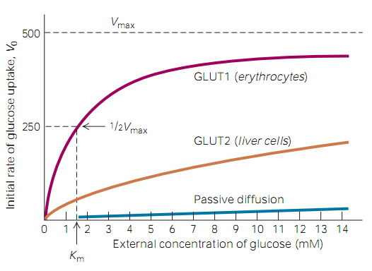
Cellular uptake of glucose by GLUT proteins
K_{m}= substrate concentration at which the reaction rate reaches its half-maximum value (V_{max}/2).

Slide 13
Energetics of carrier-mediated transport
Diffusion
Passive transport (facilitated diffusion)
  No metabolic energy required.
  Solute moves down a gradient of electrochemical potential in combination with a carrier.
  K_{m} is the same on the two sides of membrane.
  Example - glucose transport in most cells.
Notes:
Transport of water is facilitated via water channel proteins, aquaporins, which mediate massive amounts of diffusion of water.

Slide 14
Carrier proteins
Proteins that act as carriers are too large to move across the membrane.
They are transmembrane proteins, with fixed topology.
Example: GLUT1 glucose transporter (carrier), found in plasma membranes of various cells, including erythrocytes.
GLUT1 is a large integral protein, predicted via hydropathy plots to have 12 transmembrane α-helices.

Slide 15
Carrier proteins cycle between conformations in which a solute binding site is accessible on one side of the membrane or the other.
There may be an intermediate conformation in which a bound substrate is inaccessible to either aqueous phase.
With carrier proteins, there is never an open channel all the way through the membrane.

Slide 16
Classes of carrier proteins
Uniport (facilitated diffusion) carriers mediate transport of a single solute.
Examples include GLUT1, Aquaporins and valinomycin.
These carriers can undergo the conformational change associated with solute transfer either empty or with bound substrate. Thus they can mediate net solute transport.

Slide 17
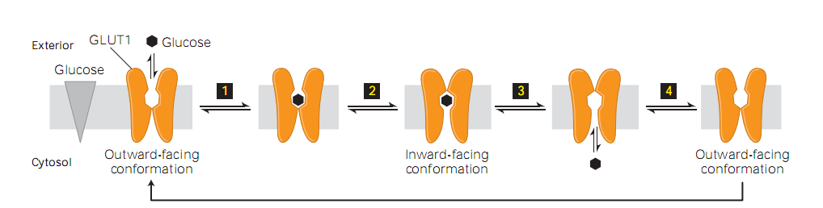
GLUT1 uniport model
All GLUT family proteins have similar structures; but different Km values, expression in different cell types and substrate specificities

Slide 18
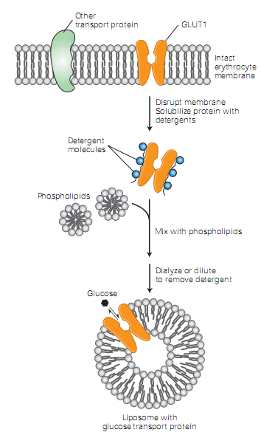
Experimental systems to study functions of carrier proteins
Liposomes containing a purified transport proteins
Cells transfected with genes encoding particular transport protein

Slide 19
Osmosis
Osmosis-”diffusion” of water
  Osmotic pressure-hydrostatic pressure required to stop water inflow.
  Directly proportional to difference in solute concentrations
  Van’t Hoff’s equation ∏ = RT (C_{B}-C_{A})
    R Gas constant, T Absolute Temperature
    8.3144621 J K ⁻¹ mol⁻¹

Slide 20
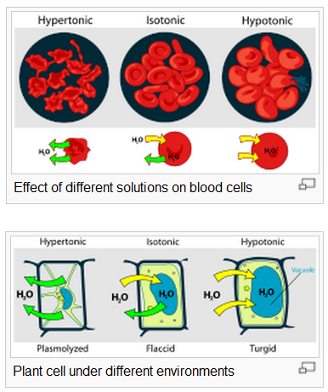

Slide 21
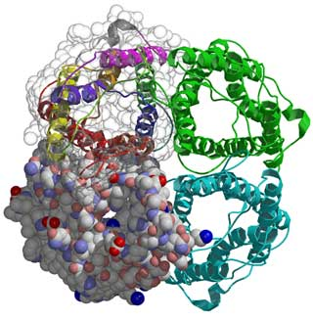
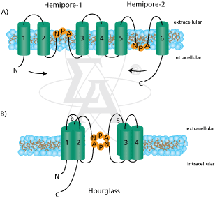
Aquaporins
Family of membrane proteins that allows water and glycerol to cross the membrane
2nm water pore
Two asparagine, arginine and histidine residies

Slide 22
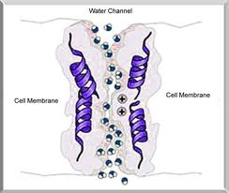
Aquaporins
Aquaporin 2 is involved with resorption of water in kidney cells, regulated by vasopressin (ADH); mutations in AQP2 or Vasopressin genes leads to Nephrogenic Diabetes insipidus

Slide 23
Aquaporins
AQP2 gene expression is more during pregnancy and congestive heart failure -> increased water resorption
Lithium administered to treat bipolar disorder can decrease expression of AQP2 gene -> decreased water resorption -> acquired DI

Slide 24
Valinomycin is a carrier for K⁺.
Valinomycin reversibly binds a single K⁺ ion.
Notes:
Valinomycin is a carrier for K⁺.
It is a circular molecule, made up of 3 repeats of the sequence shown above.

Slide 25
Valinomycin is highly selective for K⁺ over Na⁺.
Why???
Notes:
The ring puckers to closely surround the K⁺ ion, which interacts with 6 oxygen atoms of valinomycin.
Valinomycin is highly selective for K⁺ over Na⁺.
The smaller Na⁺ ion cannot simultaneously interact with all 6 oxygen atoms within valinomycin. Thus it is energetically less favorable for Na⁺ to shed its water of hydration to form a complex with this ionophore.
Whereas the interior of the valinomycin-K⁺ complex is polar, the surface of the complex is hydrophobic.
Valinomycin enters the lipid core of the bilayer and solubilizes K⁺ within this hydrophobic milieu.

Slide 26
Notes:
Valinomycin is a passive carrier for K⁺. It can bind or release K⁺ when it encounters the membrane surface.
Valinomycin can catalyze net K⁺ transport because it can translocated either in the complexed or uncomplexed state.
The direction of net flux depends on the electrochemical K⁺ gradient.

Slide 27
Symport (cotransport) carriers bind 2 dissimilar solutes (substrates) & transport them together across a membrane. Transport of the 2 solutes is obligatorily coupled.
An example is the plasma membrane Glucose-Na⁺ symport.
A gradient of one substrate, usually an ion, may drive uphill (against the gradient) transport of a co-substrate.

Slide 28
Trans-epithelial transport:
In the example shown, 3 carrier proteins accomplish absorption of glucose & Na⁺ in the small intestine.
Notes:
Trans-epithelial transport:
In the example shown, 3 carrier proteins accomplish absorption of glucose & Na⁺ in the small intestine.
This transport across a cell layer depends on localization of specific plasma membrane transporters at either the apical end of each epithelial cell (facing the intestinal lumen) or the basal end (facing a blood capillary).

Slide 29
The Na⁺ pump, at the basal end of the cell, keeps [Na⁺] lower in the cell than in fluid bathing the apical surface.
The Na⁺ gradient drives uphill transport of glucose into the cell at the apical end, via Glucose-Na⁺ symport. [Glucose] within the cell is thus higher than outside.
Glucose flows passively out of the cell at the basal end, down its gradient, via GLUT2 (uniport related to GLUT1).

Slide 30
Antiport (exchange diffusion) carriers exchange one solute for another across a membrane.
Example: ADP/ATP exchanger (adenine nucleotide translocase) which catalyzes 1:1 exchange of ADP for ATP across the inner mitochondrial membrane.
Usually antiporters exhibit "ping pong" kinetics. One substrate is transported across a membrane and then another is carried back.

Slide 31
Active transport enzymes couple net solute movement across a membrane to ATP hydrolysis.
An active transport pump may be a uniporter, or it may be an antiporter that catalyzes ATP-dependent transport of 2 solutes in opposite directions.
ATP-dependent ion pumps are grouped into classes, based on transport mechanism, genetic & structural homology.

Slide 32
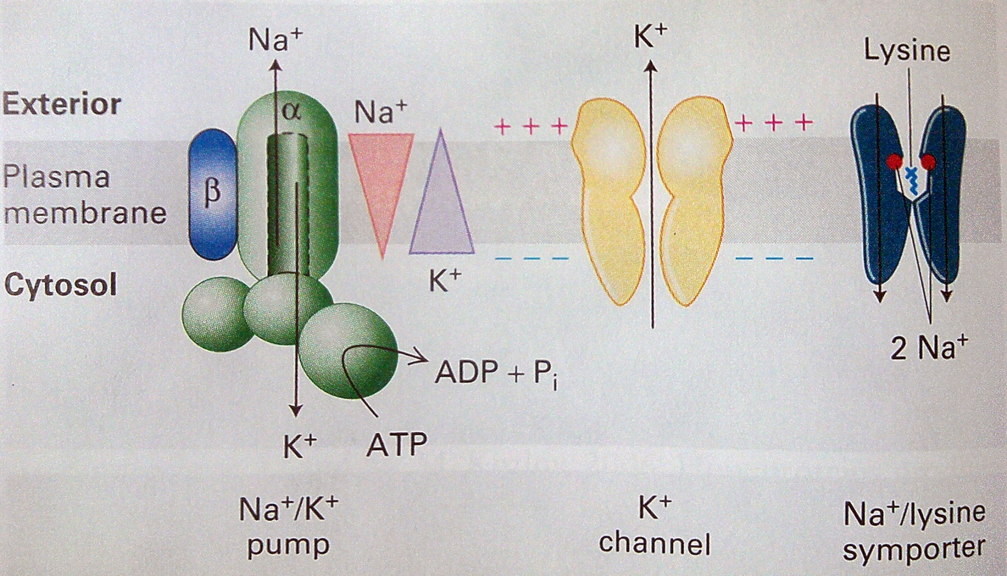
Multiple transport proteins function in a cascade

Slide 33
Energetics of active transport
Active transport
  Metabolic energy expenditure is required.
  Solute moves against a gradient of electrochemical potential.
  Assymetrical K_{m} for carrier loading. K_{m} is generally higher on that side of the membrane toward which active transport occurs.

Slide 34
Types of active transport
Primary
  The transport system is an ATPase. The energy for transport comes directly from ATP. Some cation transport systems fall into this category. The NaK-pump is the prime example.
Secondary
  The transport system utilizes the Na⁺ electrochemical gradient as an energy source to move a solute against its electrochemical gradient. Na⁺ is transported down its electrochemical gradient in the process. This is also referred to an Na-coupled or gradient-coupled transport.

Slide 35
Classes of ATP powered transport
P-Class pumps (catalyze auto-Phosphorylation of aspartate residue)
V-class pumps (Vacuolar)
F-class pumps (F_{O}-F₁ ATPase)
ABC Super family

Slide 36
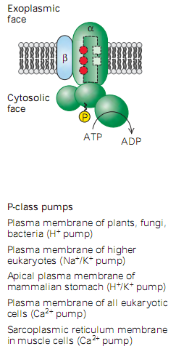
P-class pumps

Slide 37
P-class ion pumps
P-class ion pumps are a gene family exhibiting sequence homology. They include:
  Na⁺/K⁺-ATPase, in plasma membranes of most animal cells, is an antiport pump.
  Gradients for Na+ and K+ needed for action potentials & synaptic potentials
  Inhibited by cardiac glycosides, ischaemia, metabolic inhibitors and heavy metals
Notes:
Typically, an animal cell has a higher [K+] and lower [Na+] inside the cell.
Three Na+ ions in THEN 2 K+ out.

Slide 38
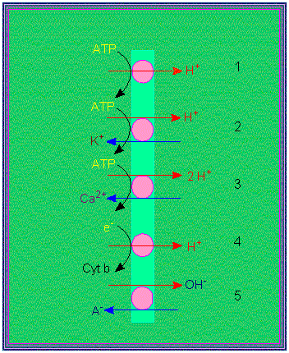
P-class pumps
(H⁺, K⁺)-ATPase, involved in acid secretion in the stomach, is an antiport pump.
  It catalyzes transport of H⁺ out of the gastric parietal cell (toward the stomach lumen) in exchange for K⁺ entering the cell.
Notes:
In plants, bacteria and fungi, a proton pump is the major electrogenic pump, actively transporting H+ out of the cell.
Proton pumps in the cristae of the mitochondria and thylakoids of chloroplasts, concentrate H+ behind membranes. These electrogenic pumps store energy that can be accessed for cellular work.
Plants commonly use the gradient of H+ ions that is generated by proton pumps to drive the active transport of aminoacids, sugars and other nutrients into the cell.
The high concentration of H+ on one side of the membrane leads to the facilitated diffusion of protons back, but only if another molecule, like sucrose, travels with the hydrogen ion.
Proton pumps: 1. electrogenic pump, 2. electro-neutral pump, 3. electro-neutral pump with calcium as its counterion, 4. electrogenic proton transport, 5. electro-neutral anion / OH antiport

Slide 39
P-class pumps
Ca⁺⁺-ATPase pump, in endoplasmic reticulum (ER) & plasma membranes catalyze transport of Ca⁺⁺ away from the cytosol, either into the ER lumen or out of the cell.
  There is some evidence that H⁺ may be transported in the opposite direction.
  Ca⁺⁺-ATPase pumps keep cytosolic Ca⁺⁺ low (10⁻⁷M vs. 10⁻³ M in plasma), allowing Ca⁺⁺ to serve as a signal.

Slide 40
The reaction mechanism for a P-class ion pump involves transient covalent modification of the enzyme.
At one stage of the reaction cycle, P_{i} is transferred from ATP to the carboxyl of a Glu or Asp residue, forming a “high energy” anhydride linkage (~P).
At a later stage in the reaction cycle, the phosphate is released by hydrolysis.
Notes:
At one stage of the reaction cycle, P_{i} is transferred from ATP to the carboxyl of a Glu or Asp residue, forming a “high energy” anhydride linkage (~P).
At a later stage in the reaction cycle, the phosphate is released by hydrolysis.

Slide 41
The ER Ca⁺⁺ pump is called SERCA:
Sarco(Endo)plasmic Reticulum Ca⁺⁺-ATPase.
Notes:
In this diagram of the SERCA reaction cycle, conformational changes altering accessibility of Ca⁺⁺-binding sites to the cytosol or ER lumen are depicted as positional changes. Keep in mind that SERCA is a large protein that maintains its transmembrane orientation.
Reaction cycle:
1. 2Ca⁺⁺ bind tightly from the cytosolic side, stabilizing a conformation that allows ATP to react with an active site aspartate residue.
2. Phosphorylation of the active site aspartate induces a conformational change that shifts accessibility of the 2 Ca⁺⁺ binding sites from one side of the membrane to the other, & lowers the affinity of the binding sites for Ca⁺⁺.
3. Ca⁺⁺ dissociates into the ER lumen.
4. Ca⁺⁺ dissociation promotes hydrolysis of P_{i} from the enzyme Asp and the conformational change (recovery) that causes the Ca⁺⁺ binding sites to be accessible again from the cytosol.

Slide 42
The structure of muscle SERCA, determined by X-ray crystallography, shows 2Ca⁺⁺ bound between transmembrane α-helices.
These intramembrane Ca⁺⁺ binding sites are presumed to participate in Ca⁺⁺ transfer across the membrane.

Slide 43
Observed changes in rotation and tilt of transmembrane α-helices may be involved in altering access of Ca⁺⁺ binding sites to one side of the membrane or the other, and the change in affinity of binding sites for Ca⁺⁺, at different stages of the SERCA reaction cycle.
Only 2 transmembrane α-helices are represented above.

Slide 44
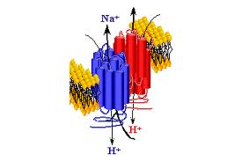
Na+/H+ antiporter
Na+/H+ antiport in extreme halophile algae Dunaliella salina plays a major role in maintaining low intracellular Na⁺ concentrations

Slide 45
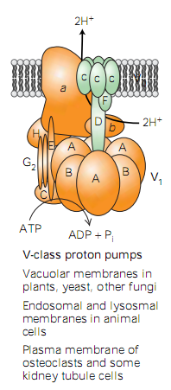
V-class proton pump

Slide 46
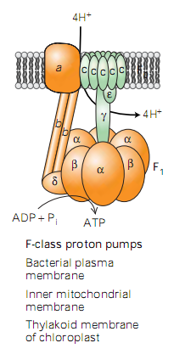
F-class proton pumps

Slide 47
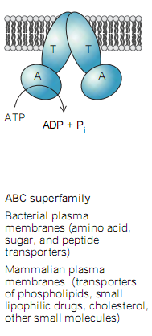
ABC Superfamily

Slide 48
Ion Channels
Notes:
Channels cycle between open & closed conformations.
When open, a channel provides a continuous pathway through the bilayer.
Whereas carriers transport only one or a few ions or molecules per conformational cycle, many ions flow through a channel, each time it opens. Thus transport rates are higher for channels than for carriers.

Slide 49
Gramicidin channels
Gramicidin acts as a channel. It is an unusual peptide, with alternating D & L amino acids.
The primary structure of gramicidin (A) is:
HCO-L-Val-Gly-L-Ala-D-Leu-L-Ala-D-Val-L-Val-D-Val-L-Trp- D-Leu-L-Trp-D-Leu-L-Trp-D-Leu-L-Trp-NHCH₂CH₂OH
Notes:
In lipid bilayer membranes, gramicidin dimerizes & folds as a right-handed β-helix that just spans the bilayer.
Gramicidin can assume other conformations in organic solvents, including double helical structures. Note: amino acids are all hydrophobic; D & L amino acids alternate; both ends of the peptide are modified (blocked).

Slide 50
Gramicidin channels
Notes:
The outer surface of the gramicidin dimer, which interacts with the core of the lipid bilayer, is hydrophobic.
Ions pass through the more polar lumen of the helix.
Gramicidin channel activity can be observed, if a small number of gramicidin molecules is present in a lipid bilayer separating 2 compartments containing salt solutions.
With voltage clamped at some value, current (ion flow through the membrane) fluctuates. Each fluctuation, attributed to opening or closing of one channel, is the same magnitude. The current increment corresponds to current flow through a single channel (drawing - not actual data).

Slide 51
Notes:
Gating (opening & closing) of a gramicidin channel is thought to involve reversible dimerization. An open channel forms when two gramicidin molecules join end to end to span the membrane. This model is consistent with the finding that at high [gramicidin] overall transport rate depends on [gramicidin]².

Slide 52
Channels that are proteins
Cellular channels usually consist of large protein complexes with multiple transmembrane α-helices. Their gating mechanisms must differ from that of gramicidin.
Control of channel gating is a form of allosteric regulation. Conformational changes associated with channel opening may be regulated by:
  Voltage
  Binding of a ligand (a regulatory molecule)
  Membrane stretch (via link to cytoskeleton)
Notes:
All cells maintain a voltage across the plasmamembrane.
Membrane potential: -50 to –200 mV favours passive transport of cations into the cell and anions out of the cell → electrochemical gradient.

Slide 53
Patch Clamping
The technique of patch clamping is used to study ion channel activity.
A narrow bore micropipette is pushed up against a cell or vesicle, and then pulled back, capturing a fragment of membrane across the pipette tip.

Slide 54
Patch Clamping
A voltage is imposed between an electrode inside the patch pipette and a reference electrode in contact with surrounding solution. Current is carried by ions flowing through the membrane.

Slide 55
If a membrane patch contains a single channel with 2 conformational states, the current will fluctuate between 2 levels as the channel opens and closes.
The increment in current between open & closed states reflects the rate of ion flux through one channel.

Slide 56
Patch clamp recording at −60 mV.
Notes:
Consecutive traces are shown. Note that at a negative voltage, increased current is a downward deflection.

