Slide 1
Enzymes
BS-602
Dr. Felix Bast
Central University of Punjab
http://sites.google.com/site/felixbast/classnotes
Molecular Cell Biology, 6th edition, 2008.
Lodish • Berk • Kaiser • Krieger • Scott • Bretscher •Ploegh • Matsudaira

Slide 2
What is a catalyst?
Speed up time for reaction to reach equilibrium
Lowers activation energy
Energy
Energy
Transition state
New
transition
state
Act.
energy
Act.
energy
Starting
material
Starting
material
∆G
∆G
Product
Product
WITHOUT CATALYST
WITH CATALYST

Slide 3
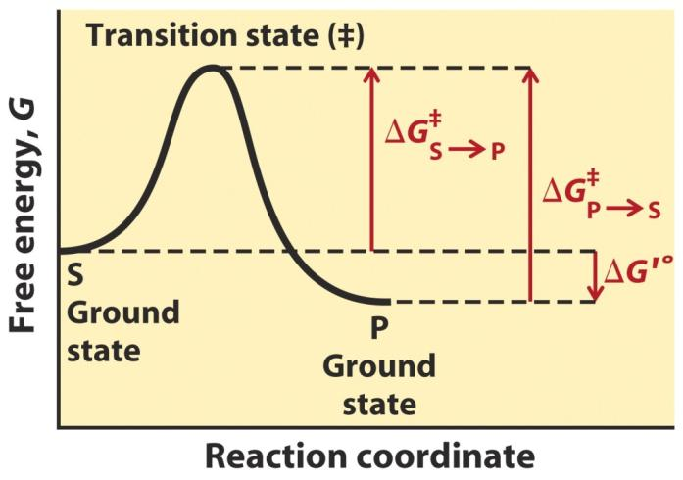
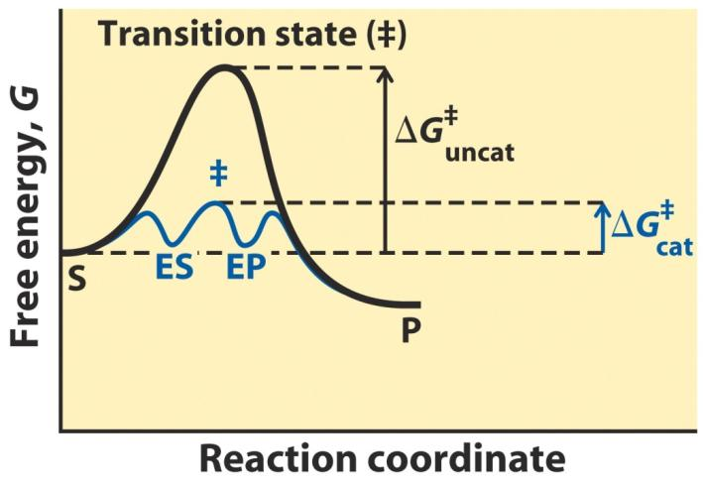
Enzymes as Catalysts

Slide 4
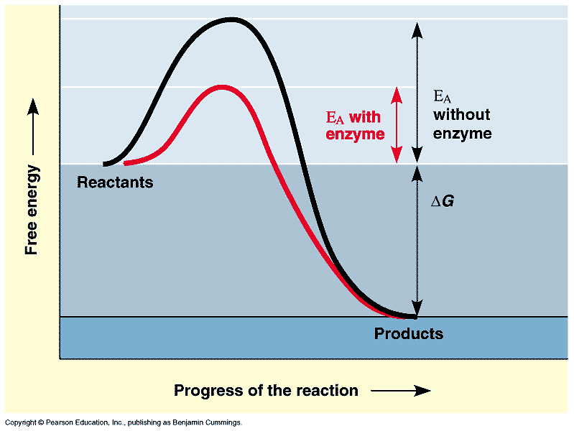
Lowering of Activation Energy

Slide 5
Definitions:
Enzymes are biological catalysts.
Catalysts are chemical agents that changes the rate of a reaction without being consumed.

Slide 6
Enzymes
Most are Proteins (generally a globular structure).
Enormous Catalytic Power
Effective in Small Amounts
Highly Specific (1 enzyme to 1 reaction; based on protein 3-D structure)
Unstable/Short-lived

Slide 7
Enzymes speed the rate of a reaction by lowering the activation energy.(They make the substrate molecules more likely to react.)
Activation Energy is the initial investment of energy needed to start a reaction. If this barrier is not overcome, the reaction will not proceed or will proceed slowly.

Slide 8
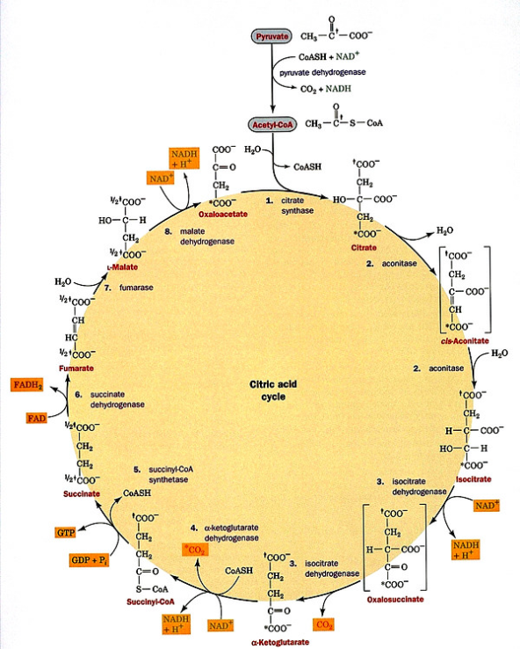
What is an enzyme?
Globular proteins acting as the body’s catalysts
Nomenclature:
  Root + ase
Classification
  Oxidoreductases
  Transferases
  Hydrolases
  Lyases
  Isomerases
  Ligases/synthetases
E.C. Numbers

Slide 9
E.C. numbering system is hierarchical
EC 3 Hydrolase
EC 3.4 Peptidase
EC 3.4.11 Aminopeptidase

Slide 10
High-level numbers
Oxido-reductases- involved in electron transfer
Oxidize- loose an electron (LEO)
Reduce- gain an electron (GER)
Transferases- transfer functional groups
Hydrolases- split a molecule and add H+ or OH-
Lyase- Elimination (adds double bonds)
Isomerase- promotes rearrangement (change isomers)
Ligase- formation of bonds (joins 2 substrates together)

Slide 11
Examples of enzyme classes
Oxidoreductase Peroxidase
Transferase DNA Polymerase, Kinase
Hydrolases Trypsin
Lyases RUBISCO
Isomerase Topoisomerase
Ligase DNA Ligase

Slide 12
Types of Enzymes
A ➔ B Isomerase
A ➔ B + C Lyase
A + B ➔ C Ligase
A + B ➔ C + D Oxido-reductase, Transferase,
Hydrolyase

Slide 13
Methods of catalysis
H
2
C
H
2
C
H
2
C
H
3
C
H
3
P
d
,
P
t
,
N
i
Provide a reaction surface/suitable environment
Bring reactants together
Position reactants correctly for reaction
Weaken bonds in the reactants
H
H
CH₂
CH₂
H
H
Surface
Metal

Slide 14
Enzymes as catalysts
Provide a reaction surface (the active site)
Provide a suitable environment (hydrophobic)
Bring reactants together
Position reactants correctly for reaction
Weaken bonds in the reactants
Provide acid / base catalysis
Provide nucleophiles

Slide 15
An example reaction:
Reduction of pyruvate to lactate
Homolactic fermentation
LDH = Lactate dehydrogenase (enzyme)
NADH = reducing agent & coenzyme
Pyruvic acid = substrate
O
H
O
H
C
O
LDH
C
O
N
A
D
H + H⁺
+
H
3
C
C
H
C
C
+
N
A
D
+
3
O
H
O
H
Pyruvic acid
Lactic acid

Slide 16
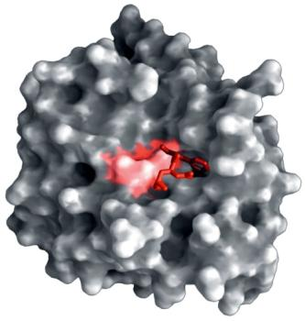
The active site
Hydrophobic hollow or groove on the enzyme surface
Accepts reactants (substrates and coenzymes)
Contains amino acids which
  bind reactants (substrates and coenzymes)
  catalyze the reaction
Active site
Active site
ENZYME
chymotrpysin

Slide 17
Cofactors
Sometimes enzymes require a coenzyme/cofactor.
These are simple non-protein molecules or ions that work with an enzyme, usually as an electron donor or acceptor.
(often metal ions)
They can be permanently bound to the active site or loosely bound to the substrate during catalysis

Slide 18
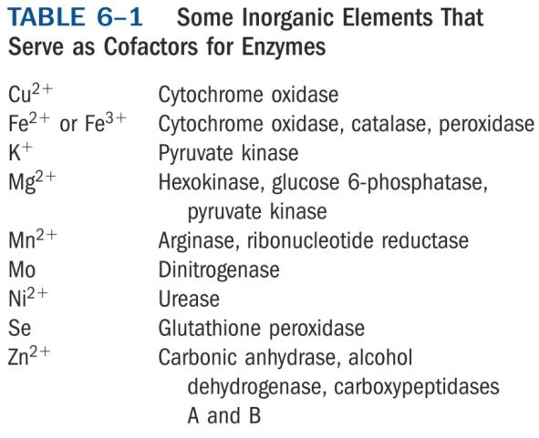
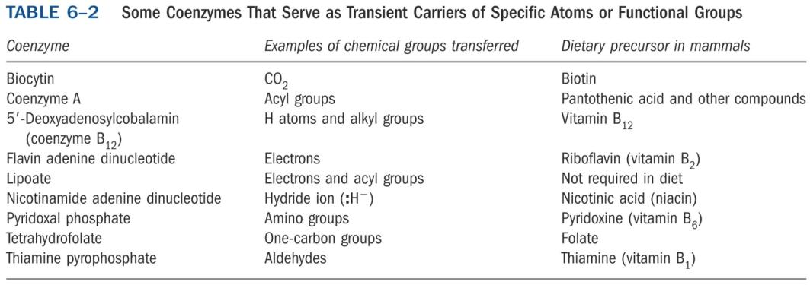
Cofactors/Coenzymes

Slide 19
MECHANISM OF REACTIONS:
The 3° structure defines the active site where the substrate will fit.
E + S ES E + P
(intermediate)
***S denotes the substrate(s) of the reaction
***P denotes the product(s) of the reaction

Slide 20
Enzyme catalysis
S
P
S
P
E
E
E
E
E
E + S
ES
EP
E + P
Binding interactions:
  strong enough to hold the substrate sufficiently long for the reaction to occur
  weak enough to allow the product to depart
Drug design:
  designing molecules with stronger binding interactions results in enzyme inhibitors which block the active site

Slide 21
Types of Fits
Lock and key- substrate fits enzyme perfectly
Induced fit- binding of the substrate causes a conformational change in the enzyme (substrate has to wiggle to get in)
Absolute specificity- specific substrate for a specific target
Group specificity- Specific for a group of substrates with similar "shapes"
Types of specificity

Slide 22
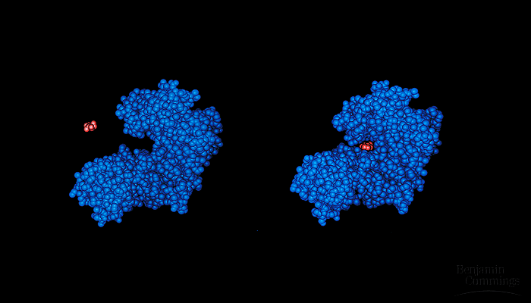
Lock and Key-Molecular complimentarity
Proposed first by Emil Fischer, 1894

Slide 23
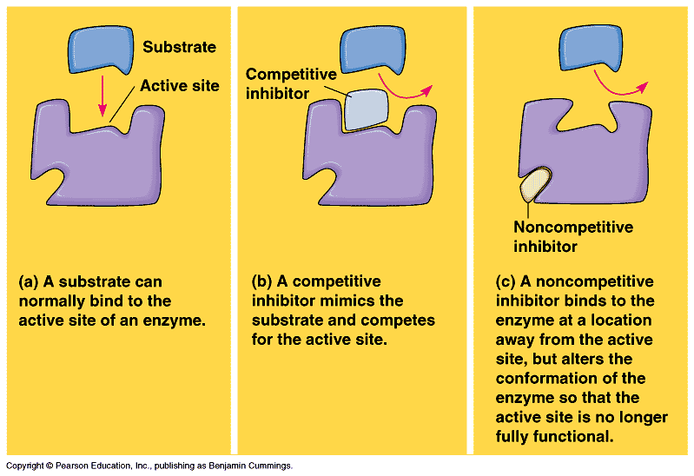
Enzyme Binding

Slide 24
Substrate binding: bonding forces
Ionic
H-bonding
Hydrophobic
vdw
interaction
S
H-bond
Active site
O
H
ionic
bond
Phe
Ser
CO₂
Asp
Enzyme

Slide 25
Binding of pyruvic acid in LDH
O
H-Bond
H
Ionic
bond
H₃N
Possible interactions
vdw-interactions
H-Bond
van der Waals
Ionic

Slide 26
Substrate binding: induced fit
Active site is nearly the correct shape for the substrate
Binding alters the shape of the enzyme (induced fit)
Binding will strain bonds in the substrate
Substrate
S
Induced fit

Slide 27
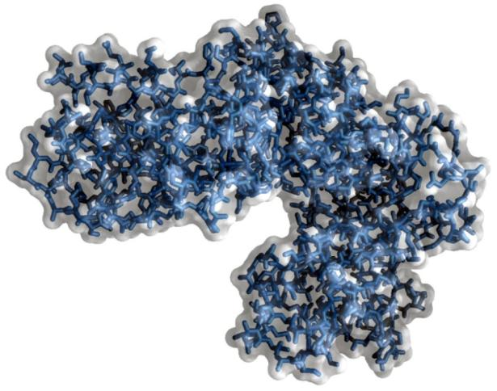
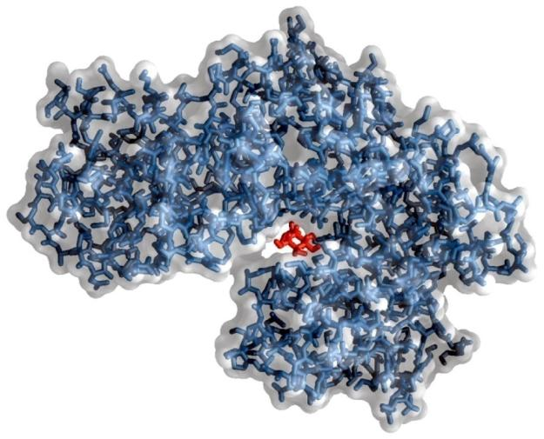
Induced Fit
Hexokinase

Slide 28
Induced fit
Active site alters shape to maximize intermolecular attractions
S
Phe
S
Phe
O
H
O
H
Ser
Ser
CO₂
Induced
fit
CO₂
Asp
Asp
Intermolecular bonds not optimum length for maximum bonding
Intermolecular bond lengths optimized
Susceptible bonds in substrate strained & more easily broken

Slide 29
Binding of pyruvic acid in LDH
O
H
O
O
H₃N
O

Slide 30
Binding of pyruvic acid in LDH
O
π bond
weakened
H
H₃N

Slide 31
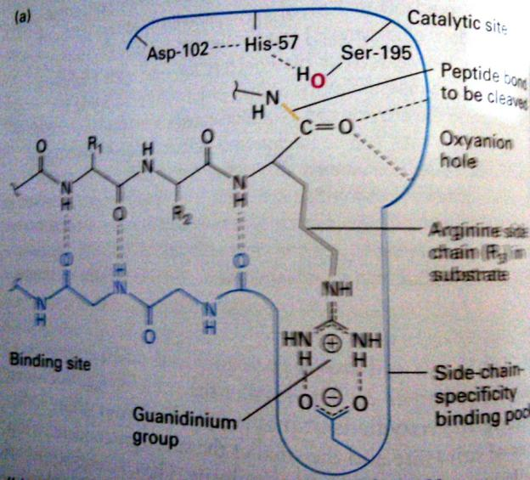
Trypsin-like Serine protease
Specificity Pocket
Asp-189
Substrate side-chain determines the position of cleavage

Slide 32
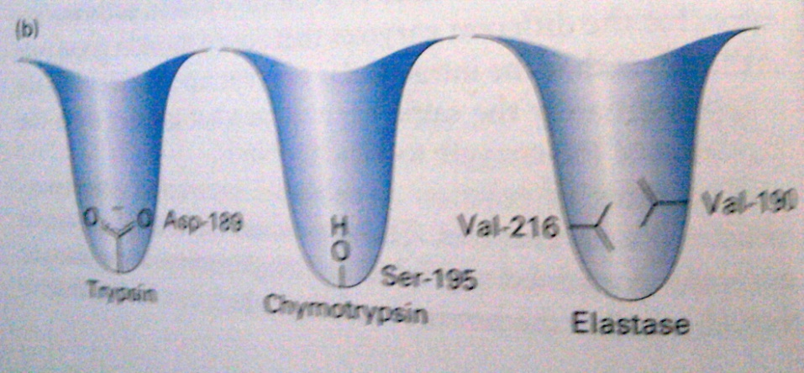
Specificity pocket
Trypsin prefers long, positively charged side chains (Arg & Lys)
Chymotrypsin prefers large aromatic groups (Phe, Tyr & Trp)
Elastase prefers small side chains (Gly & Ala)

Slide 33
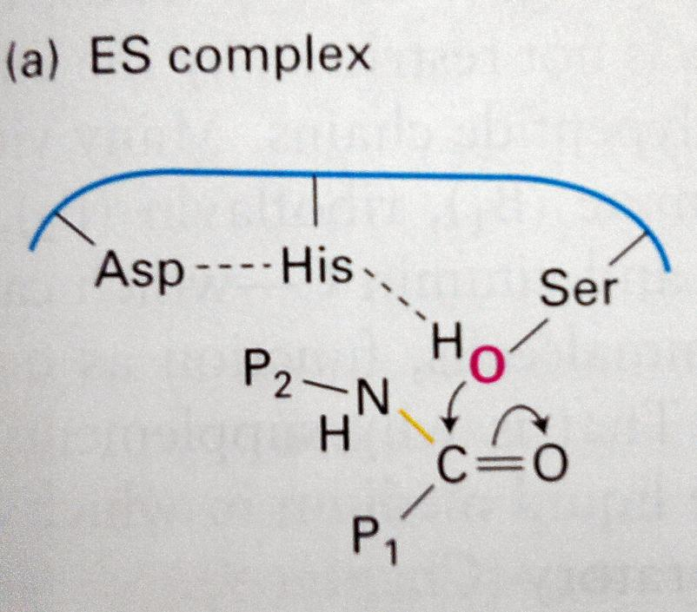
Mechanism
Non-protonated state;
Only at
pKa 6.8

Slide 34
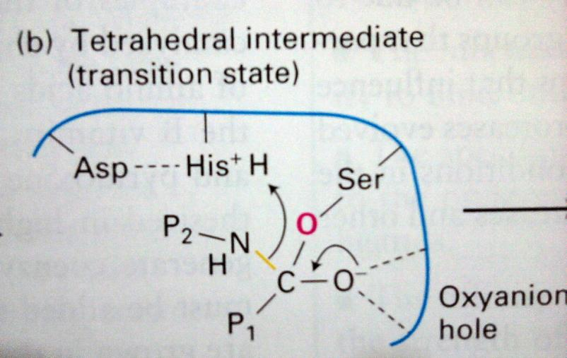
Mechanism

Slide 35
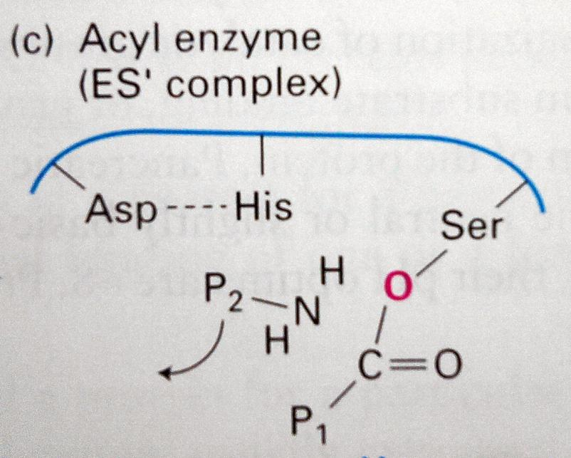
Mechanism

Slide 36
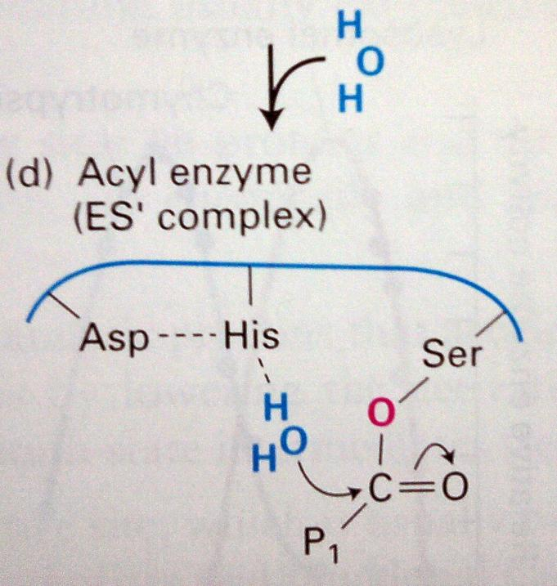
Mechanism

Slide 37
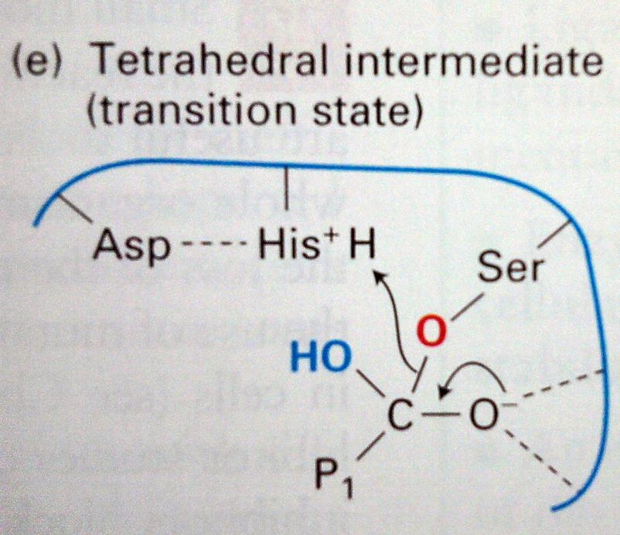
Mechanism

Slide 38
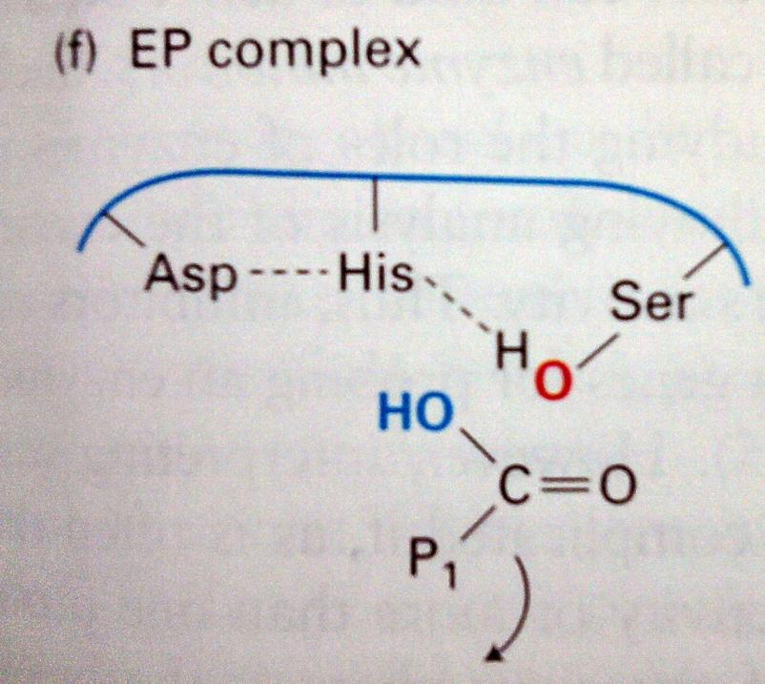
Mechanism

Slide 39
PROPERTIES OF ENZYMES
Since most enzymes are proteins, they have properties in common with other proteins:
Iso-electric pH: Charge can affect the conformation of a protein.
Coagulation: Irreversibly denatures the proteins (enzymes).
3° and 4° structures affect the active sites and substrate recognition.

Slide 40
Factors Affecting Enzyme Activity
1. Concentrations:
a). Enzyme concentration: Increasing the enzyme increases the rate of reaction.
b). Substrate concentration: Increasing substrate also increases the rate of reaction until the Vmax (enzyme is the limiting reagent). At this point, the enzyme is considered “saturated”.

Slide 41
Factors Affecting Enzyme Activity
2. Temperature: Increase temperature will increase the reaction rate until the enzyme becomes denatured. (Every 10°C increase will double the reaction rate).
3. pH: pH is specific for each enzyme. It has a direct effect on shape and rate of reaction.

Slide 42
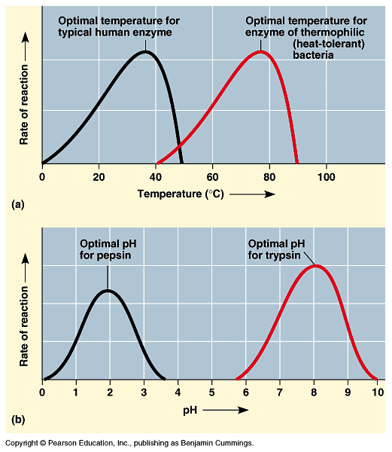
Factors Affecting Enzyme Activity

Slide 43
Factors Affecting Enzyme Activity
4. Salt: Most enzymes cannot tolerate extremely saline (salty) solutions because the inorganic ions interfere with the ionic bonds within the protein molecule.
5. Cofactors/Coenzymes: Non-protein helpers that help the catalytic activity of an enzyme. If these non-protein helpers are inorganics (i.e, metal atoms such as iron, zinc or copper), they are called cofactors. If they are organics (i.e, FAD [Flavine adenine dinucleotide] and vitamins), they are called coenzymes.

Slide 44
Factors Affecting Enzyme Activity
Inhibitors:
a. Competitive Inhibitors: Inhibitor binds to E. Inhibitors compete with the substrate for the active site of an enzyme and are similar in structure to the substrate. Concentration of the substrate is important (i.e, this problem can be solved by increasing substrate concentration).

Slide 45
Factors Affecting Enzyme Activity
b. Non-competitive Inhibitors: Inhibitor binds to both E and ES. Inhibitors react in a location other than the active site of the enzyme, causing a conformation change so it will not bind the substrate. (can not be solved by increasing substrate concentration; must move inhibitor).
c. Uncompetitive Inhibitors: Inhibitor binds only to ES complex. Inhibition increases as substrate increases by forming enzyme-substrate-inhibitor complex.

Slide 46
Examples of Noncompetitive Inhibitors
Pesticides DDT and parathion inhibit key enzymes in the nervous system.
Penicillin blocks the active site of an enzyme that many bacteria use to make their cell walls.

Slide 47
Some terms
A coenzyme or metal ion that is very tightly or even covalently bound to the enzyme protein is called prosthetic group
Holoenzyme = Apoenzyme/Apoprotein+ Prosthetic group
inorganic
organic
Cofactor
Coenzyme

Slide 48
Zymogens
Also called Proenzyme-are inactive enzyme precursors
Requires biochemical change (usually occurs at lysosome) to make it active
Pancreas secretes zymogens to prevent protease digesting its own cells
Examples: Trypsinogen, Chymotripsinogen, Pepsinogen, Most proteins in coagulation system

Slide 49
Enzyme kinetics.

Slide 50
Part 2: Enzyme Kinetics, Inhibition, and Regulation
Enzyme kinetics
At what rate do enzymes react?
  How does rate change with varied conditions?
Enzyme inhibition
  What prevents interactions between enzymes and substrates?
Enzyme regulation
  How is enzymatic activity controlled?

Slide 51
I. Enzyme Kinetics
Expression for enzyme catalyzed reaction:
In order for the equilibrium to favor product formation, the overall standard free energy change (∆G’º) in the direction of substrate to product, which is the net change between the substrate and product ground state free energies, must be negative.

Slide 52
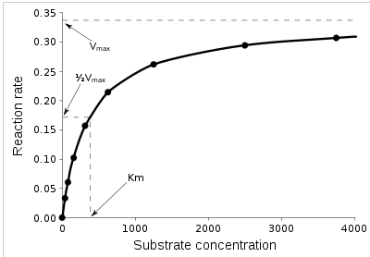
Michaelis & Menten’s kinetics, 1913
First experimental evidence for Fischer’s Lock & Key hypothesis explaining molecular complimentarity of enzyme and substrate
One of the simplest and best known models of enzyme kinetics
At low [S], reaction rates are proportional to [S];
At v_{max} reaction rates are independent of [S]

Slide 53
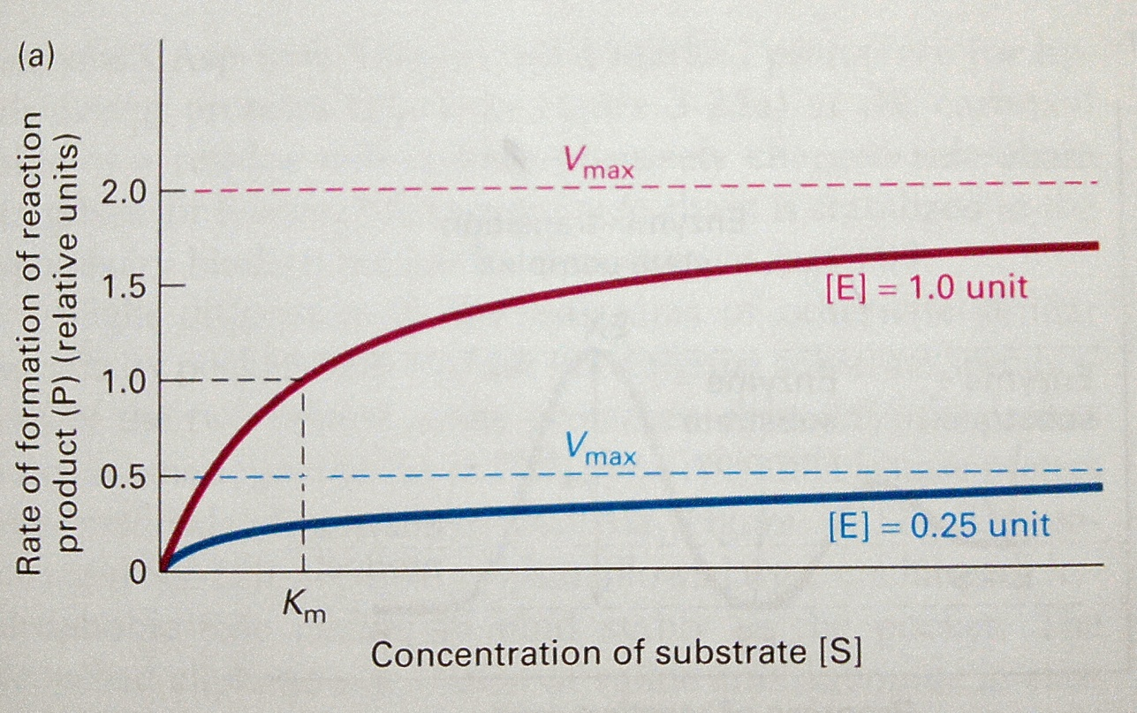
Michaelis & Menten’s kinetics, 1913
V_{max} depends on [E]
K_{m} independent on [E]

Slide 54
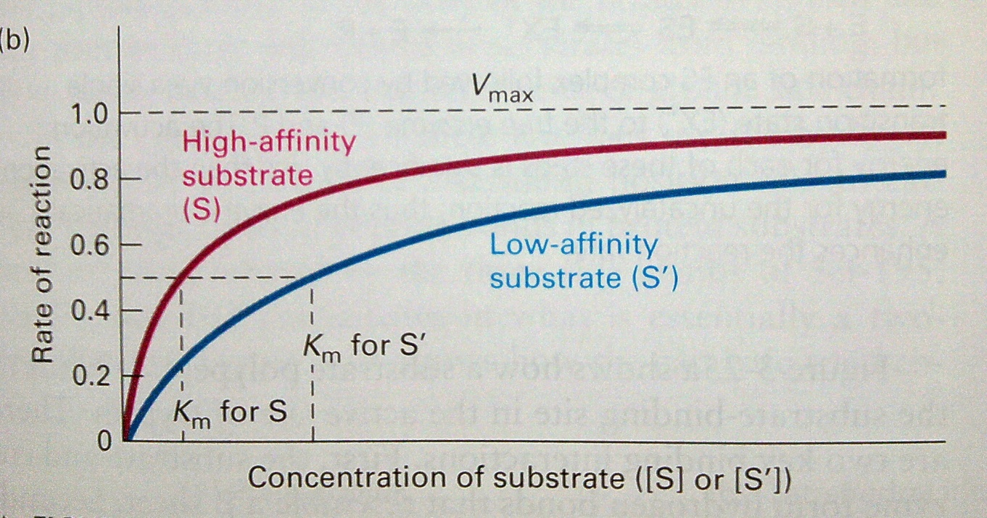
Michaelis & Menten’s kinetics, 1913
V_{max} independent on substrate affinity
K_{m} dependent on substrate affinity

Slide 55
Michaelis-Menton Equation
Kinetics
Relates rate and [S]
Initial velocity V₀ = k₂[ES]
  Neglects complications from inhibition, deactivation, etc.
What is the [ES]?
  To determine, look at rate of formation and disappearance of [ES]

Slide 56
[ES]
Kinetics
Rate of formation = k₁[E][S]
Rate of breakdown = k₋₁[ES] + k₂[ES]
Assume steady state
  As ES is produced, it reacts
  [ES] remains constant
  Rate formation = rate breakdown
So, k₁[E][S] = k₋₁[ES] + k₂[ES]

Slide 57
Kinetics
k₁[E][S] = k₋₁[ES] + k₂[ES]
k₁[E][S] = (k₋₁ + k₂)[ES]
Rearrange
[E][S] / [ES] = (k₋₁ + k₂) / k₁
Where (k₋₁ + k₂) / k₁ = K_{M} (Michaelis constant)
Define total enzyme concentration [E]_{T} = [E] + [ES]
Substitute for [E]
([E]_{T} – [ES])[S] / [ES] = K_{M}
Solve for [ES]
[ES] = [E]_{T}[S] / K_{M} + [S]

Slide 58
Kinetics
[ES] = [E]_{T}[S] / K_{M} + [S]
Since V₀ = k₂[ES]
V₀ = k₂[E]_{T}[S] / K_{M} + [S]
Maximum velocity V_{max}
  Occurs at high [S]
  Enzyme is all in ES form
  [ES] = [E]_{T}
V_{max} = k₂[E]_{T}
Therefore
V₀ = V_{max}[S] / K_{M} + [S]

Slide 59
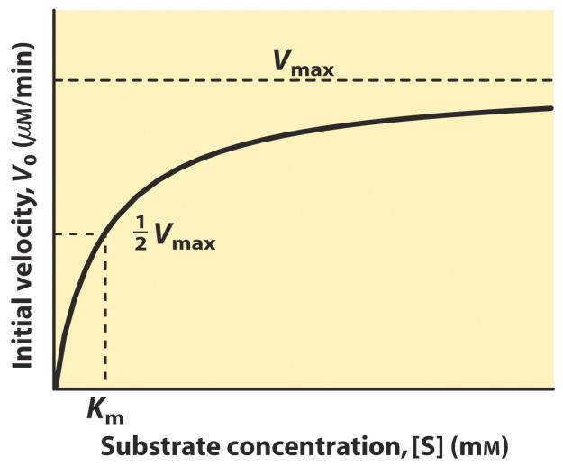
Michaelis-Menton Equation
Kinetics
V₀ = V_{max}[S] / K_{M} + [S]
Rate increase with [S]
Rate levels off as approach V_{max}
  More S than active sites in E
  Adding S has no effect
At V₀ = ½ V_{max}
  [S] = K_{M}
Hyperbolic simple M-M curve

Slide 60
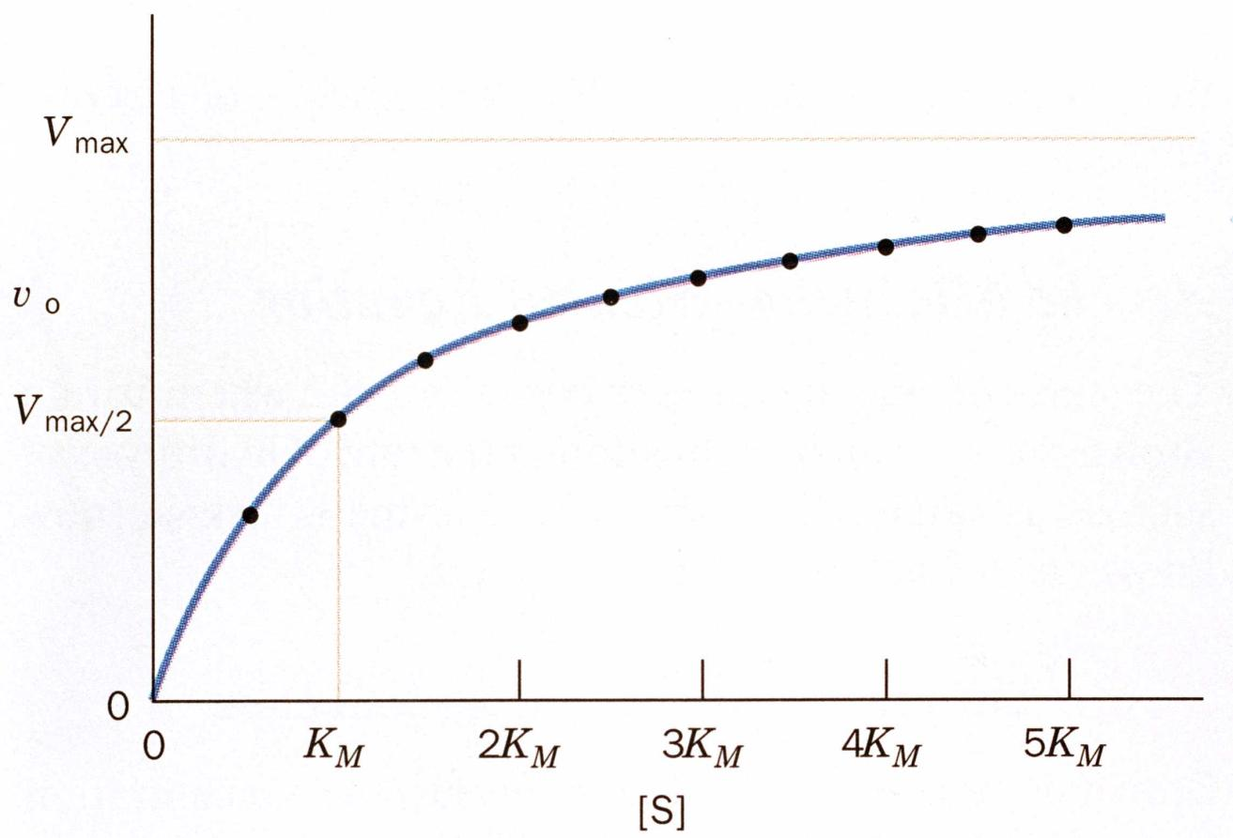
The K_{m} is the substrate concentration where v_{o} equals one-half V_{max}

Slide 61
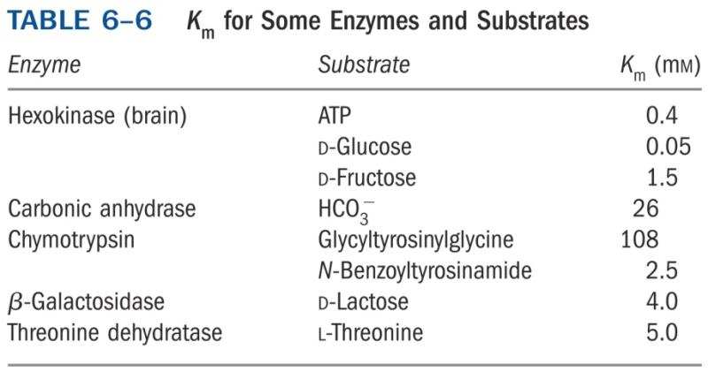
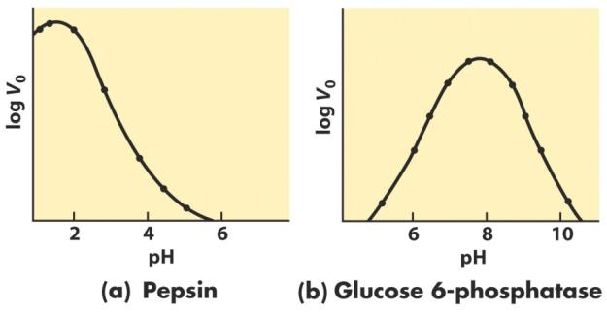
K_{M}
Kinetics
Unique for each E-S pair
Magnitude varies
  Depends on E and S
Function of Temperature
  Rate increases with T
  Optimum T ~ 37°C for most enzymes
Function of pH
  Change catalytic activity
  Most enzymes active in narrow pH range close to pH of environment of enzyme

Slide 62
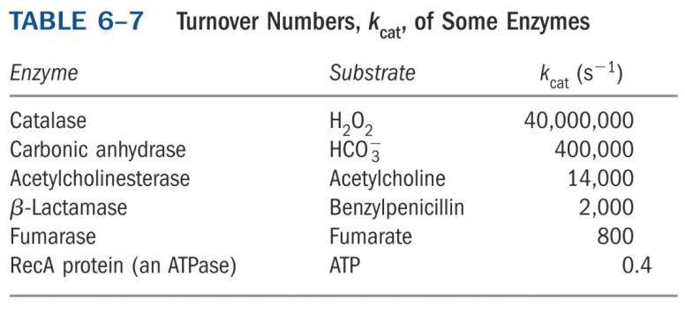
Catalytic Constant k_{cat}
Kinetics
k_{cat} = V_{max} / [E]_{T}
Turnover number
Number of reaction processes each active site catalyzes per unit time
Measure of how quickly an enzyme can catalyze a specific reaction
For M-M systems k_{cat} = k₂
  Rate constant of RDS (Rate Determining Step)

Slide 63
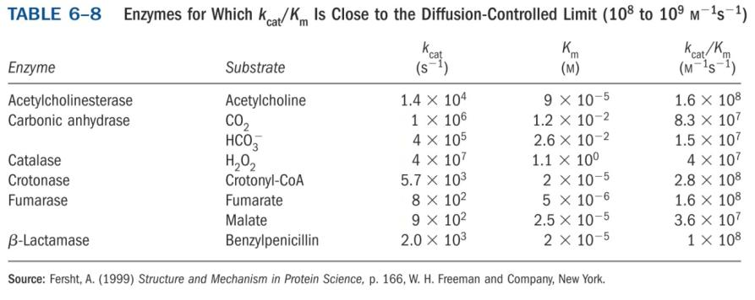
k_{cat} / k_{M}
Kinetics
Rate constant of rxn E + S → E + P
Specificity constant
Gauge of catalytic efficiency
Catalytic perfection ~ 10⁸ ─ 10⁹ M⁻¹ s⁻¹

Slide 64
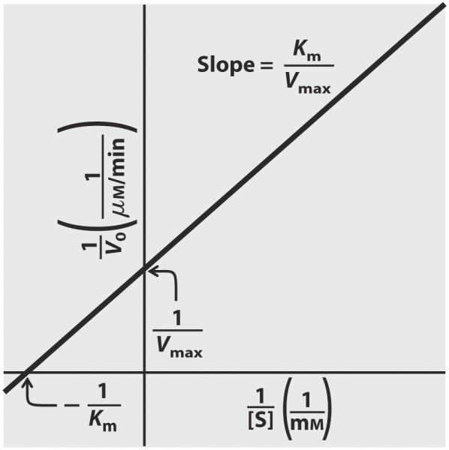
Lineweaver-Burk Plot
Kinetics
Another method to determine V_{max} and K_{M}
Reciprocal of M-M equation
Linear equation
Allows more accurate determination
  of V_{max}
Double reciprocal plot

Slide 65
II. Enzyme Inhibition
S
P
S
P
E
E
E
E
E
E + S
ES
EP
E + P
What happens if a substrate does not leave the active site?
  Enzyme is blocked (inhibited) from further interactions with substrate
Why inhibit?
  To control [S] or [P]
  Increase [S] unreacted
  Decrease [P] formed

Slide 66
Examples
Inhibition
Increase [S]
  Decreased levels of GABA cause seizures
  GABA aminotransferase degrades GABA
  Inhibition of enzyme raise GABA levels
Decrease [P]
  Xanthine converts to uric acid with xanthine oxidase
  Excess uric acid leads to gout
  Inhibition of enzyme lowers production of uric acid

Slide 67
Types of Inhibition
Inhibition
Reversible
  Competitive
  Uncompetitive
  Mixed
  Noncompetitive
Irreversible
  Suicide inactivators

Slide 68
Competitive Inhibition
Inhibition
Most common
Inhibitor competes with natural substrate for binding to active site
Inhibitor similar in structure to natural substrate
  Binds more strongly
  May or may not react
  If reacts, does so very slowly
  Gives info about active site through comparison of structures
Example: antifreeze poisoning

Slide 69
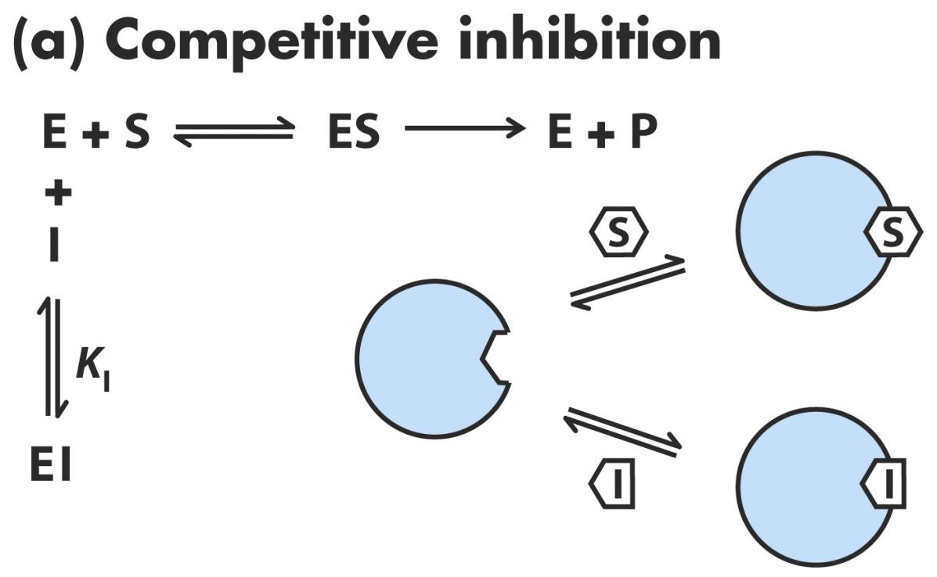
Inhibition

Slide 70
Competitive Inhibitors in Medicine
  Ethanol is used as a competitive inhibitor to treat methanol poisoning.
  Methanol is metabolized by the enzyme alcohol dehydrogenase producing highly toxic formaldehyde.
  Ethanol competes for the same enzyme.
  Administration of ethanol occupies the enzyme thereby delaying methanol metabolism long enough for clearance through the kidneys.

Slide 71
Competitive Inhibition
Inhibition
I and S compete for E
Increasing [I]
  Increases [EI]
  Reduces [E] available for substrate binding
Need to keep [I] high to ensure inhibition
  Dosage

Slide 72
Michealis-Menton Equation for Competitive Inhibition
Inhibition
Where α = 1 + [I]/K_{I}
  Function of inhibitor concentration and affinity for enzyme
  α = 1 when [I] = 0
As [S] increases, V₀ will approach V_{max} for any value of α
  S overcome inhibitor effects; saturate
As [I] increases, K_{M} increases by α
  More S required to reach ½ V_{max}
  Rate does not increase rapidly with [S] due to inhibition

Slide 73
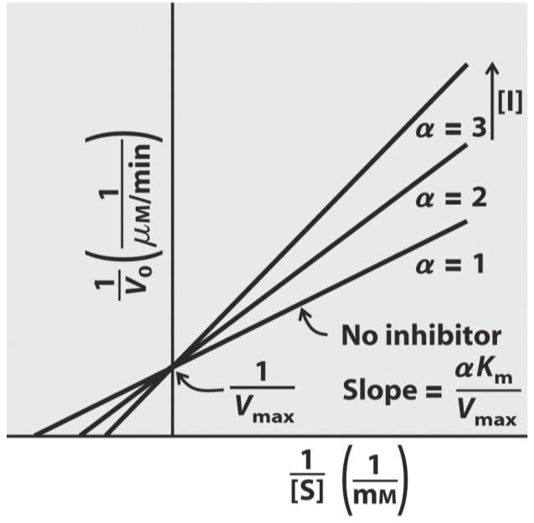
Lineweaver-Burk Equation for Competitive Inhibition
Inhibition
Slope is larger (multiplied by α)
Intercept does not change (V_{max} is the same)
K_{M} is larger (multiplied by α)

Slide 74
Uncompetitive Inhibition
Inhibition
Inhibitor binds to enzyme-substrate complex, not to free enzyme
Inhibitor does not need to resemble substrate
Active site = multisubstrate, or I in second site
Distorts active site; prevents reaction from occurring
Increasing [S] does not change binding of inhibitor to ES (uncompetitive)
  V_{max} is affected by [I]

Slide 75
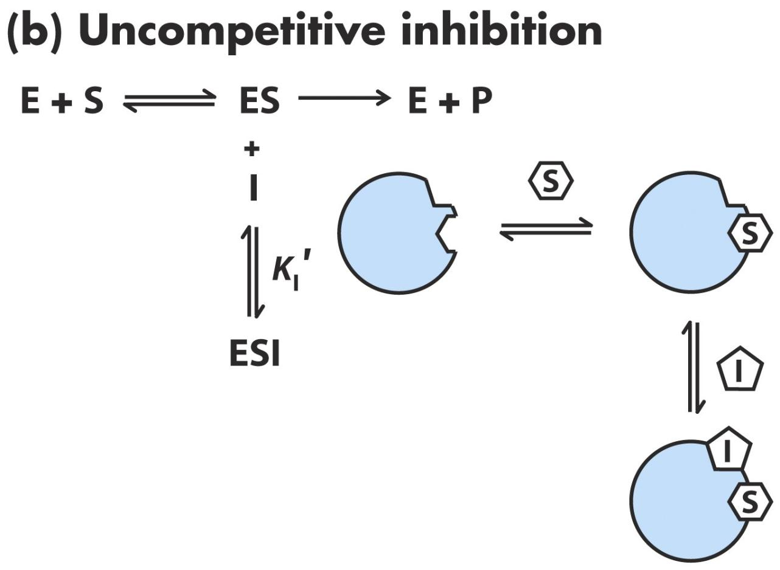
Inhibition

Slide 76
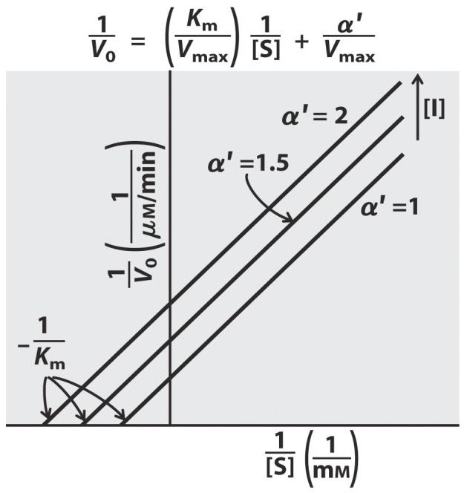
M-M and L-B Equations for Uncompetitive Inhibition
Inhibition
Increasing [I]
  Lowers V_{max} (y-intercept increases)
  Lowers K_{M} (x-intercept decreases)
  Ratio of K_{M}/V_{max} is the same (slope)

Slide 77
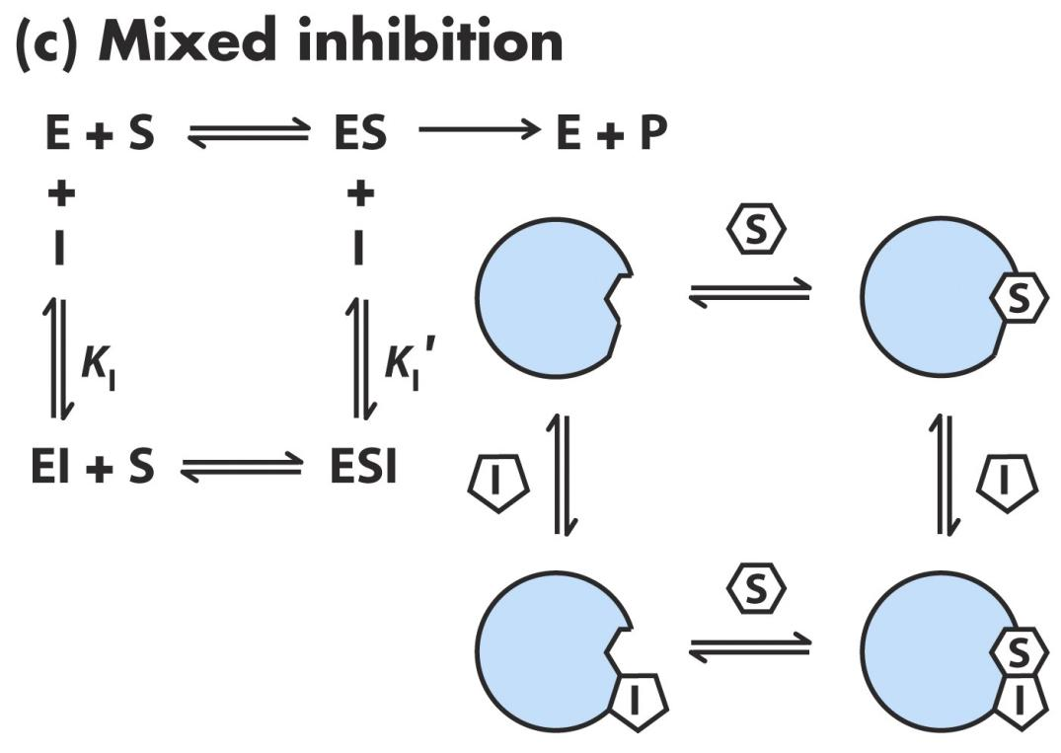
Mixed Inhibition
Inhibition
Inhibitor binds to either E or ES

Slide 78
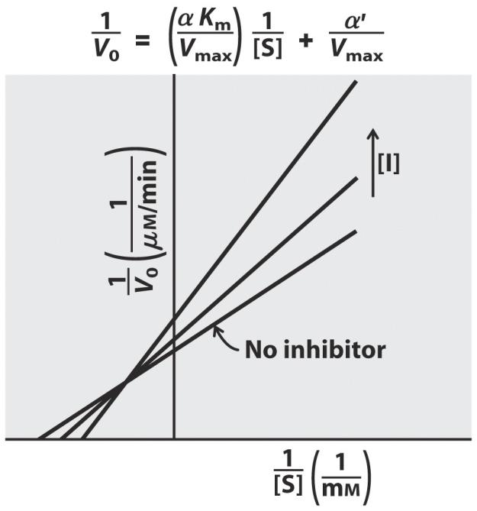
M-M and L-B Equations for Mixed Inhibition
Inhibition
Increasing [I]
  Lowers V_{max} (y-intercept increases)
  Raises K_{M} (x-intercept increases)
  Ratio of K_{M}/V_{max} is not the same (slope changes)

Slide 79
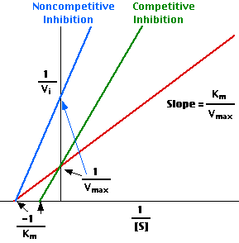
Noncompetitive Inhibition
Inhibition
V_{max} lowers as increase [I]
Lines intersect on x-axis
  K_{M} does not change

Slide 80
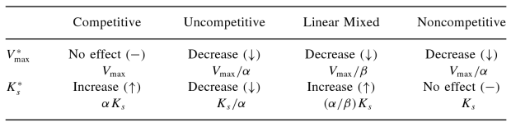
Summary of Reversible Inhibition
Inhibition
Effects of reversible inhibitors on apparent enzyme catalytic parameters Vmax and Ks

Slide 81
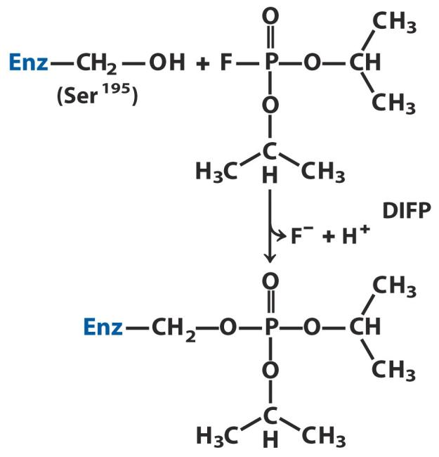
Irreversible Inhibition
Inhibition
Inhibitor
  Binds covalently, or
  Destroys functional group necessary for enzymatic activity, or
  Very stable noncovalent binding
Suicide Inactivators
  Starts steps of chemical reaction
  Does not make product
  Combines irreversibly with enzyme

Slide 82
Irreversible Inhibition
In irreversible inhibition, the inhibitor binds to the enzyme irreversibly through formation of a covalent bond with the enzyme , permanently inactivating the enzyme

Slide 83
Irreversible Inhibition - Reaction Mechanism
In irreversible inhibition, the inhibitor permanently inactivates the enzyme. The net effect is to remove enzyme from the reaction.
  V_{max} decreases
  No effect on K_{m}

Slide 84
The Michaelis-Menten plot for an irreversible inhibitor looks like noncompetitive inhibition
Irreversible inhibitors decrease V_{max,app}, but leave the apparent K_{m} unchanged..
V_{max,app} < V_{max}
K_{m,app} = K_{m}

Slide 85
Irreversible inhibition is distinguished from noncompetitive inhibition by plotting V_{max} vs [E]_{t}
Enzyme is inactivated until all of the irreversible inhibitor is used up

Slide 86
Examples of Irreversible Inhibitors
diisopropylphosphofluoridate
  prototype for the nerve gas sarin
  permanently inactivates serine proteases (acetylecholinesterase) by forming a covalent bond with the active site serine
  With the enzyme inhibited, acetylcholine builds up in the synapse and continues to act

Slide 87
Penicillin is a suicide inhibitor
Glycopeptide transpeptidase catalyzes the formation of cross-links between D-amino acids in the cell walls of bacteria. This enzyme also catalyzes the reverse reaction, the hydrolysis of peptide bonds. During the course of hydrolyzing the strained peptide bond in penicillin, the enzyme activates the inhibitor (penicillin), which then covalently modifies an active site serine in the enzyme. In effect, the enzyme “commits suicide” by hydrolyzing the strained peptide bond in penicillin.

Slide 88
Suicide inhibitors work by “tricking” the enzyme into activating the inhibitor, which then forms a covalent bond with the enzyme, leading to its permanent inactivation.

Slide 89
III. Regulatory Enzymes
Regulation
Catalytic activity modified in response to a signal
  Increase or decrease
Allow cell to meet changing needs
  Energy
  Substrate
  Product
Usually located early in multi-enzyme reaction pathway

Slide 90
Regulation Mechanisms
Regulation
Three main mechanisms
Often used in combination
Control enzyme synthesis or degradation
Noncovalent conformational change
  Allosteric enzymes
Covalent modification

Slide 91
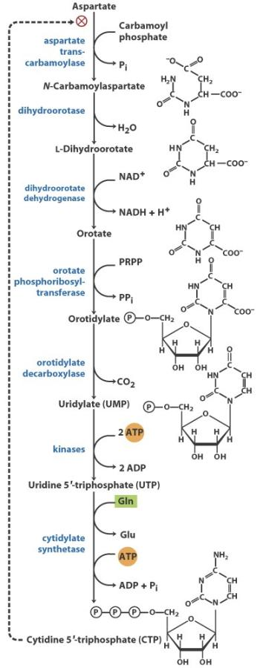
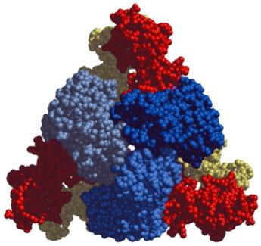
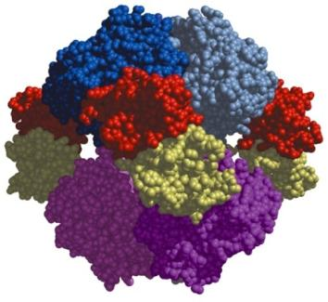
Aspartate carbamoyltransferasease
Regulation
Synthesis of pyrimidine nucleotides
Regulatory
subunits
Feedback inhibition
  Noncovalent
  reversible
Catalytic
subunits

Slide 92
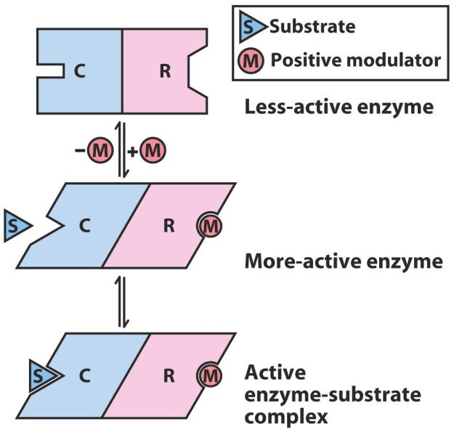
Allosteric Enzymes
Regulation
Usually large; multiple subunits
  Compare to Hb
Site for allosteric modulator (R = regulatory) generally different from active site (C = catalytic)
Can be positive or negative
Undergo a conformational change in the active site in response to binding of an allosteric modulator to a regulatory

Slide 93
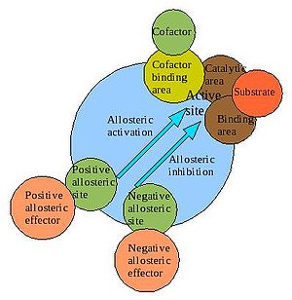
Allosteric Modulation
Regulation
Positive Modulation Binding of O₂ to Hb
Negative Modulation Binding of 2,3 BPG (bisphosphoglycerate) to Hb

Slide 94
Kinetics of Allosteric Enzymes
Regulation
Differ from Michaelis-Menton
  Sigmoidal curve (rather than hyperbolic) in simple M-M plot
  K_{0.5} instead of K_{M}

Slide 95
Allosteric regulation
Regulation
Types:
Homotropic
Regulator is as well substrate for its target enzyme
Typically activator
Heterotropic
  Different from the substrate
  Activator or inhibitor

Slide 96
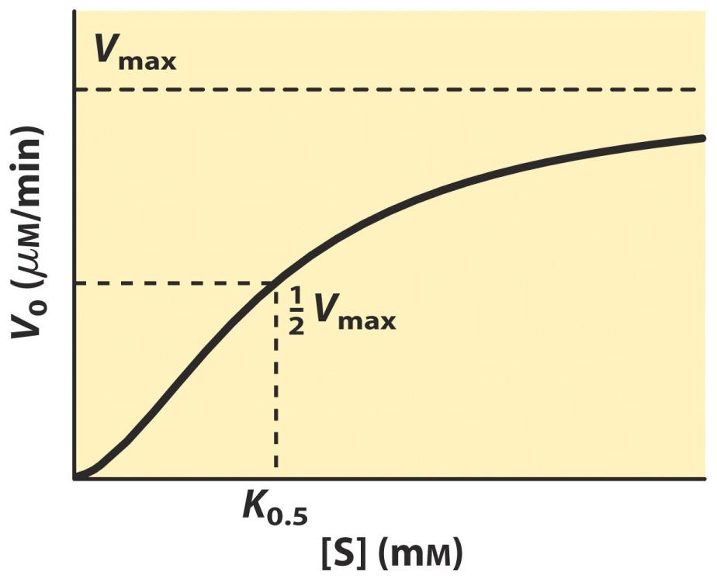
Homotropic Regulation
Regulation
Substrate is positive modulator

Slide 97
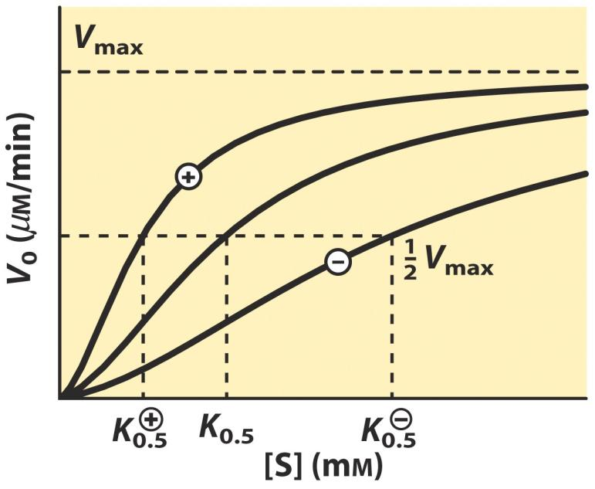
Heterotropic Regulation
Regulation
Modulator is metabolite
Activator approach hyperbola
Deactivator more sigmoidal

Slide 98
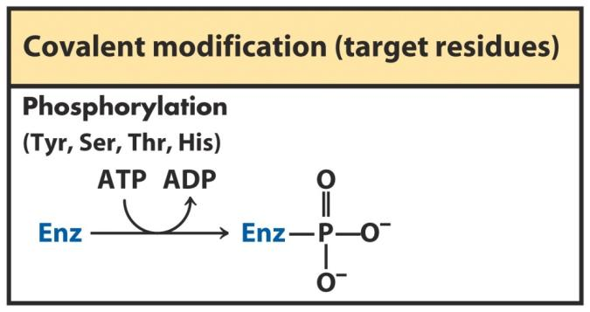
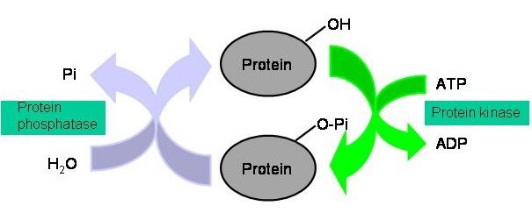
Covalent Modification
Regulation
Reversible
Phosphorylation
  Most common
  Catalyzed by kinases
Change conformation
  Introduce bulky, charged group
  Increase polarity and H-bonding
  Repel negative side chains (Asp and Glu)

Slide 99
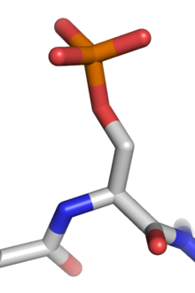
Protein phosphorylation
Regulation
Phosphorylation activates or deactivates many protein enzymes, causing or preventing the mechanisms of diseases such as cancer and diabetes.
Biological thermodynamics of energy-requiring reactions
Mediates enzyme inhibition
Important for protein-protein interaction via "recognition domains "
Important in protein degradation.
Usually proteins with –OH groups are phosphorylated (Ser, Thr, or Tyr residues)
Phosphorylated serine

Slide 100
Sections for exam
Membranes and organelles
Membrane transport phenomena
Enzyme-overview
Enzyme kinetics
Proteins
Stress physiology and metabolism

