Slide 1
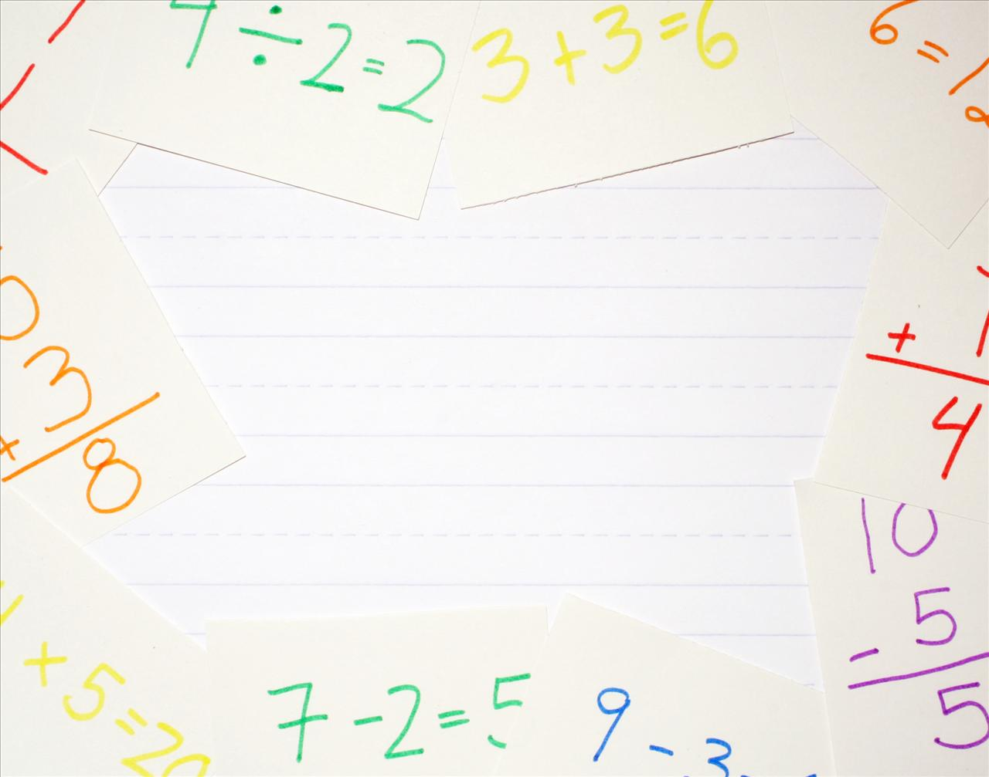
Quadratic
Advanced Level Mathematics
CAMBRIDGE

Slide 3
Quadratic Expressions
a, b, and c are constants

Slide 4
Completed Square Form
Example:
Locate the vertex and the axis of symmetry of the quadratic graph y = x² – 6x + 8
Answer: y = x² – 6x + 8
y = (x-3)² -1
The vertex is at the point (3, -1)
Axis of symmetry is the line x = 3
completed square form

Slide 5
Completing the square
Example:
Write x² + 10x + 32 in completed square form
Answer:
x² + 10x + 32 = (x² + 10x) + 32
= {(x+5)² – 25} + 32
= (x+5)² + 7

Slide 6
Completing the square
Example:
Write 2x² + 10x + 7 in completed square form
Answer:
2x² + 10x + 7 = 2 (x² + 5x) + 7
= 2 {(x+ )² – } + 7
= 2 (x+ )² –

Slide 7
Completing the square
Example:
Write 3 – 4x – 2x² in completed square form
Answer:
3 – 4x – 2x² = 3 – 2(x² + 2x)
= 3 – 2{(x+ 1)² – 1}
= 3 – 2(x+ 1)² + 2
= 5 – 2(x+ 1)²

Slide 8
Completing the square
Example:
Write 12x² – 7x – 12 in completed square form and find the factors
Answer:
12x² – 7x – 12 = 12(x² – x) – 12
= 12{(x – )² – } – 12
= 12{(x – )² – }
= 12{(x – )² – }
= (3x – 4)(4x – 3)
completed square form
factors

Slide 9
Completing the square
Example:
Write x² – 8x + 12 in completed square form and find the range of the function f(x) = x² – 8x + 12, which is defined for all real values of x
Answer:
x² – 8x + 12 = (x – 4)² – 4
As (x – 4)² ≥ 0 for all values of x
x² – 8x + 12 = (x – 4)² – 4 ≥ – 4, so f(x) ≥ – 4
Writing f(x) as y, the range is y ≥ – 4

Slide 10
EXERCISE
Source: Book “Advanced Level Mathematics Pure Mathematics 1”, Hugh Neil and Douglas Quadling.
Completing the square (Page 57 Exercise 4A number 8, 9)

Slide 11
Sketch Graphs
Find the vertex
Find the equation of the line of symmetry
Find the points of intersection of the x-axis
Substituting y = 0 in the equation
Find the points of intersection of the y-axis
Substituting x = 0 in the equation

Slide 12
Sketch Graphs
Example:
Sketch the graph of y = 3x² – 2x – 1
Answer: y = 3x² – 2x – 1
= 3(x² – x) – 1
= 3{(x – )² – } – 1
= 3(x – )² –
The vertex is at the point ( , )
Axis of symmetry is the line x =

Slide 13
Sketch Graphs
Example:
Sketch the graph of y = 3x² – 2x – 1
Answer:
y = 3x² – 2x – 1 = 3(x + ) (x –1)
The points of intersection of the x-axis is ( ,0)
and (1,0)
The points of intersection of the y-axis is (0,-1)

Slide 14
Sketch Graphs
Example:
Sketch the graph of y = 3x² – 2x – 1
Answer:

Slide 15
Sketch Graphs
(Page 48 Exercise 3E number 3)

Slide 16
Quadratic Formula
The solution of ax² +bx + c = 0, where a ≠ 0 , is

Slide 17
Solving Quadratic Equations
Example:
Use the quadratic formula to solve the equations:
2x² – 3x – 4 = 0 ➔ a = 2, b = -3, c = -4
The equation 2x² – 3x – 4 = 0 has two roots.

Slide 18
Solving Quadratic Equations
Example:
Use the quadratic formula to solve the equations:
b. 2x² – 3x + 4 = 0 ➔ a = 2, b = -3, c = 4
The equation 2x² – 3x + 4 = 0 has no roots.

Slide 19
Solving Quadratic Equations
Example:
Use the quadratic formula to solve the equations:
c. 30x² – 11x – 30 = 0 ➔ a = 30, b = -11, c = -30
The equation 30x² – 11x – 30 = 0 has two roots.

Slide 20
Solving Quadratic Equations
(Page 61 Exercise 4B number 1)

Slide 21
The Discriminant b² – 4ac
If b² – 4ac is a perfect square, the roots will be integers or fractions.
If b² – 4ac > 0, the equation ax² + bx + c = 0 will have two roots.
If b² – 4ac < 0, there will be no roots.
If b² – 4ac = 0, the roots are given by , and there is
one root only. Sometimes it is said that there are two coincident roots, or a repeated root, because the values
are equal.

Slide 22
The Discriminant b² – 4ac
Example:
Use the value of the discriminant b² – 4ac to determine whether the following equations have two roots, one root or no roots.
2x² – 3x – 4 = 0
b² – 4ac = 41. The discriminant is positive, so the equation 2x² – 3x – 4 = 0 has two roots. Also, as 41 is not a perfect square, the roots are irrational.
b) 2x² – 3x – 5 = 0
b² – 4ac = 49. The discriminant is positive, so the equation 2x² – 3x – 5 = 0 has two roots. Also, as 49 is a perfect square, the roots are rational.

Slide 23
The Discriminant b² – 4ac
Example:
Use the value of the discriminant b² – 4ac to determine whether the following equations have two roots, one root or no roots.
c) 2x² – 4x + 5 = 0
b² – 4ac = – 24. The discriminant is negative, so the equation 2x² – 4x + 5 = 0 has no roots.
d) 2x² – 4x + 2 = 0
b² – 4ac = 0. The discriminant is zero, so the equation 2x² – 4x + 2 = 0 has only one (repeated) root.

Slide 24
The Discriminant b² – 4ac
Example:
The equation kx² – 2x –7 = 0 has two real roots. What can you deduce about the value of the contant k?
Answer:
b² – 4ac = 4 + 28k.
As the equation has two real roots, the value of the discriminant is positive, so
4 + 28k > 0
k > -1

Slide 25
The Discriminant b² – 4ac
Example:
The equation 3x² + 2x + k = 0 has a repeated roots. Find the value of k.
Answer:
The equation has repeated roots if b² – 4ac = 0
4 – 12k = 0
k = 1/3

Slide 26
EXERCISE
Source: Book “Advanced Level Mathematics Pure Mathematics 1”, Hugh Neil and Douglas Quadling.
The Discriminant b² – 4ac (Page 61 Exercise 4B number 2, 3, 4)

Slide 27
Solving Linear Inequalities
Example:
Solve the inequality -3x < 21
Answer: -3x < 21
x > -7 …… Divide both sides by -3

Slide 28
Solving Linear Inequalities
Example:
Solve the inequality
Answer:

Slide 29
EXERCISE
Solving Linear Inequalities (Page 74 Exercise 5A number 5, 6)

Slide 30
Quadratic Inequalities
Example:
Solve the inequality (x – 2)(x – 4) < 0
Answer:
Find the values of x for which (x – 2)(x – 4) = 0. These values, x = 2 and x = 4, are called the critical values for the inequality.
Make a table showing the signs of the factors in the product (x – 2)(x – 4)
From table, you can see that (x – 2)(x – 4) < 0 when 2 < x < 4
 | x < 2 | x = 2 | 2 < x < 4 | x = 4 | x > 4
x – 2 | – | 0 | + | + | +
x – 4 | – | – | – | 0 | +
(x – 2)(x – 4) | + | 0 | – | 0 | +

Slide 31
Quadratic Inequalities
Example:
Solve the inequality (x + 1)(5 – x) ≤ 0
Answer:
Find the values of x for which (x + 1)(5 – x) = 0. These values, x = -1 and x = 5., are called the critical values for the inequality.
Make a table showing the signs of the factors in the product (x + 1)(5 – x)
From table, you can see that (x + 1)(5 – x) ≤ 0 when x ≤ -1 or x ≥ 5
 | x < -1 | x = -1 | -1 < x < 5 | x = 5 | x > 5
x + 1 | – | 0 | + | + | +
5 – x | + | + | + | 0 | –
(x + 1)(5 - x) | – | 0 | + | 0 | –

Slide 32
Quadratic Inequalities
Example:
Solve the inequality x² ≤ a² , where a > 0
Answer: x² ≤ a²
x² - a² ≤ 0
(x – a)(x + a) ≤ 0
critical values : x = -a and x = a,
From table, you can see that (x - a)(x + a) ≤ 0 when -a ≤ x ≤ a
x² ≤ a²
-a ≤ x ≤ a
 | x < -a | x = -a | -a < x < a | x = a | x > a
x – a | – | – | – | 0 | +
x + a | – | 0 | + | + | +
(x – a)(x + a) | + | 0 | – | 0 | +

Slide 33
Quadratic Inequalities
Example:
Solve algebraically the inequality 2x² – 8x + 5 ≤ 0
Answer:
2x² – 8x + 5 = 2(x² – 4x) + 5 = 2(x – 2)² – 3.
So, 2(x – 2)² – 3 ≤ 0
(x – 2)² – ≤ 0
(x – 2)² ≤

Slide 34
EXERCISE
Quadratic Inequalities (Page 77 Exercise 5B number 2, 3)

Slide 35
Simultaneous Equations
Example:
Solve the simultaneous equations y = x² , x + y = 6
Answer:
From x + y = 6, y = -x + 6. Substituting for x in y = x²
-x + 6 = x²
x² + x – 6 = 0
(x + 3)(x – 2) = 0
x = 2 or x = -3
The solution is therefore x = 2, y = 4 or x = -3, y = 9

Slide 36
Simultaneous Equations
Example:
Solve the simultaneous equations x² – 2xy + 3y² = 6 and 2x – 3y = 3
Answer:
From 2x – 3y = 3
2x = 3 + 3y
4x² = (3 + 3y)²
From x² – 2xy + 3y² = 6
4x² – 8xy + 12y² = 24
4x² – 4y (2x) + 12y² = 24
(3 + 3y)² – 4y (3 + 3y) + 12y² = 24
9y² + 18y + 9 – 12y -12y² + 12y² = 24
9y² + 6y -15 = 0
3y² + 2y -5 = 0
(y – 1)(3y + 5) = 0
The solution is therefore x = 3, y = 1 or x = -1, y = -5/3

Slide 37
EXERCISE
Simultaneous Equations (Page 65 Exercise 4C number 1, 2)

Slide 38
Equations Which Reduce to Quadratic Equations
Example:
Solve the equation t⁴ – 13t² + 36 = 0
Answer:
Let x stand for t², the equation becomes:
x² – 13x + 36 = 0
(x – 4)(x – 9) = 0
x = 4 or x = 9
t = ± 2 or t = ± 3

Slide 39
Equations Which Reduce to Quadratic Equations
Example:
Solve the equation
Answer:
Letting , the equation becomes:
y = 6 – y²
y² + y – 6 = 0
(y + 3)(y – 2) = 0
y = -3 or y = 2
But, as , and is never negative, the only solution is y = 2, giving x = 4

Slide 40
EXERCISE
Equations Which Reduce to Quadratic Equations (Page 65 Exercise 4C number 4, 5)

